Slide 1
Setting the Stage for Implementation:
CPL, ACE & Serving Today’s Students
College and University Partnerships
April 2018
California State University System

Slide 2
Agenda
Introductions and Learning Outcomes
Burning Questions
Serving Today’s Students
The Case for CPL
CPL Trends and Challenges
ACE Overview
Student Navigation Exercise
Takeaways and Day 2 Discussion

Slide 3

Burning Questions

Slide 4

Serving Today’s Students

Slide 5

Students on the Move
More than 60% of today’s students are post-traditional
More than 30% of today’s students transfer
Today’s students use multiple sources for learning
http://www.acenet.edu/news-room/Pages/The-Post-Traditional-Learners-Manifesto-Revisited.aspx

Slide 6

Post-traditional Students
Support self and/or family through work
Lack postsecondary credential
Are determined to pursue additional knowledge and skills
Balance work, life and education
Are military-connected

Slide 7
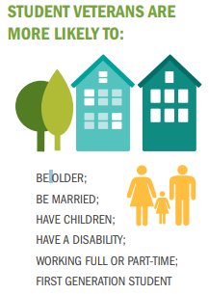
I am a Post 9-11 Student Veteran Report, IVMF & SVA, June 2017

Slide 8
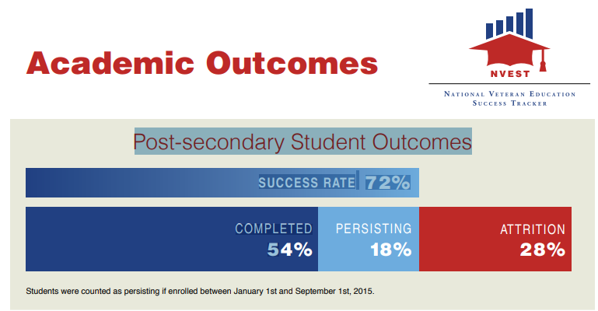

Slide 9
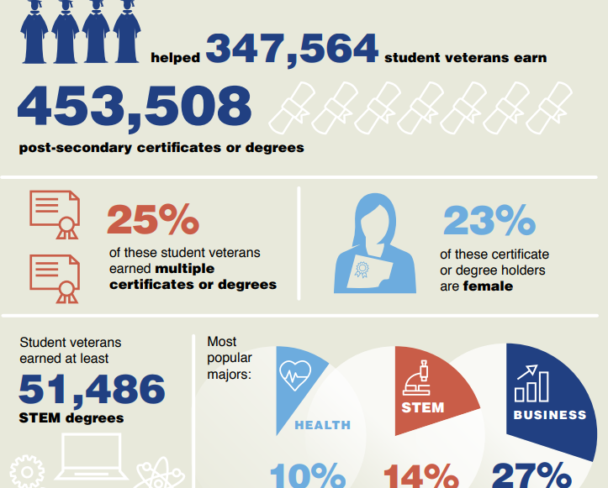
Results of 9-11 Bill after 6 Years
NVEST Report, SVA, 2017

Slide 10
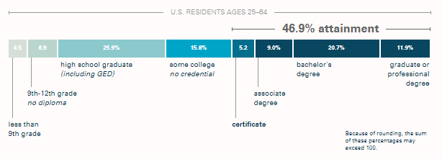
California and Completion
A Stronger Nation, Lumina Foundation, 2018

Slide 11

What is Credit for Prior Learning (CPL)?

Slide 12
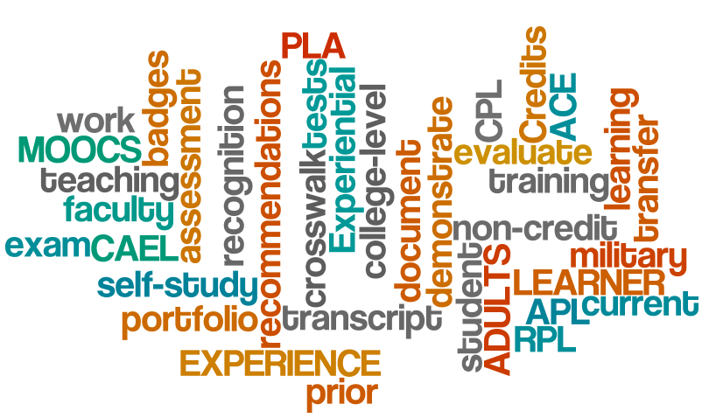
Definitions
A set of well-established, researched and validated methods for assessing noncollegiate learning for college credit.
A process that allows learners to demonstrate knowledge and skill in a particular field or fields and have that learning evaluated for college credit.

Slide 13
Credit for Prior Learning Classifications
 | Institutional Evaluations | Third-party Evaluations
Individual Evaluations | Departmental Challenge Examinations Individualized Portfolios | CLEP Exams Advanced Placement Exams (AP) DSST Credit by Exam Excelsior College Exam Program
Program Evaluation of Sponsored Learning | Local Articulation Agreements Consortium for the Assessment of College Equivalency (CACE) | ACE Military Training and Occupation Review ACE CREDIT Review National College Credit Recommendation Service (NCCRS)
CPL
Classifications
®Brewer, 2015

Slide 14

Making The Case for CPL

Slide 15



Transfer and Award of Credit: Considerations
Wise Use of Resources
Social Equity
Comparability
Consistency
Quality
Transparency
Accreditation
      Joint Statement, AACRAO, ACE & CHEA, 2017

Slide 16
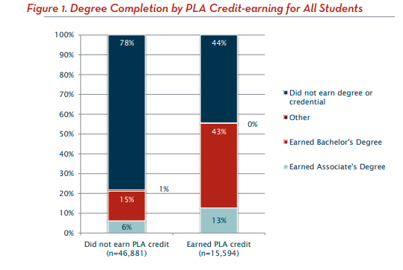
Fueling the Race To Postsecondary Success, CAEL, 2010
Students with PLA—Course Taking & Completion
  2.5X more likely to complete bachelor’s degree.
  Take 9.9 more course credits.

Slide 17
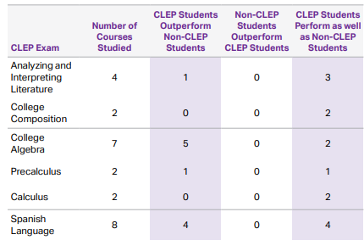
CLEP Testing Taking: Student Performance, College Board 2017
  Higher GPA
  Better Course Performance

Slide 18
University of Memphis: Finish Line
Students in the Finish Line Program at the
University of Memphis have completed 615 Saylor courses
earning a total of 1,850 credit hours
saving almost $630,000 over the last four years.
http://www.memphis.edu/innovation/finishline/

Slide 19

University of Memphis: Meet Jane
Returned after 20 year absence
42 credit hours in PLA
Graduated in 6 semesters
  Savings of $14,150
  Reduced time to degree by 7 semesters
Received promotion less than 1 month after graduation

Slide 20
CPL Trends And Challenges

Slide 21

Trends in Practice
State Legislation
Federal and Philanthropic Funding
Consortia Collaborations
State System Approaches
Faculty Development
Alternative Credit Pathways

Slide 22
Challenges
Multiple Sources of Learning--Validation
Institutional Autonomy & Student Mobility
Transferability
Faculty Engagement and Development
Capacity and Resource Development
Information Sharing
Navigation: Processes and Roles
Accreditation Questions

Slide 23
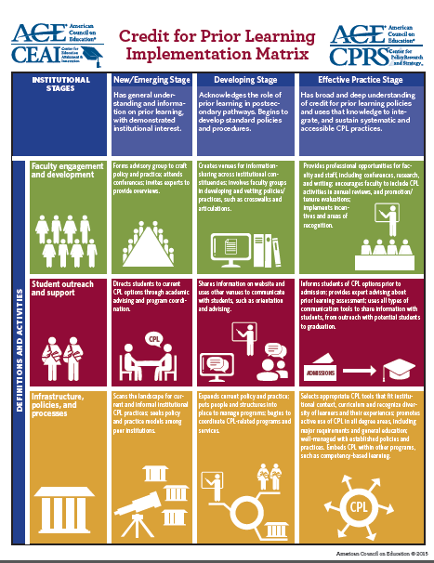
Implementation Challenges
and Opportunities
Faculty Engagement
Infrastructure Development
Student Outreach
Credit for Prior Learning:
Charting Institutional Practice
for Sustainability
ACE, 2015
Notes:
23

Slide 24
aCE overview

Slide 25
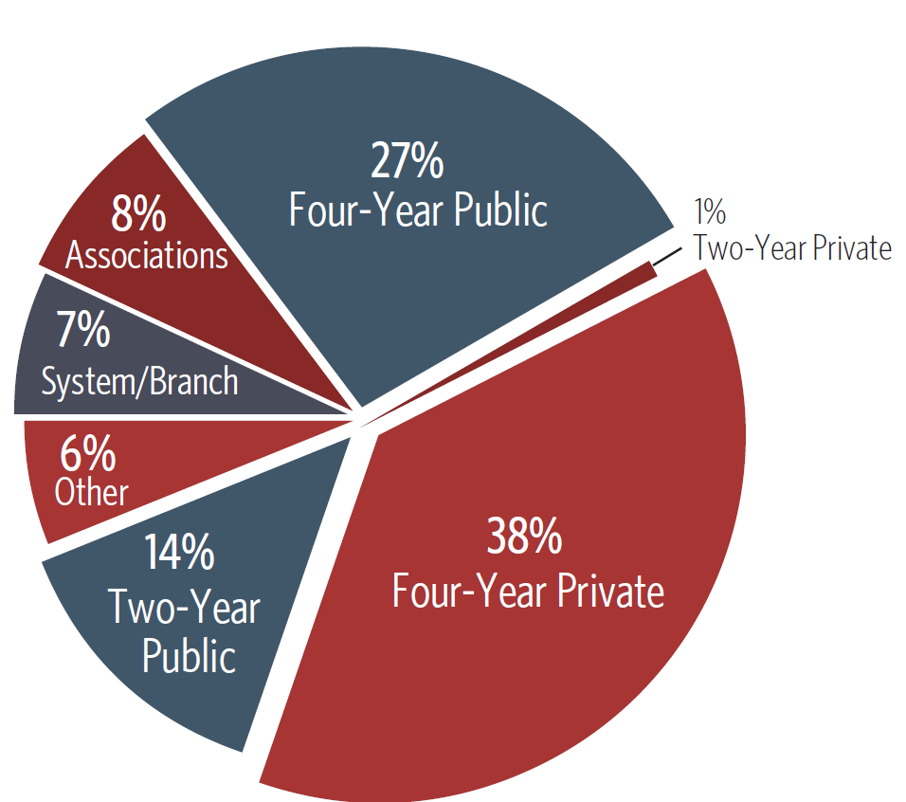
American Council on Education
1918
  Emergency Council on Higher Education; Prepare WW I veterans for workforce
1942
  Special committee develop policies for evaluating education experiences of military
1944
  Guide to the Evaluation of Educational Experiences in the Armed Services (the Guide)
1974
  CREDIT Evaluation & Military Occupation reviews started

Slide 26

Center for Education Attainment and Innovation (CEAI)
College and University Partnerships (CUP)
CREDIT® Evaluations
Military Evaluations
Academic Innovation
“To be the world class organization that transforms lives through innovative practices across all forms of learning.”

Slide 27
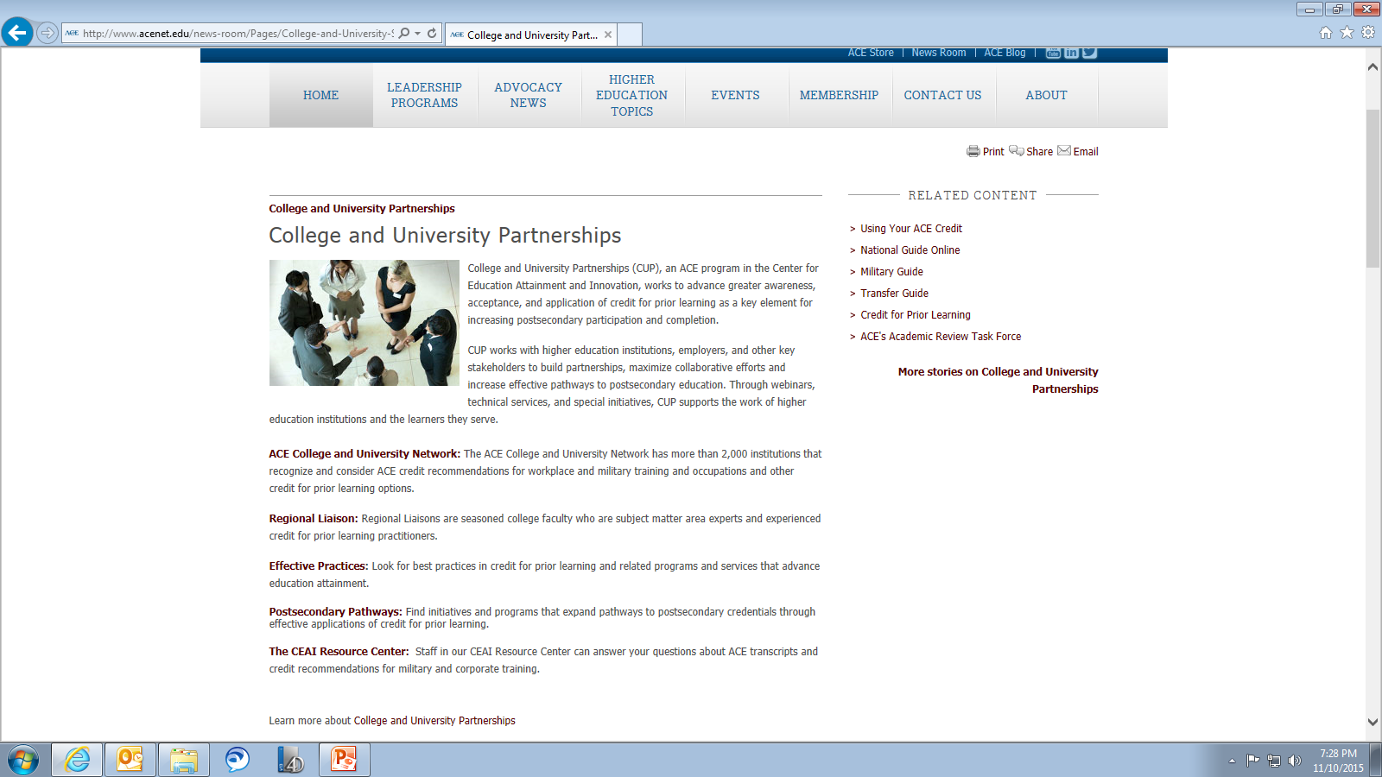
College and University Partnerships
(CUP)

Slide 28
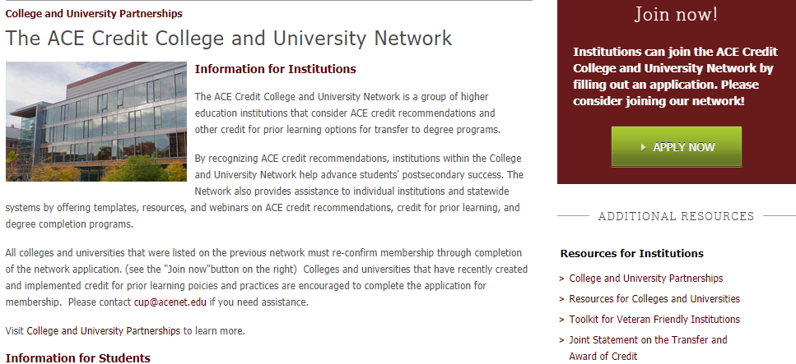

College and University Partnerships
www.acenet.edu/CUP

Slide 29
College Credit Recommendation Service
ACE CREDIT®--Workforce & Corporate
Alignment of formal courses, industry-related certifications, and corporate training to current post secondary content, scope, rigor and assessment for credit.
Introduced in 1974 and to date have evaluated and recommended over 35,000 courses.
150 currently active organizations and nationally-recognized testing programs such as CLEP, DSST, AP & DLPT.

Slide 30

















ACE CREDIT®

Slide 31
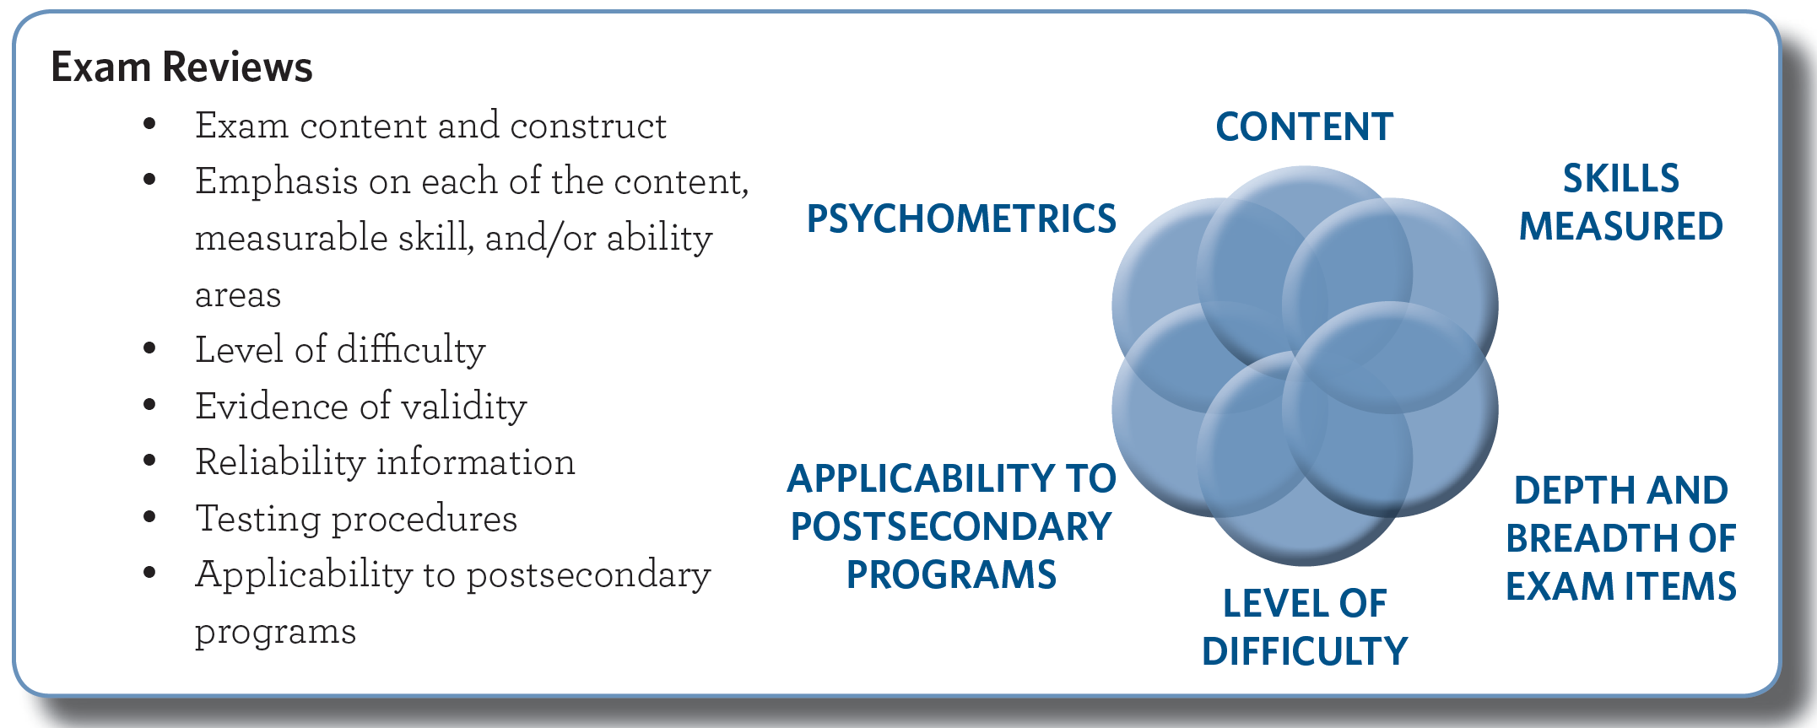
CREDIT Exam Review

Slide 32





Armed Forces

Slide 33
Foundations Military Education
USA ~ Training and Doctrine Command (TRADOC)
USMC ~ Training and Education Command (TECOM)
USN ~ Navy Education and Training Command (NETC)
USCG ~ Coast Guard Institute (CGI)
USAF ~ Air Force Voluntary Education (AF-A1)
Enlisted
Limited Duty / Warrant Officers
Officers

Slide 34


Slide 35
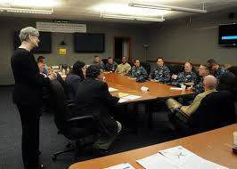
The Role of Faculty

Slide 36
Faculty are the Key!
Minimum 5 years teaching experience
Must actively be teaching college-level courses
  CHEA recognized institutions
Based on academic discipline alignment
ACE pays honorarium and travel
www.acenet.edu/evaluatorform
Higher Learning Commission (HLC); Middle States Commission on Higher Education (MSCHE); North Central Association (NCA); New England Association of Schools and Colleges (NEASC); Southern Association of Colleges and Schools (SACS); Western Association of Schools and Colleges (WASC)

Slide 37
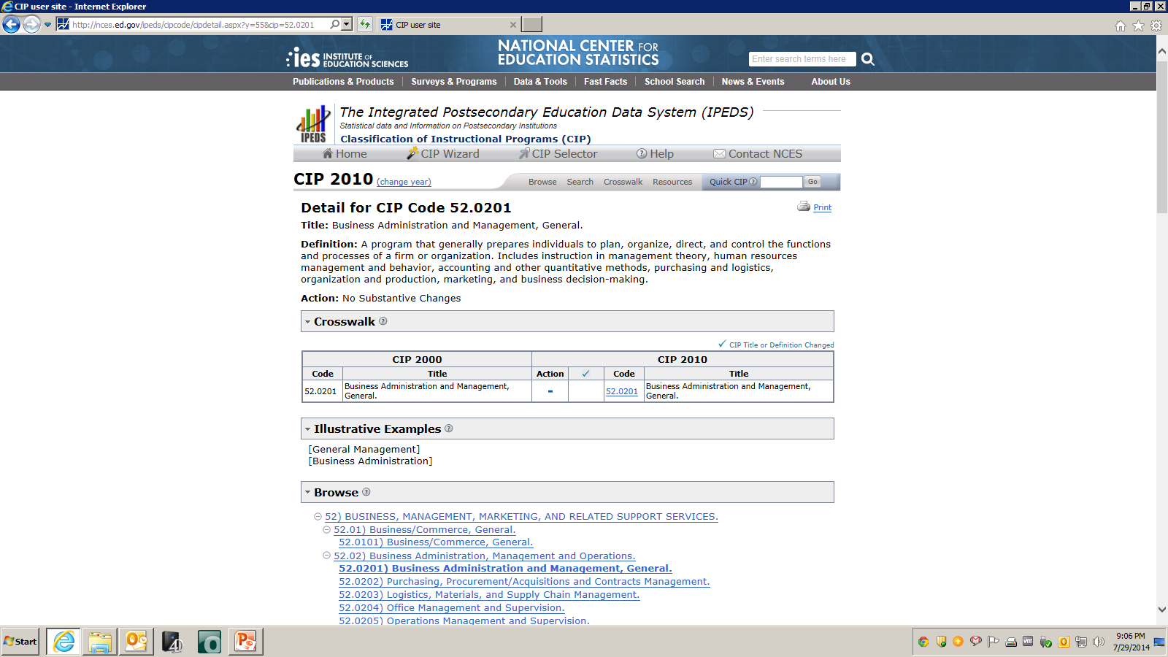
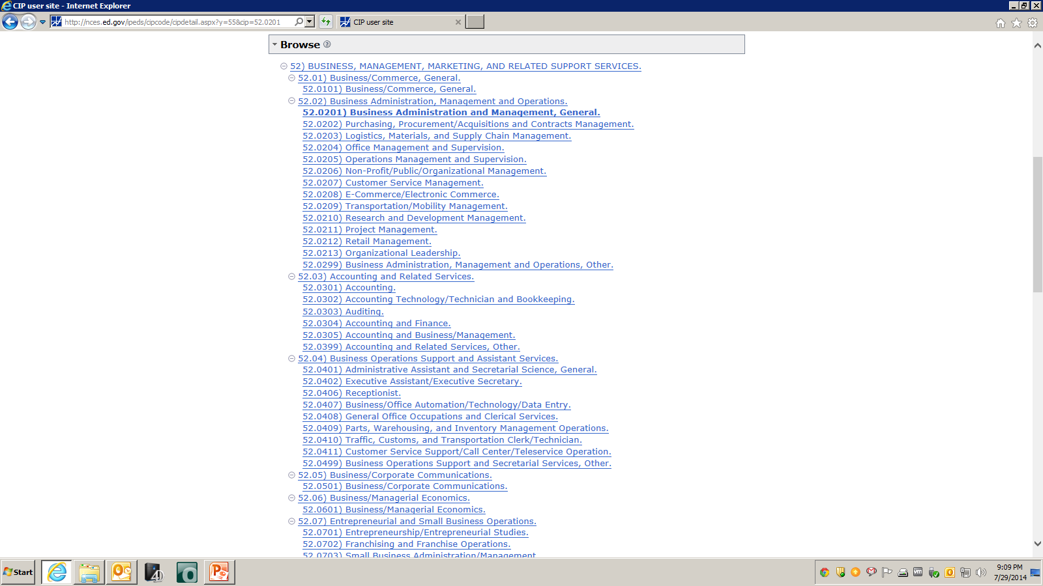
Classification of Instructional Programs
(CIP)
http://nces.ed.gov/ipeds/cipcode

Slide 38
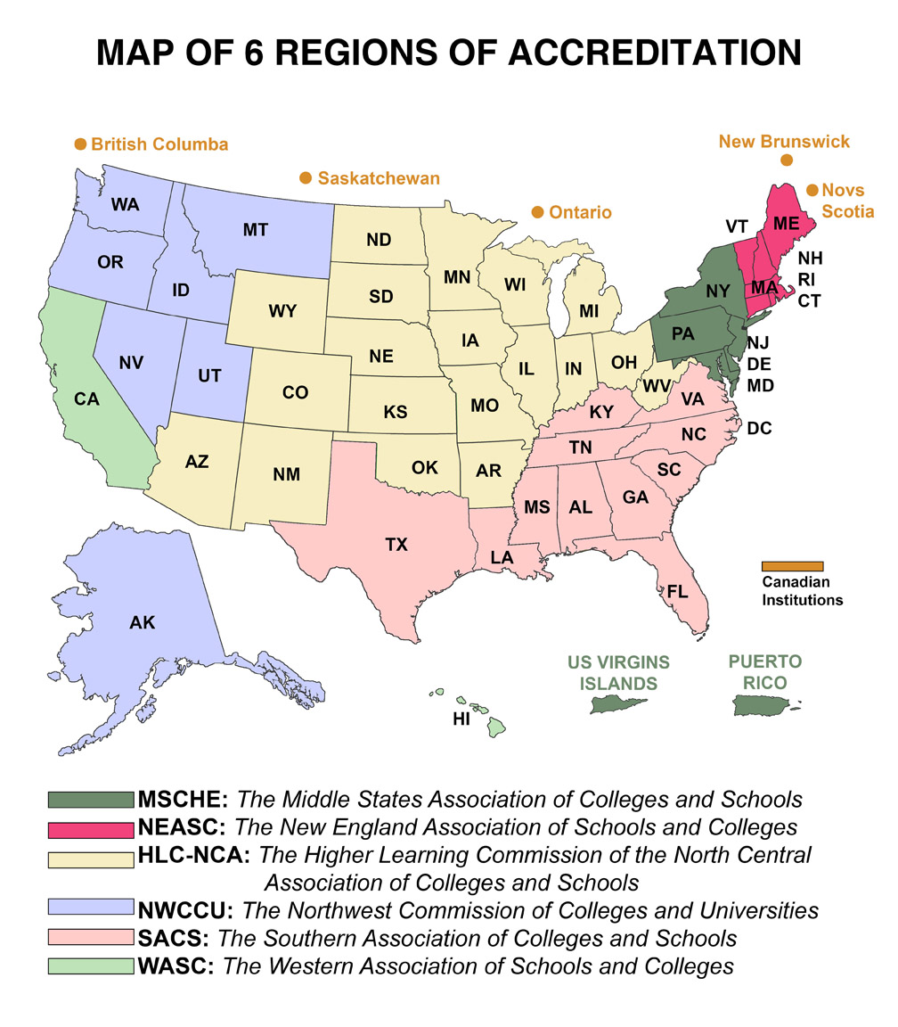
Accreditation

Slide 39
ACE Faculty Reviewers
It is the faculty’s charge to determine the academic rigor, content equivalency, and scope of the course, based on the depth and breadth of the materials and alignment of learning outcomes with evaluation methods.

Slide 40


ACE Faculty Reviewers
Are grounded in current curricular standards
Bring content area expertise
  Ex. Healthcare, leadership, aviation
Represent all post secondary levels of education
  Each bring a different perspective
Take a multidisciplinary approach

Slide 41


Review Team
Team Coordinator
Subject Matter Experts selected from college faculties
Psychometrician if needed

Slide 42
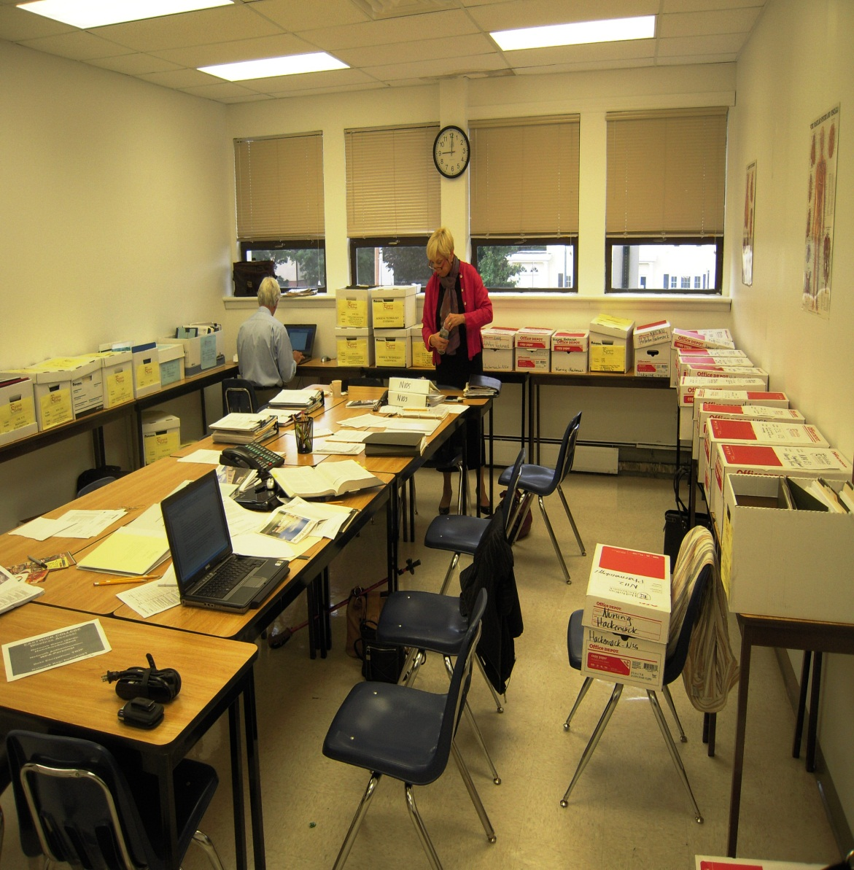
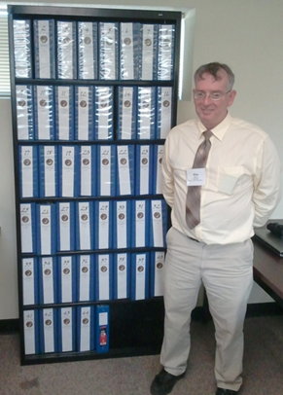
Course Evaluation: CREDIT & Military
Content, Scope, and Rigor
Learning Outcomes
Level of Difficulty
Applicability to Programs and Courses
Assessment Tools
Depth and Breadth of Material

Slide 43
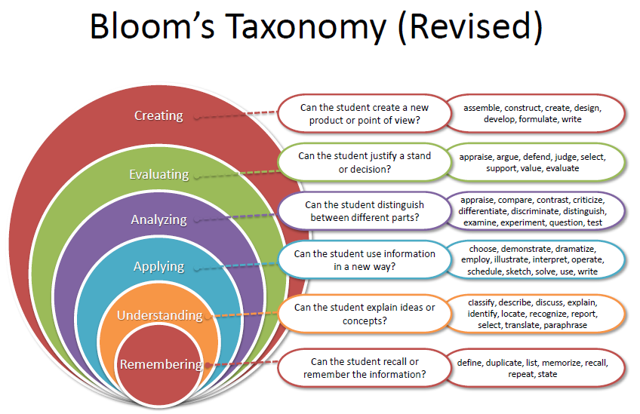
Review Rigor
Semester Hours (SH)
Graduate
Upper- Division
Lower -Division
Vocational / Certificate
Content, scope and rigor must be at the post-secondary level!

Slide 44
Review Mechanics
Course Objectives
  Measurable Demonstrated Academic Level
Learning Outcomes
  Knowledge Performance Affective
Instructional Strategies
  Topics Resources Textbooks Information Literacy
Methods of Instruction
  AV Materials Case Studies Laboratory/Simulations
  Practical Exercises Presentations Lecture
  Discussion Classroom Exercise Computer-based Training
Methods of Assessment
  Quizzes/ Exams Research Papers Case Studies
  Presentations Performance Rubrics Written Assignments

Slide 45

No Credit Recommended
Course is too limited in scope or too narrowly focused to be comparable to college courses.
Evaluation and assessment methods are inadequate to support learning outcomes and course content.
Course content lacks academic rigor expected in college-level courses.
Material presented for review is insufficient to allow team to make judgment.

Slide 46

Tools and Resources

Slide 47
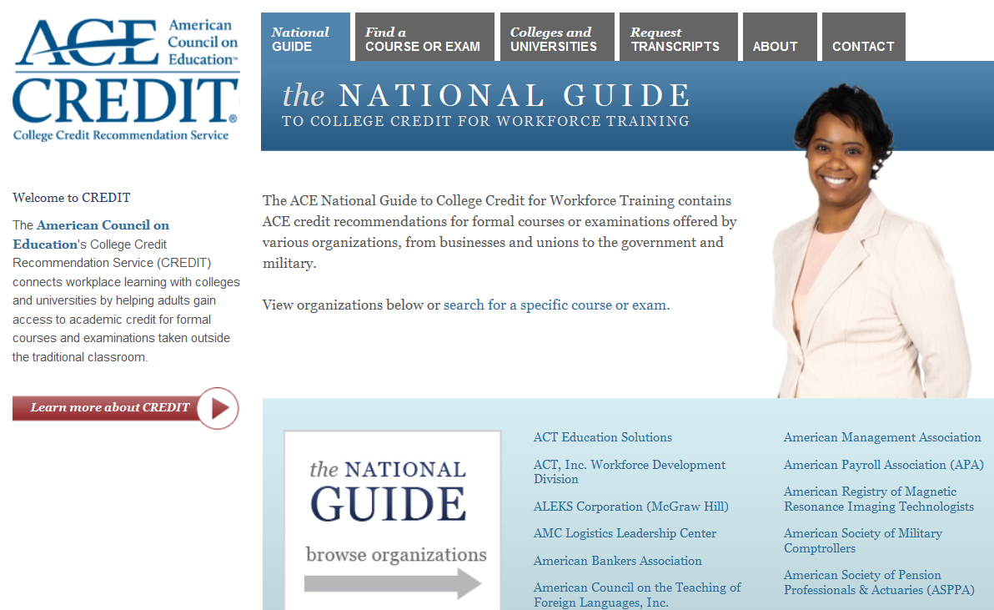
The National Guide
www.acenet.edu/nationalguide
47

Slide 48
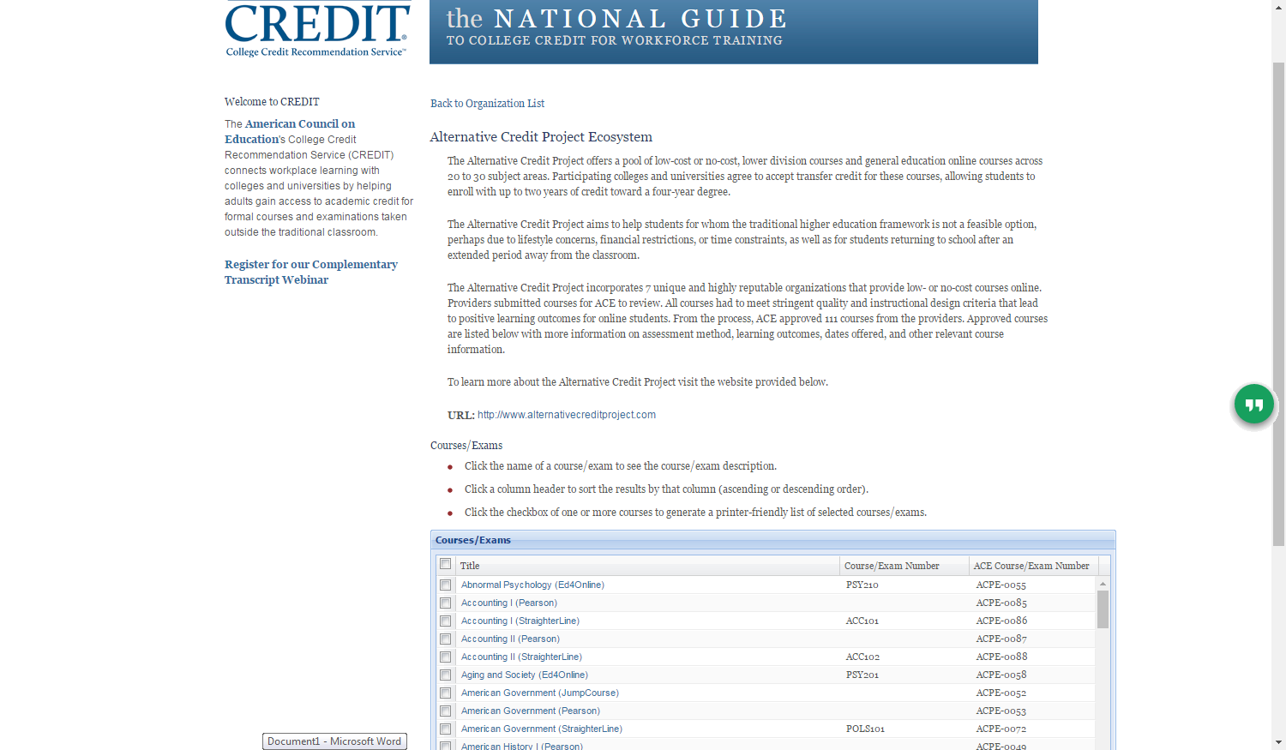
National Guide

Slide 49
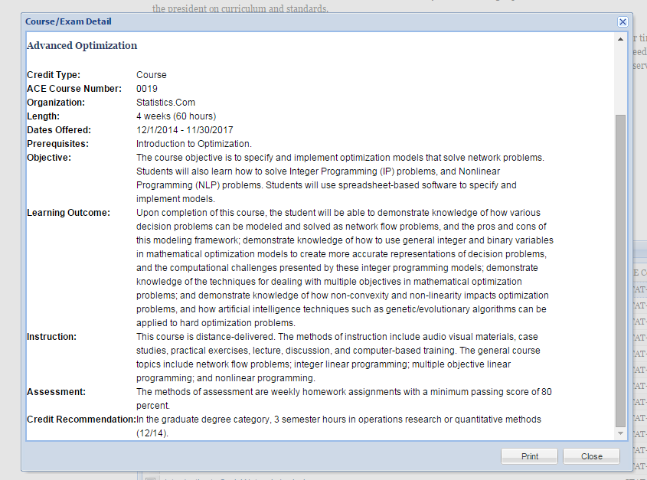
National Guide

Slide 50
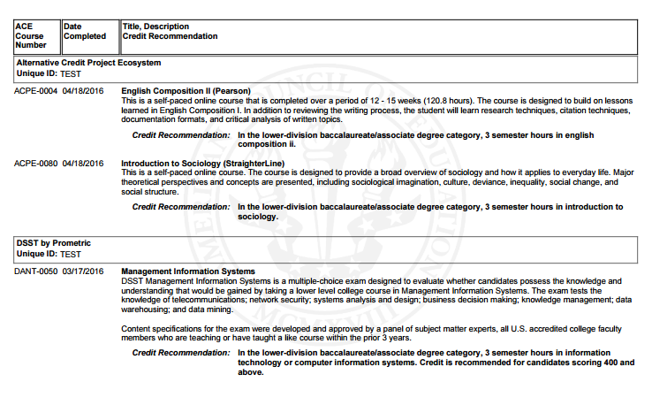
CREDIT Transcript

Slide 51
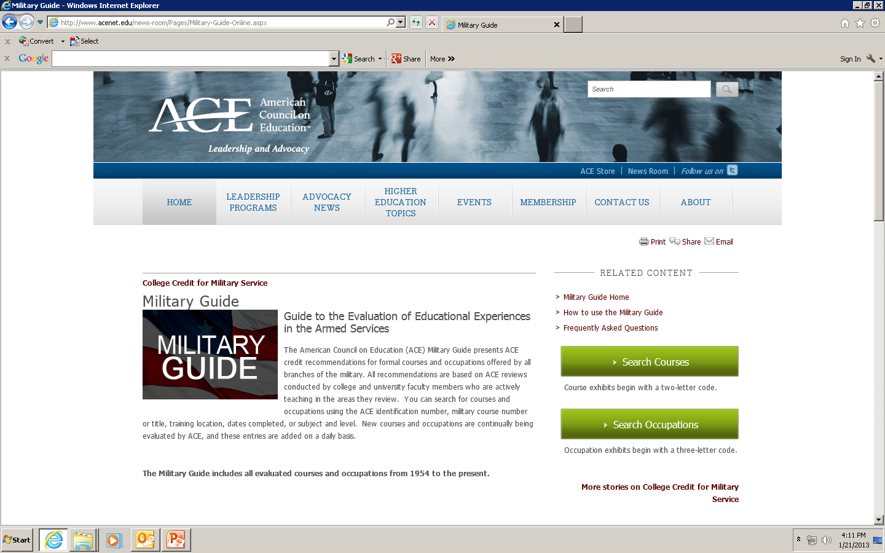
The Military Guide

Slide 52
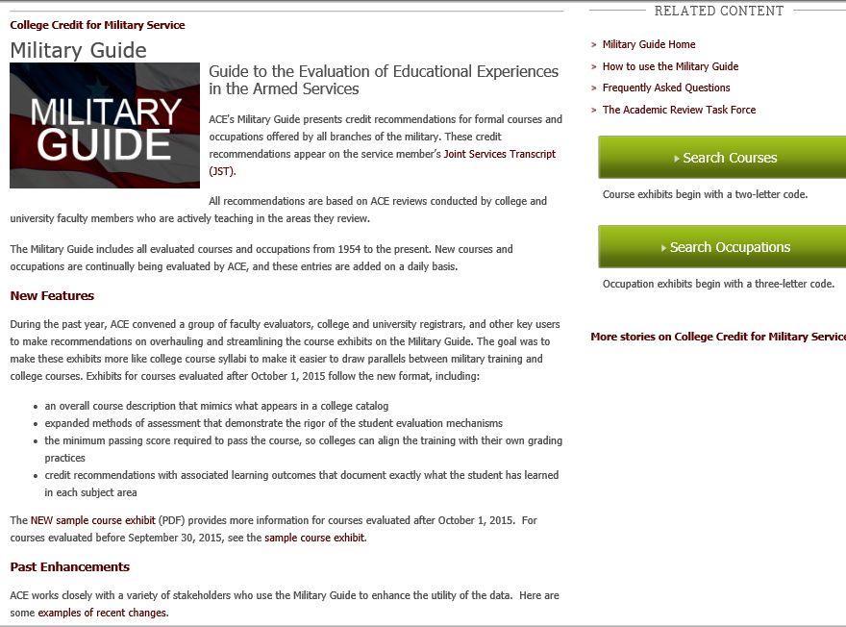
The ACE Military Guide (1954 to present)
www.acenet.edu/militaryguide

Slide 53
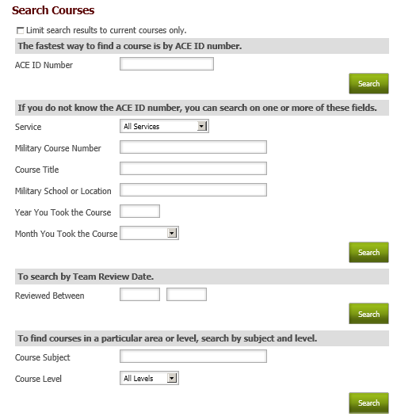
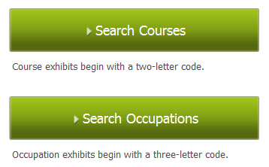
The Military Guide ~ Search Courses

Slide 54
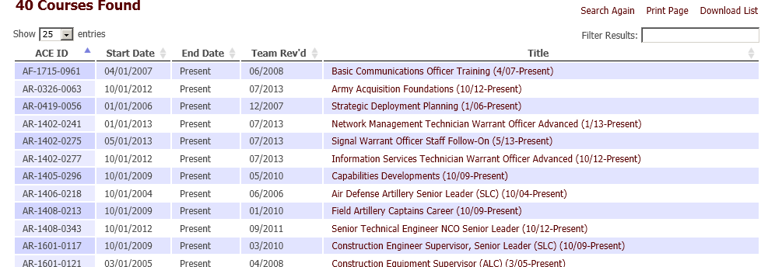
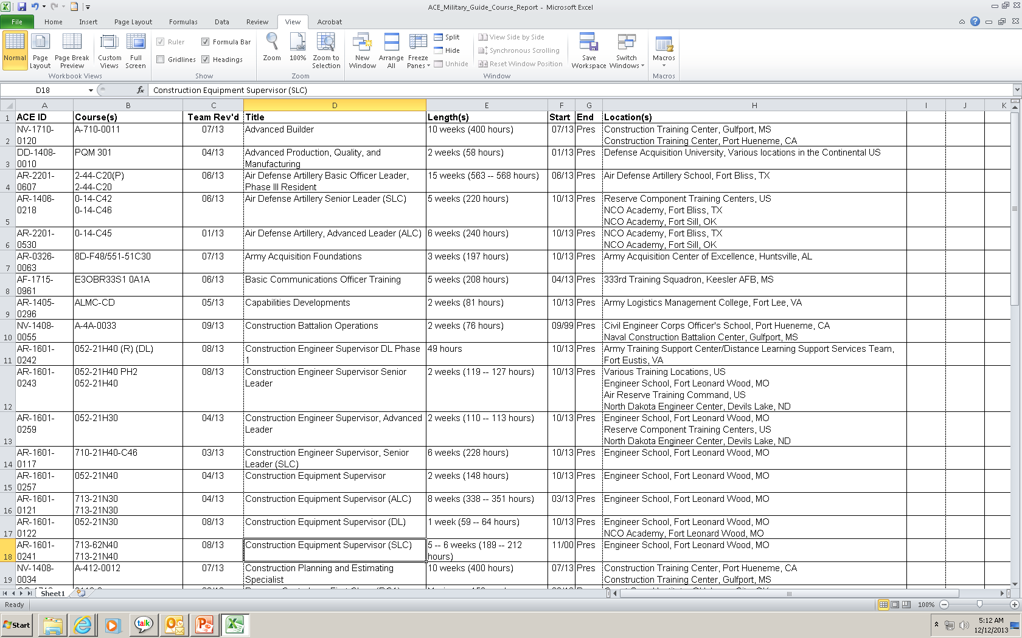
IMPORTANT: Index-level Data Reports
Exports to Excel

Slide 55
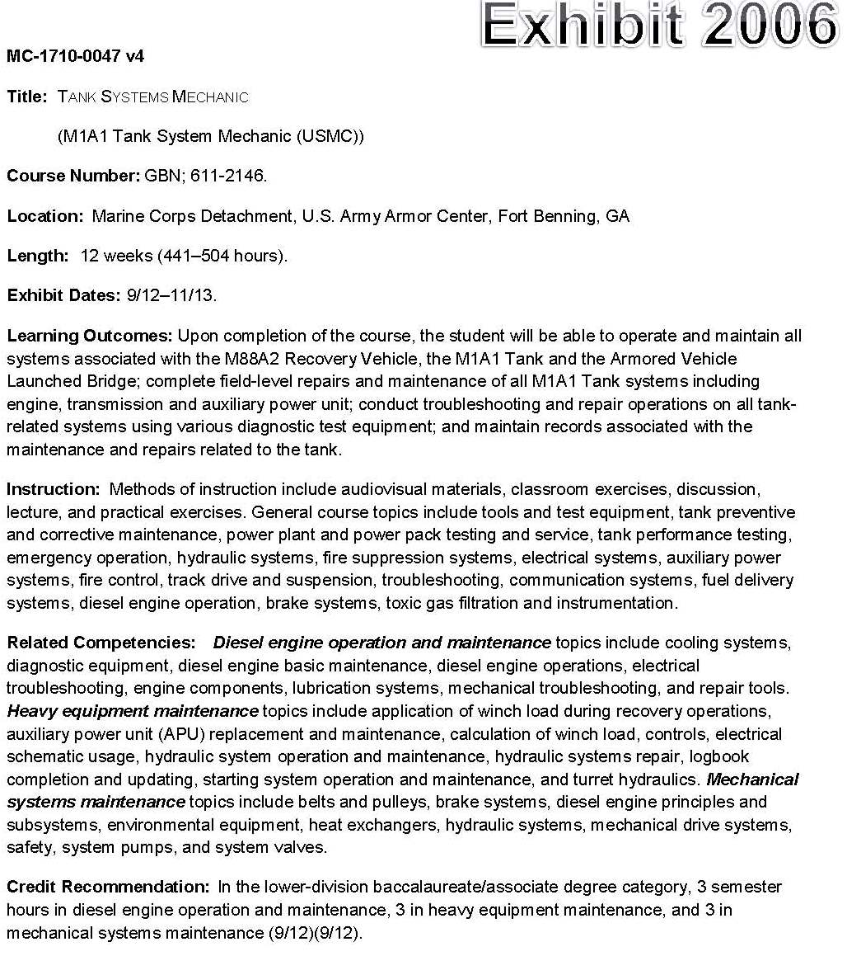
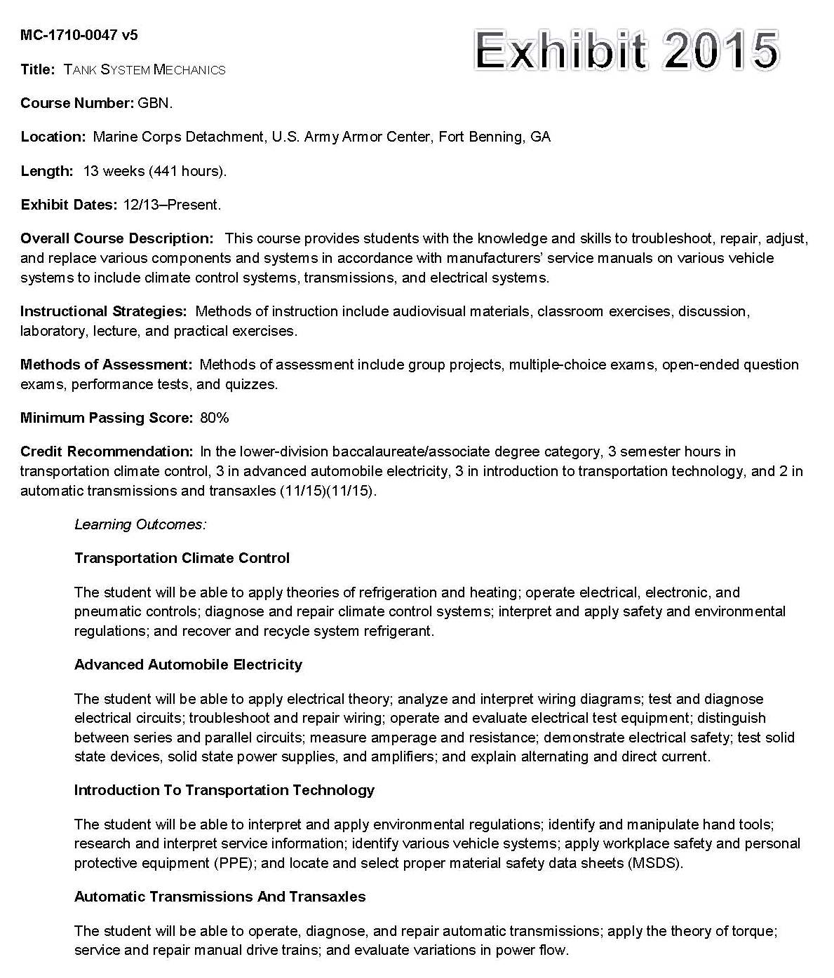
The New Military Course Exhibit

Slide 56
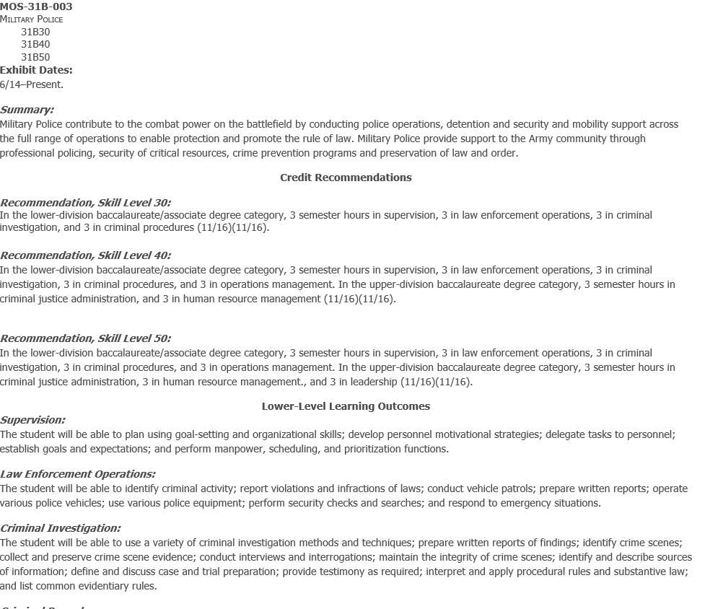
Military Guide Occupation Exhibit
Home page updates and reminders
Three exhibit versions
  1974 to 2006
  2006 to 2016
  Oct 2016 to present
Content redesign FY17
Service nuances and challenges
Footers

Slide 57
The Joint Services Transcript
(JST)
Academically accepted document
Validates service member's occupational experience; formal military training aligns ACE college credit recommendations
Owned and issued by respective service
  Central support services JST Operations
ACE supplies data
  performs quality checks on transcript
  cannot make changes to JST
Member’s Individual Record
ACE Guide
The JST
Service’s Registrar System
https://jst.doded.mil

Slide 58
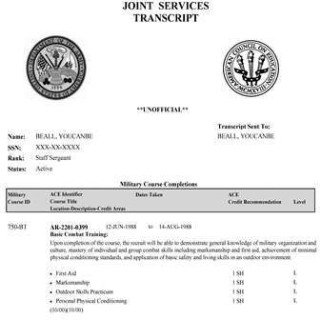
The Joint Services Transcript
Transcript Core (Official)
  Course Completions
  Military Experience
  College-level Test Scores
  Other Learning Experiences (OLE)
Summary Page (Unofficial)
  Displays ACE credit recommendations only
  SOC Transferability Codes
Academic Institution Page (Unofficial)
  College courses (Coast Guard, Marines, Navy)
  Certificates, Degrees, Licenses and Apprenticeships
58

Slide 59

System examples

Slide 60
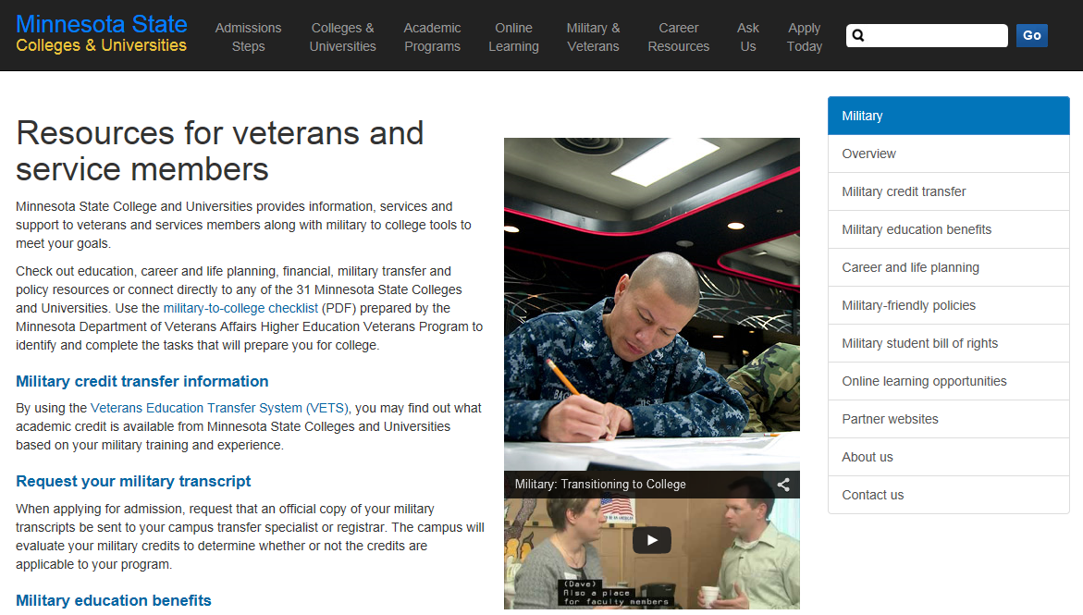
www.mnscu.edu/military/index.html

Slide 61
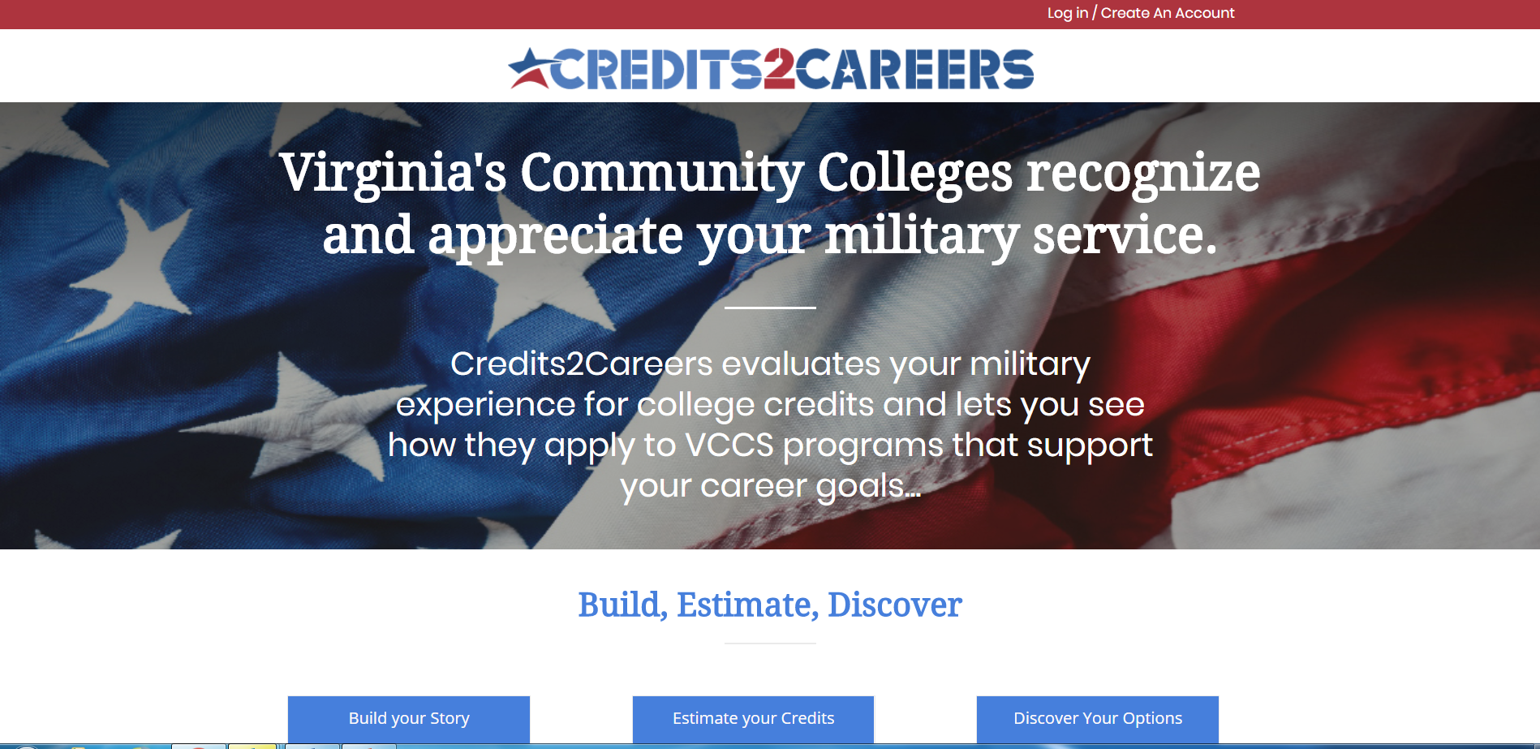

Slide 62
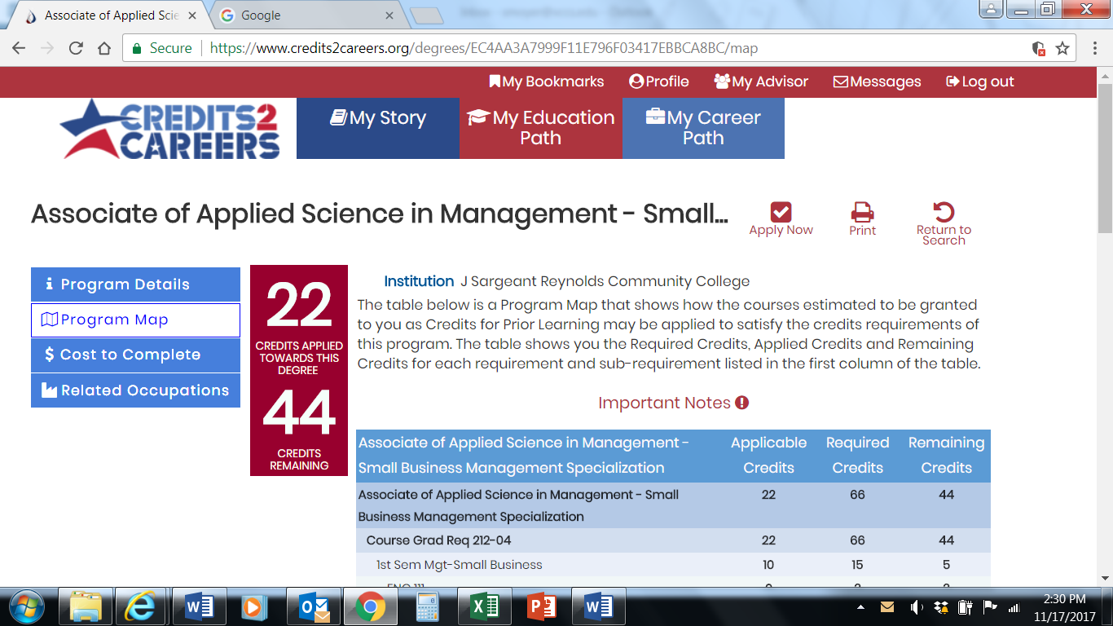

Slide 63
Resources
Joint Statement on the Transfer and Award of Credit
http://www.acenet.edu/news-room/Documents/Joint-Statement-on-the-Transfer-and-Award-of-Credit.pdf (AACRAO, ACE & CHEA)
A Guide to Best Practices: Awarding Transfer and Prior Learning Credit
  http://www.aacrao.org/docs/default-source/TrendTopic/Transfer/a-guide-to-best-practices-awarding-transfer-and-prior-learning-credit.pdf (AACRAO)
50-State Comparison: Prior Learning Assessment Policies
https://www.ecs.org/50-state-comparison-prior-learning-assessment-policies/ (Education Commission of the States)
Prior Learning Assessment Handbook: http://achievingthedream.org/sites/default/files/resources/PLA%20Handbook%20for%20NRC.pdf (Northeast Resiliency Consortium, Achieving the Dream)
PLA Inside Out (PLAIO):
http://www.plaio.org/index.php/home

Slide 65

Student Navigation Activity

Slide 66

Takeaways?
Student Navigation

Slide 67
Questions to Ponder for Day 2
Does your campus have a standard written process for CPL administration?
What are your campus’s processes?
What role do you play?
What processes are working? Where are opportunities for improvement?

Slide 69
Contact Information
Mary Beth Lakin, Director
College & University Partnerships
mlakin@acenet.edu
Angel Harriott, Associate Director
College & University Partnerships
aharriott@acenet.edu
Patricia Brewer, Ed.D.- Midwest Regional Liaison
College & University Partnerships
pbrewer@acenet.edu
Christopher Johnson, Ph.D. – Regional Liaison- West
College & University Partnerships
chjohnson@acenet.edu

