Slide 1
Space and Facilities Database
April 27, 2016

Slide 2
Topics
Space and Facilities Database (SFDB)
Academic Planning Database (APDB)
Space Management Resources
Capital Planning Tools
SFDB Update Process
Reports
Private Use Reporting
2017-18 Custodial Updates
Scenarios and Case Study

Slide 3
Space and Facilities Database

Slide 4
Group Discussion
The key players in reviewing and approving facility and space changes.
The process in which the campus takes to review facility and space changes.
a. Space Survey
b. Floor plans

Slide 5
What is SFDB?
SFDB – Space and Facilities Database
Centralized database maintained by CO
Reported by campus through web-based database
Two master tables:
Facility Table
Space Table
Notes:
What is SFDB? The Space and Facilities is a physical inventory of all the buildings and spaces on all 23 campuses and off campus centers as reported by the campus. The database is managed by the Space Management unit at the Chancellor’s office. SFDB coordinators can submit updates during the annual reporting window through our web-based interface.
SFDB is made up of two master tables: the Facility table and Space table

Slide 6
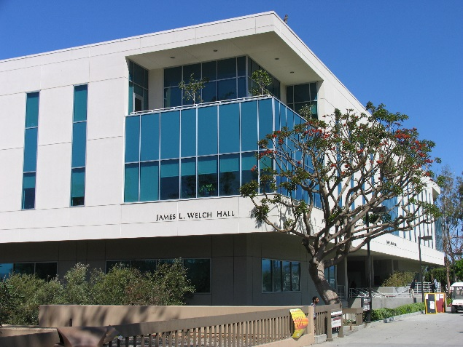
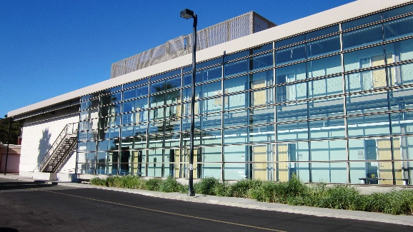
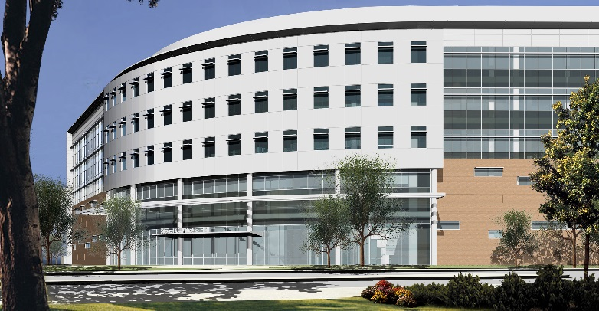
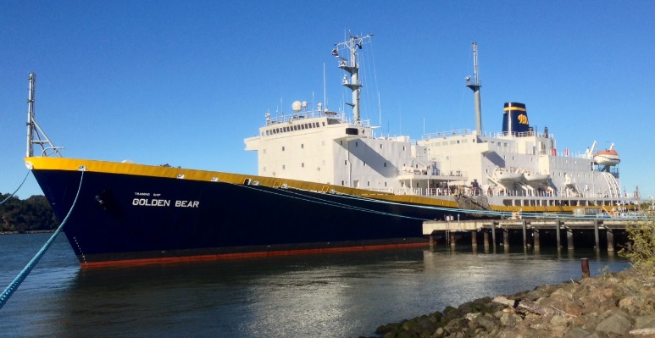
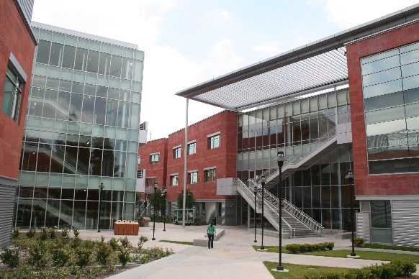
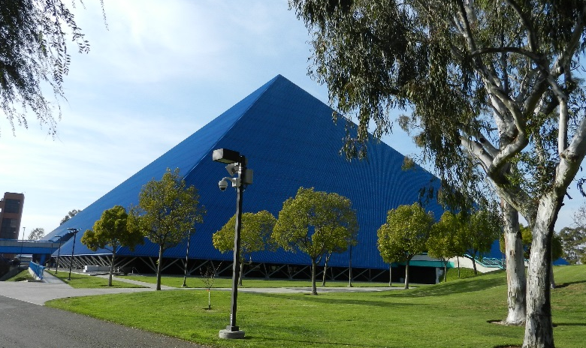
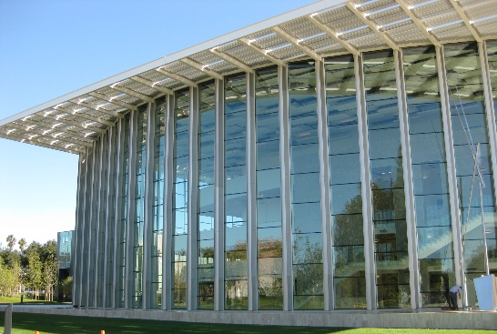
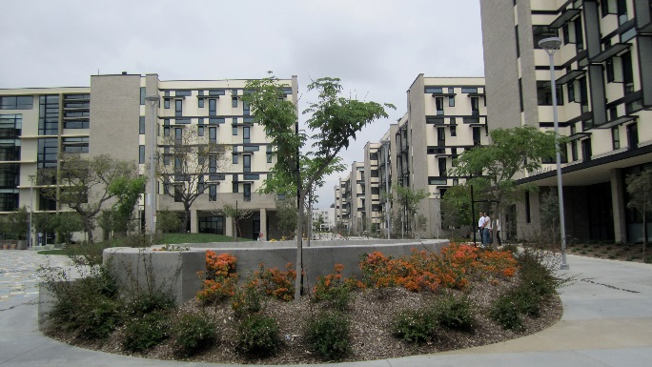
State Facilities (Academic)
Non-state Facilities (Self-Support)
Notes:
The facility table contains detailed descriptions of each facility. Such as the category code, this tells us what type of building it is, for example, it can be coded as a science building, a business building or an administrative building. Or it can be a self-support facility such as performing arts centers, housing, and student unions.

Slide 7
Campus: CSU Maritime Facility
Name: Golden Bear Ship
Facility ID: 500-
GSF: 200,000
Number of Floors: 5
Category: Classroom
Condition: Satisfactory
Master Plan Status: Permanent
Ownership: State Owned
Notes:
The facility table also contains the facility name, facility ID, it tells us the size of the building measured in gross square feet, number of floors, condition of the building, master plan status (permanent or temporary building), ownership (state or nonstate building), the cost of the building, date of completion or acquired.

Slide 8
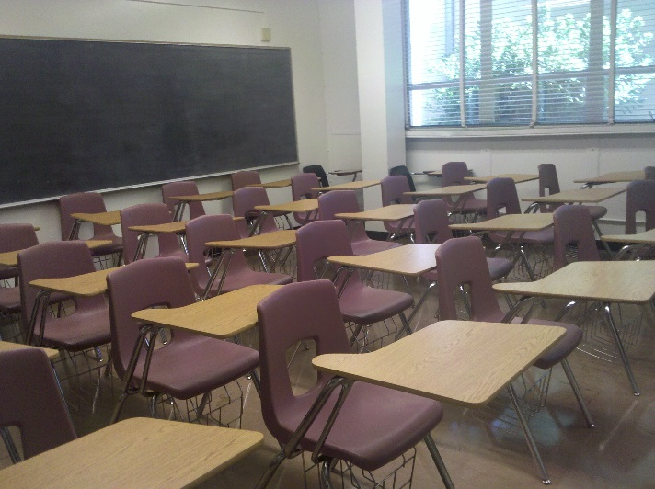
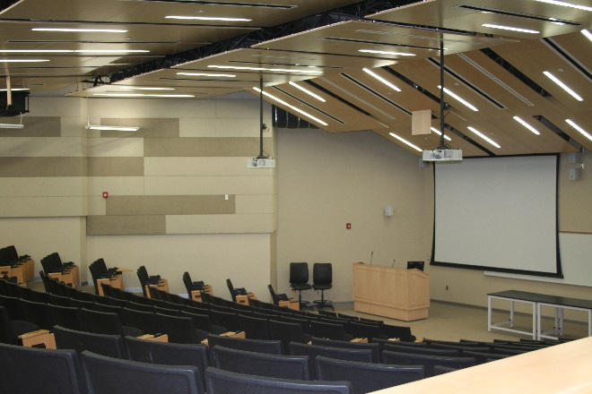
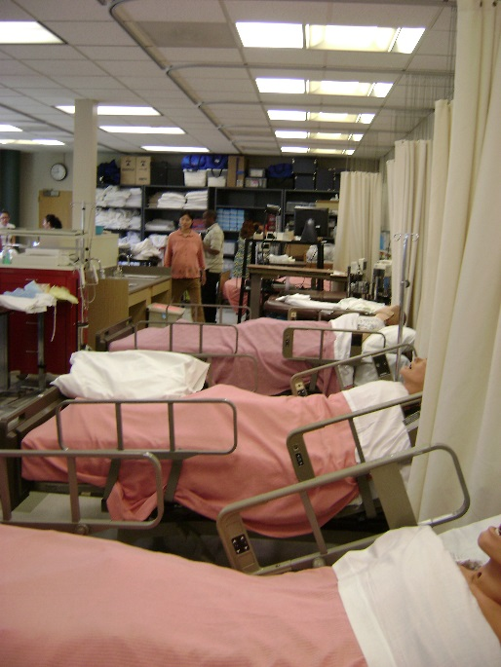
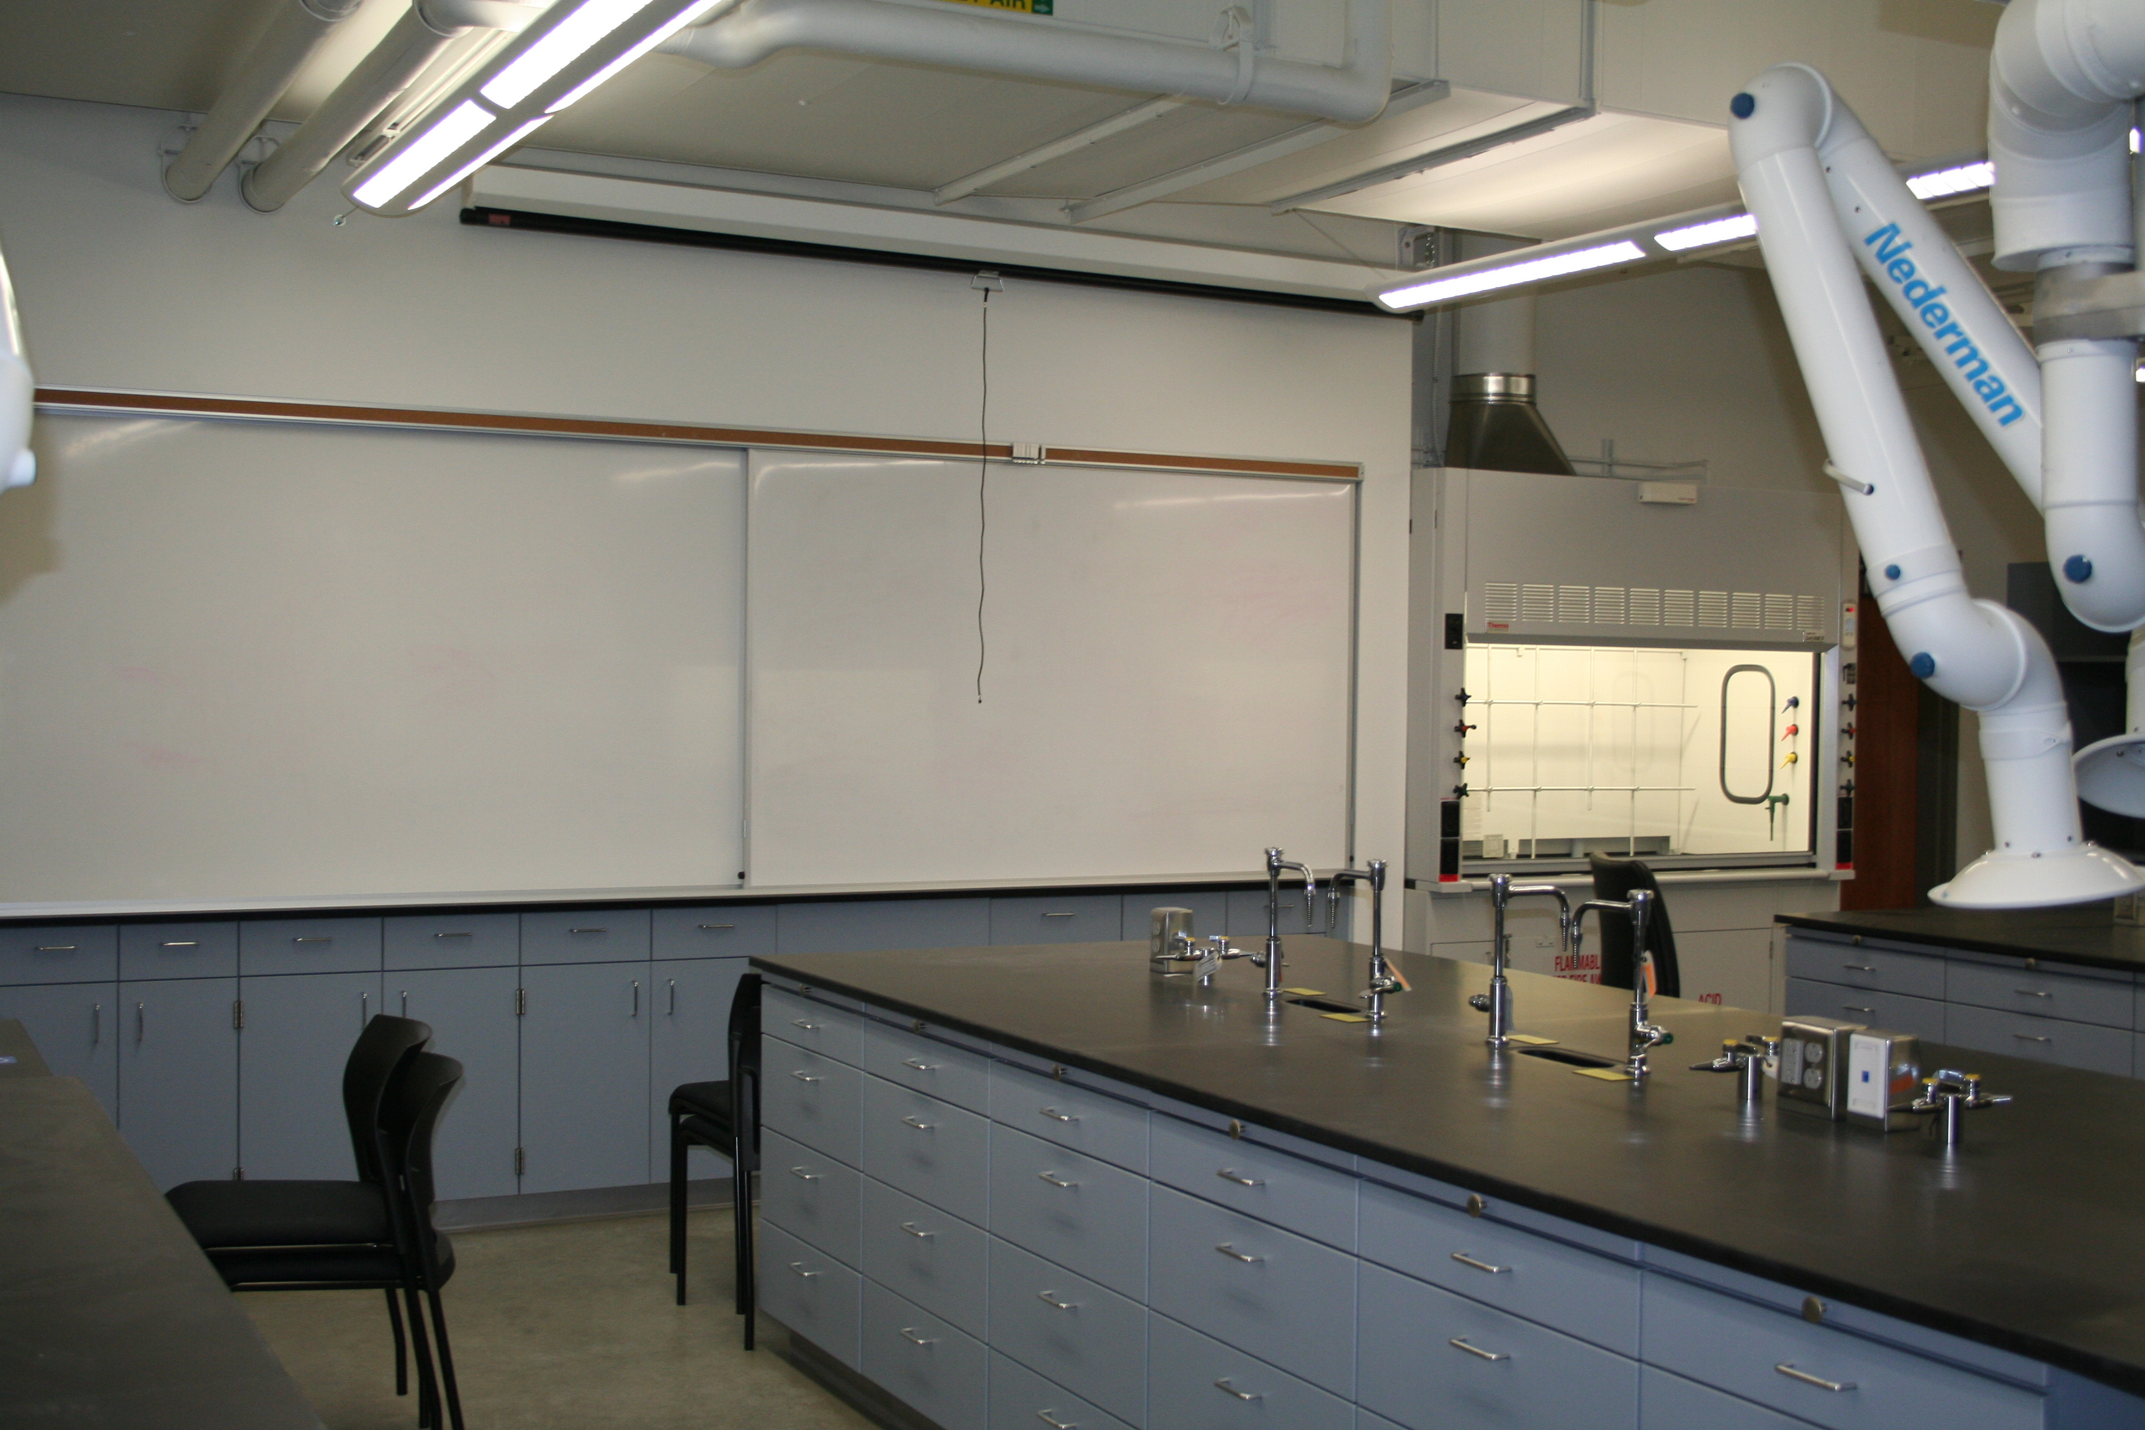
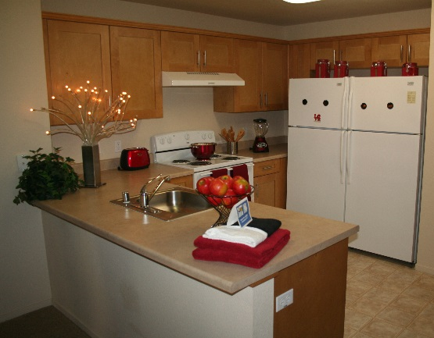
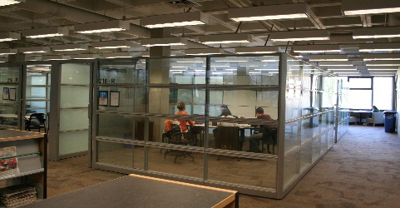
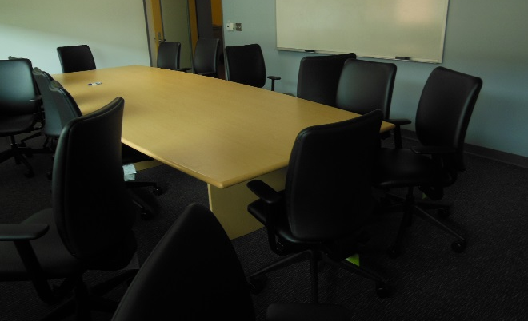
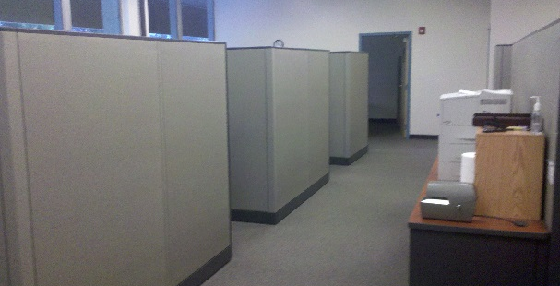
Instructional Spaces
Instructional Support Spaces
Notes:
The space table contains attributes for instructional and instructional support spaces.

Slide 9
Campus: Los Angeles
Facility Name: Science Building
Facility ID: 027B
Space ID: 0250--
ASF: 1,214
Space Type: Teaching Lab
Discipline: Chemistry
Instructional Level: Lower Division
Station Count: 24
Notes:
The name of the facility the space is in, the Facility ID, the space ID, the size of the room in assignable square footage (ASF), the space type is it a lecture or lab room, the discipline (is it a chemistry or a biology lab), instructional level (if the space is a upper or lower division, and station count.

Slide 10
Capacity
Lecture and teaching laboratory space.
Lecture: Space Type 0001 & 0004
Teaching laboratory: Space Type 0010
Expressed by Full Time Equivalent Students (FTES).
Lecture = stations x 2.33
Teaching Lab (Lower Division) = stations x 0.52
Teaching Lab (Upper & Grad Division)= stations x 0.39
Notes:
So when we talk about capacity space we are talking about lecture and teaching lab. To convert these spaces to FTES we would multiply the number of stations by the factor.

Slide 11
Academic Planning Database

Slide 12
Group Discussion
Learning the relationship between Facilities Planning and APDB coordinator
The role Facilities Planning plays in supporting APDB coordinator

Slide 13
What is APDB?
APDB – Academic Planning Database
Also a database maintained by CO
Reported by campus for each term
APDB contains information on course data.
Notes:
So we know SFDB is an inventory of facilities and space, but now we need to know how these spaces are being used.
The APDB is an inventory of all the courses that were taught during each term.
APDB is also maintained at the Chancellor’s office but under the Academic Research department.
The APDB coordinators at each campus are required to report updates to the Chancellor’s Office after each term.

Slide 14
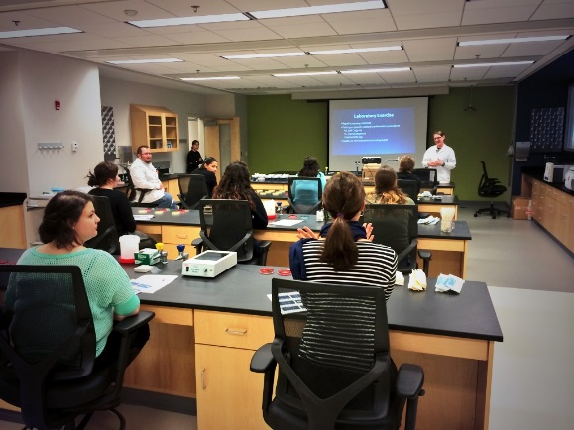
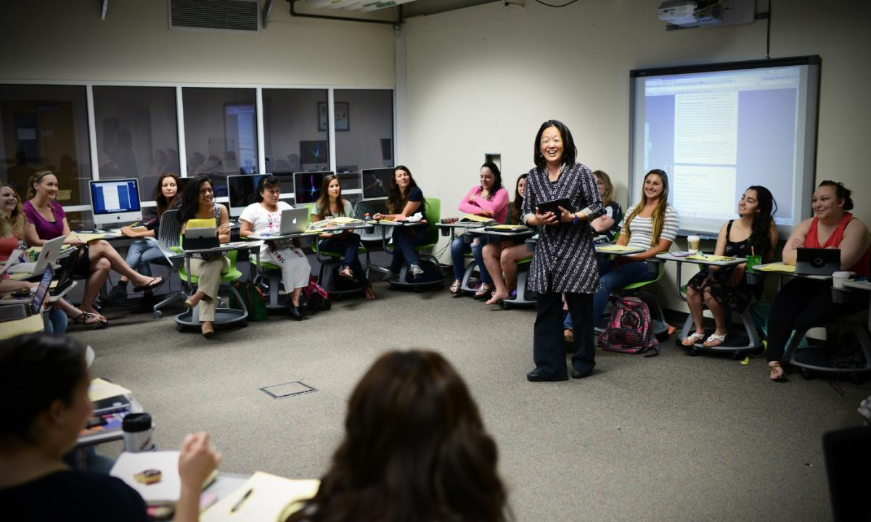
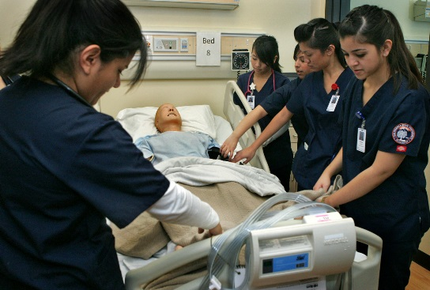
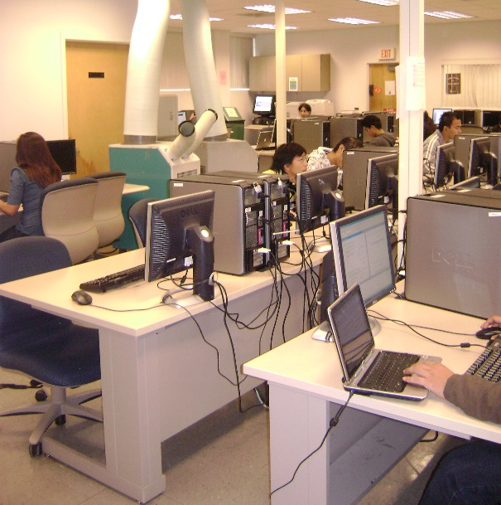
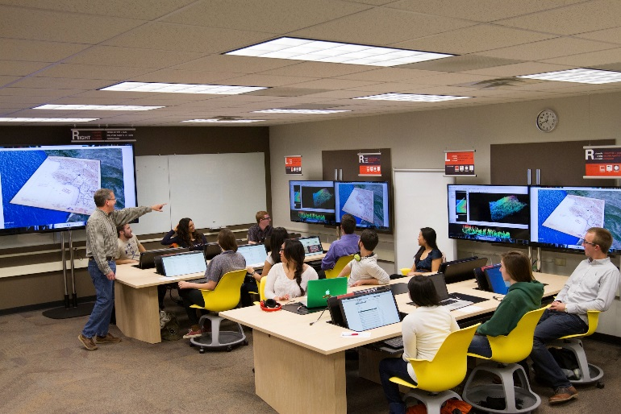
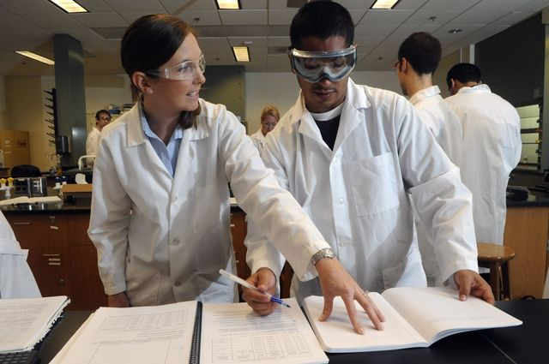
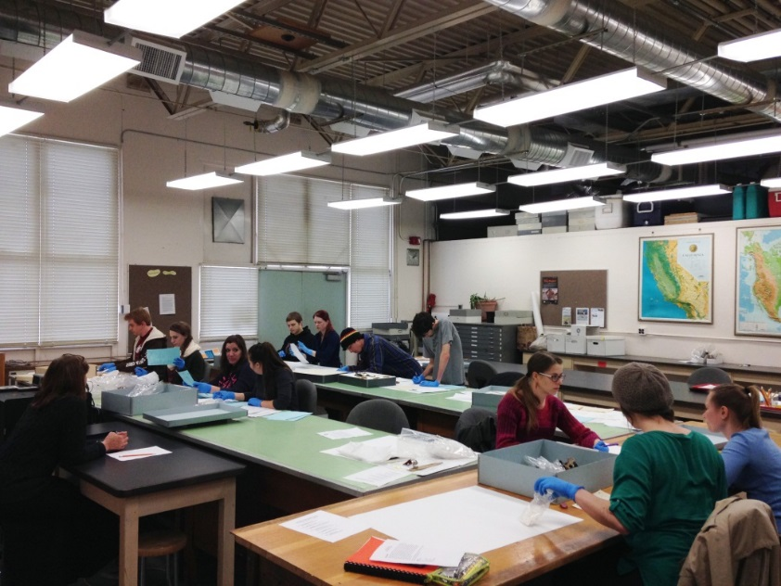
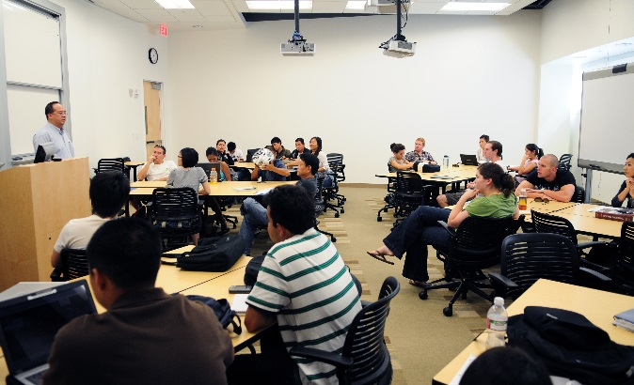
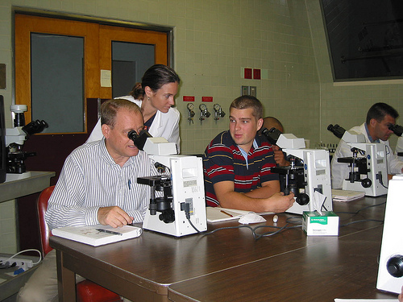
Notes:
APDB contains information on each class section that is offered and the resources used to teach these courses. It also tells us the discipline of each course, Biology or Chemistry, what time the course ends and begins, days the course meet, the number of students enrolled in the course. The APDB provides enrollment data which we will be used to justify space need.

Slide 15
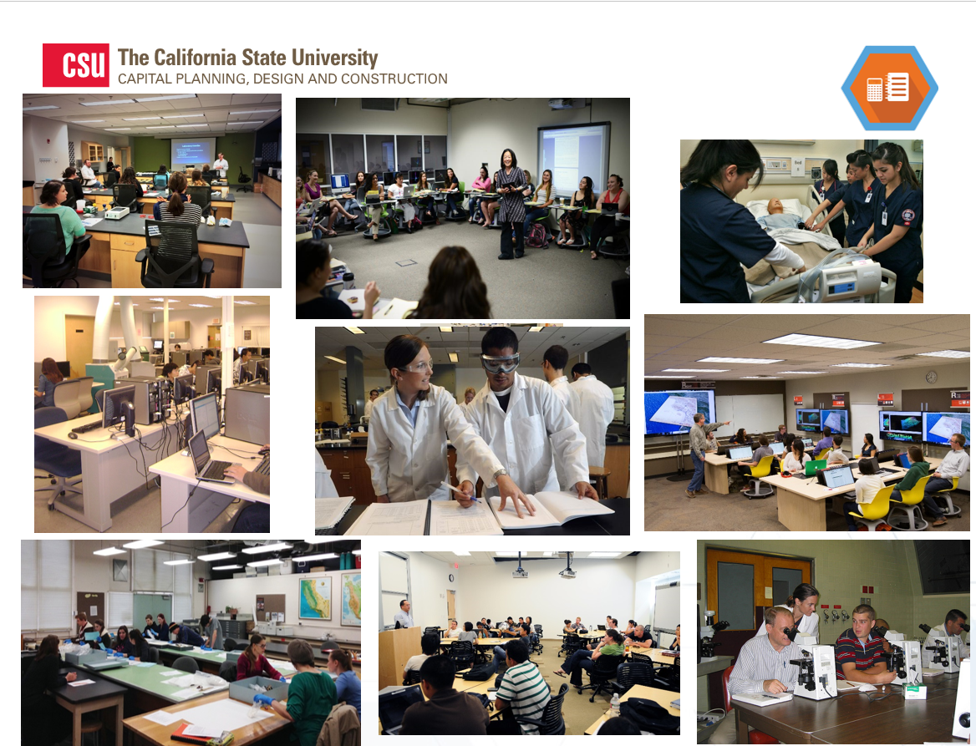
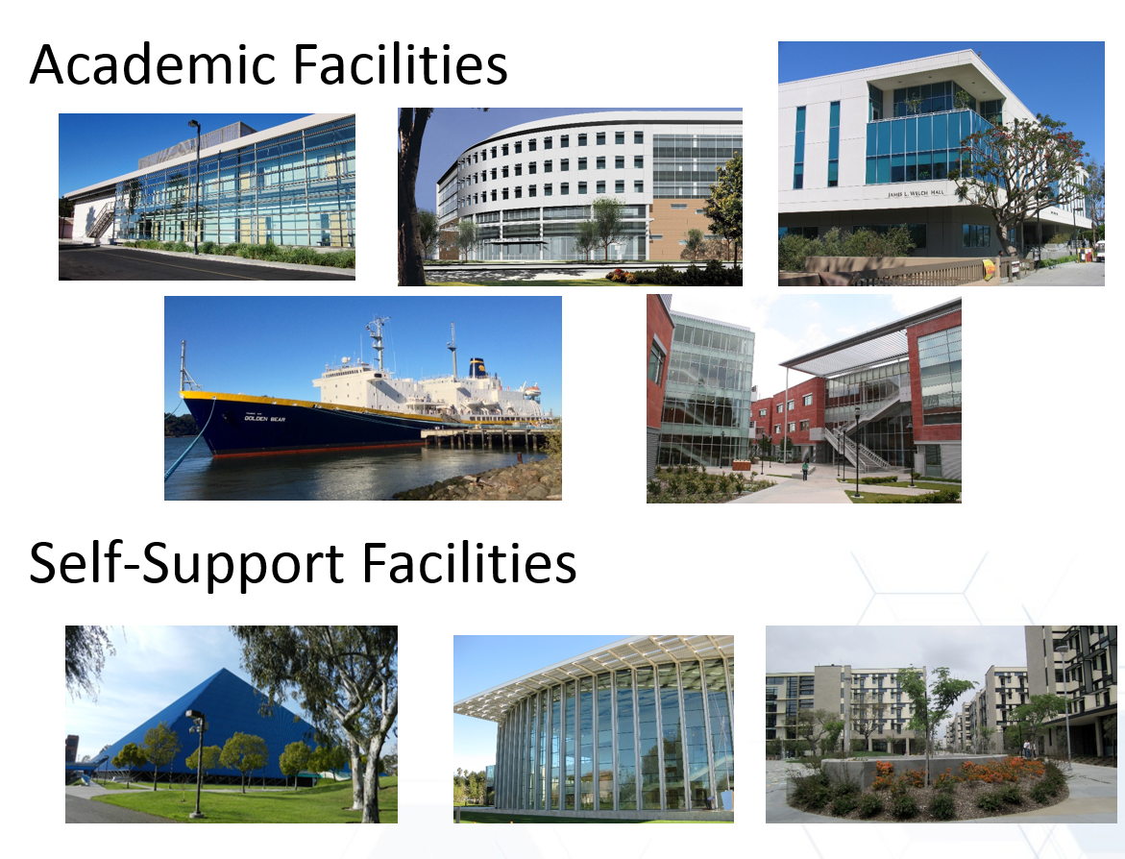
Notes:
There is a check in place between the APDB and SFDB. When APDB gets updated, it verifies that the facility ID and the space ID exists in SFDB.
-Maintain the consistency of rooms reported in APDB and rooms reported in the SFDB.
-Improve the accuracy of campus space utilization reports
-Ensure accurate enrollment data for capital planning:
onsite other earned % and offsite % in APDB reports

Slide 16
SFDB Update & APDB Reporting
Fall Term: REQUIRED to fix in APDB or SFDB
Other terms: warning message only
Minimize non-matching SFDB ID errors:
Communicate with APDB coordinator/scheduler
Update SFDB annually, share fall space file with APDB coordinator/scheduler
Notes:
When APDB coordinators report fall term updates and there is a mismatch, they will get a catastrophic error and must be fix this error. So you may get a call from your APDB coordinator asking for help in fixing this error. For all other term it is just a warning message and can by bypassed. We focus on fall because it has the highest enrollment and we based our utilization report off the fall term.

Slide 17
APDB Reports
Report provides enrollment data (FTES) by term, by discipline, and by level
APD53 Course Section Report (CSR)
APD 791 Utilization Report
APDB course report
Notes:
The apdb coordinator at the CO provides me with reports that contains FTES and FTEF data either by division or discipline (HEGIS) and by term.
Then there is the utilization report that tells us how well the room is being used based on standards. And the CSU is required to send this report to the legislature every other year. Last, it’s a report that shows line by line, every course that was offered for the term.

Slide 18
What is MYP?
MYP – Multiyear Enrollment Projection
Served as official enrollment projection for capital planning
Prepared by CO Academic Research and Resources
Notes:
The last resource facilities planning uses is the multiyear projections. The multiyear projection serves as the official enrollment data that help in the capital outlay and budget planning processes. The Chancellor’s office Academic Research and Resources department work closely with each campus to determine their overall future enrollment growth.

Slide 19
Notes:
As of now, the multiyear enrollment projections for the CSU is 2%, annually, for the next few years.

Slide 20
The Foundation of Capital Planning
Capital Planning Tools:
CPDC 1-2 (Summary of Capacity)
Lab Lab Book (Lab Enrollment vs. Lab Capacity)
Utilization Report
SFDB
(Space and Facilities
Database)
MYP
(Multiyear Enrollment
Projection)
APDB
(Academic Planning
Database)
Notes:
So to recap, the SFDB provides a inventory of all the building and space, the APDB tells us how the space is being used, and the MYP is a forecast of future enrollment. The three resources is the foundation to our capital planning tools. Each resource is fed into our capital planning tools that will help analyze how well campus is using their capacity space.
Meaghan will be reviewing this tools in just a little bit.

Slide 21
Space Management Resources

Slide 22
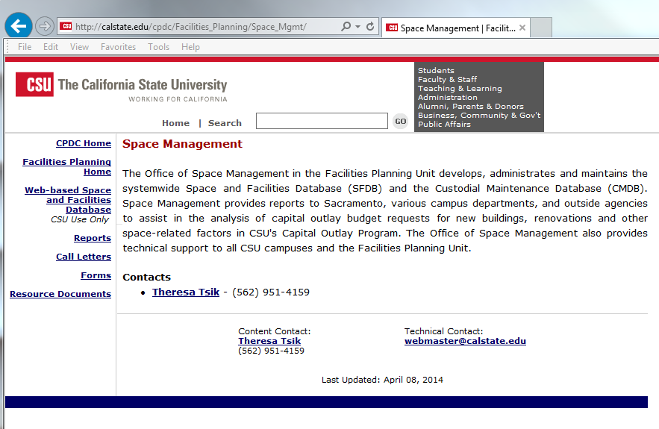
Space Management Website

Slide 23
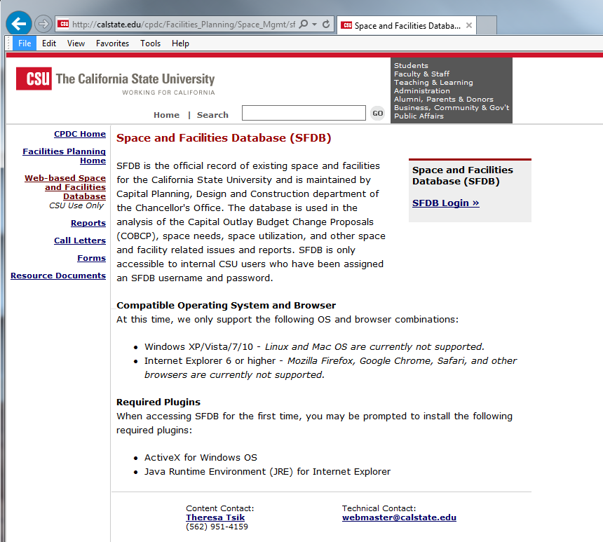

Slide 24
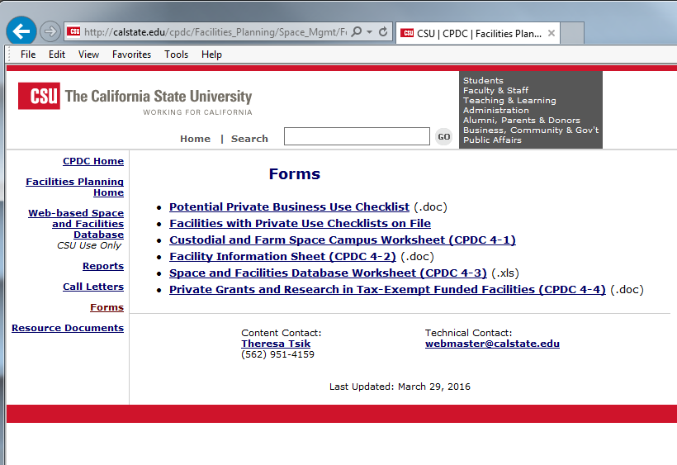

Slide 25
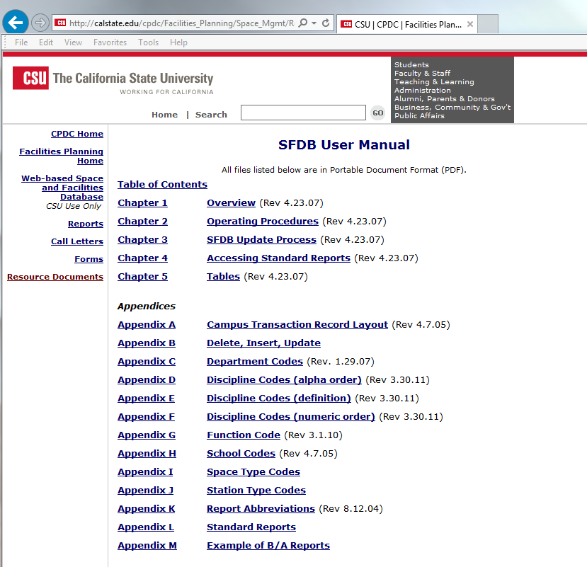
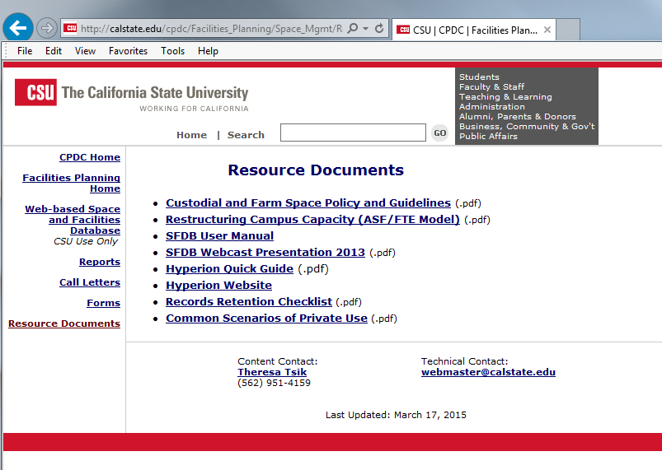

Slide 26
Planning Tools

Slide 27
Planning Tools
SUAM and Space Standards
CPDC 1-2 (Summary of Campus Capacity)
Lab Lab Book (Lab Enrollment vs. Lab Capacity)
Utilization Report

Slide 28
SUAM – Section VI: Standards For Campus Development Programs

Slide 29
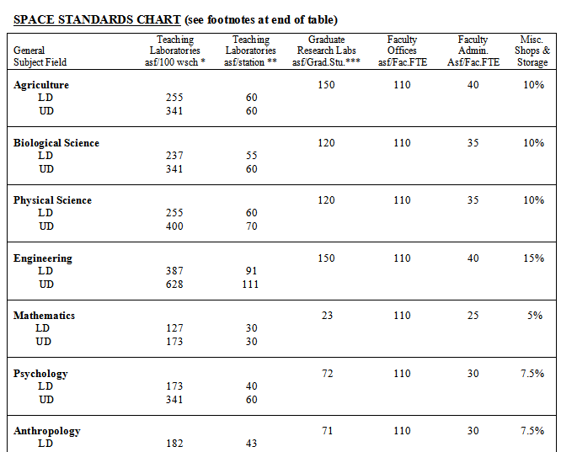
SUAM – Appendix B:

Slide 30
What is a CPDC 1-2?
Companion document to the Capital Outlay Program and Five-Year Capital Improvement Program
Used to evaluate effects of proposed capital projects
Lecture
Teaching Lab (LD and UD)
Faculty Offices
Available on the website:
http://www.calstate.edu/cpdc/Facilities_Planning/Space_Mgmt/Reports/campus_SumCap.shtml

Slide 31
CPDC 1-2 Main Components
Capacity:
SFDB* Physical Capacity
Uninventoried Projects Capacity
Proposed Projects Capacity
Enrollment:
APDB* Reported Enrollment
MYP*
*SFDB - Space and Facility Database *APDB - Academic Planning Database *MYP - Multiyear Enrollment Projection

Slide 32
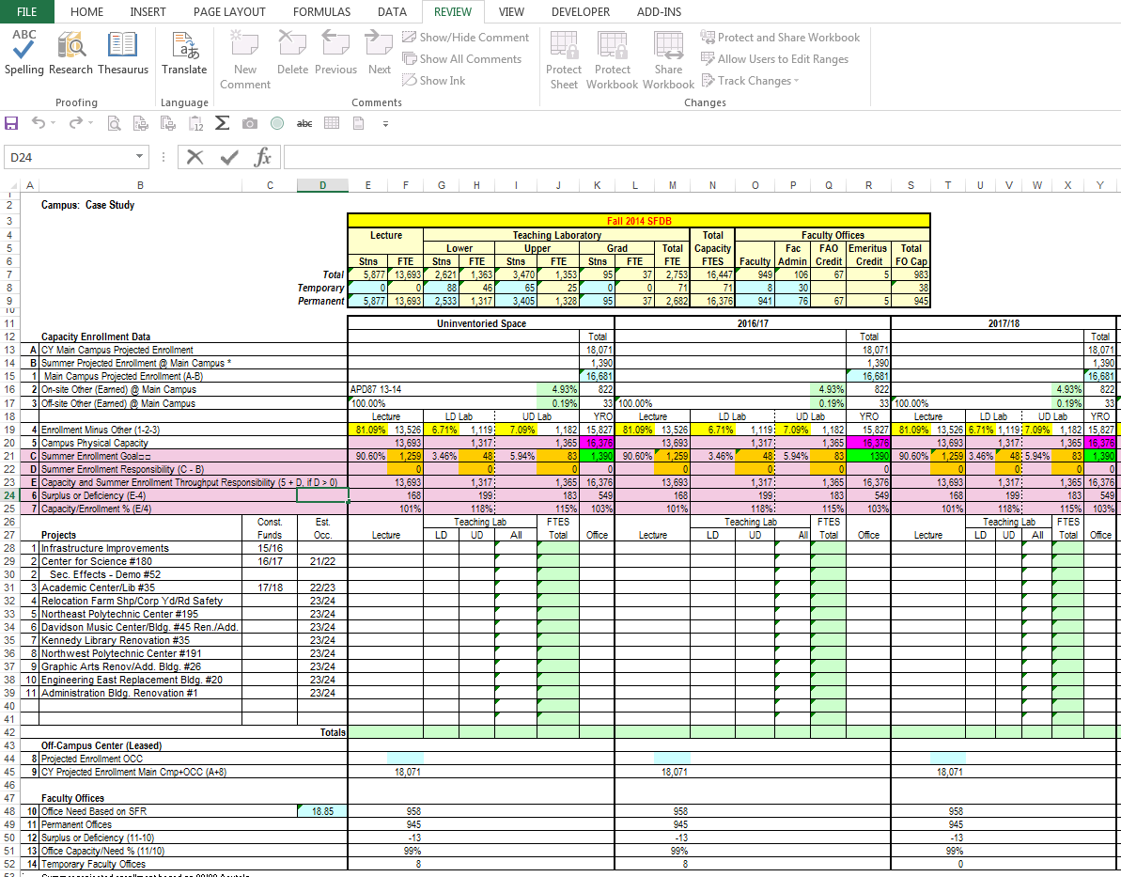
CPDC 1-2
Physical
Capacity (SFDB)
Enrollment
Project
Capacity

Slide 33
How To Use 1-2 as a Planning Tool?
Line 7: Capacity/Enrollment %
Line 13: Office Capacity/Needs %

Slide 34
Line 7 - Capacity/Enrollment %
Permanent Capacity:
Capacity reported in SFDB
Uninventoried capacity
Proposed new project capacity
Enrollment:
Main campus CY enrollment projection, excluding on-site or off-site other earned and summer
Actual enrollment relates to the enrollment projection
What does % mean:
>100%: more capacity than what the campus needs
<100%: capacity does not meet the campus needs

Slide 35
Line 13 - Office Capacity/Need %
Permanent Office Capacity:
Faculty office capacity in SFDB
Uninventoried office capacity
Proposed new project office capacity
Office Need:
CY Enrollment Projection (Main & OCC) x Student Faculty Ratio
What does % mean:
>100%: more capacity than what the campus needs
<100%: capacity does not meet the campus needs

Slide 36
Laboratory Enrollment vs. Laboratory Capacity (Lab-Lab book)
A planning tool to analyze Teaching LAB needs
Comparison between target enrollment FTES and physical capacity FTES
By HEGIS Category
By specific HEGIS Discipline in the proposed project
By instructional level
Lower Division
Upper Division

Slide 37
Lab-Lab Book Main Components
LAB Capacity:
SFDB Physical Capacity
Uninventoried Projects Capacity
Proposed Projects Capacity
LAB Enrollment:
APDB Reported Enrollment
MYP
http://www.calstate.edu/cpdc/Facilities_Planning/Space_Mgmt/Reports/LabFTES.shtml

Slide 38
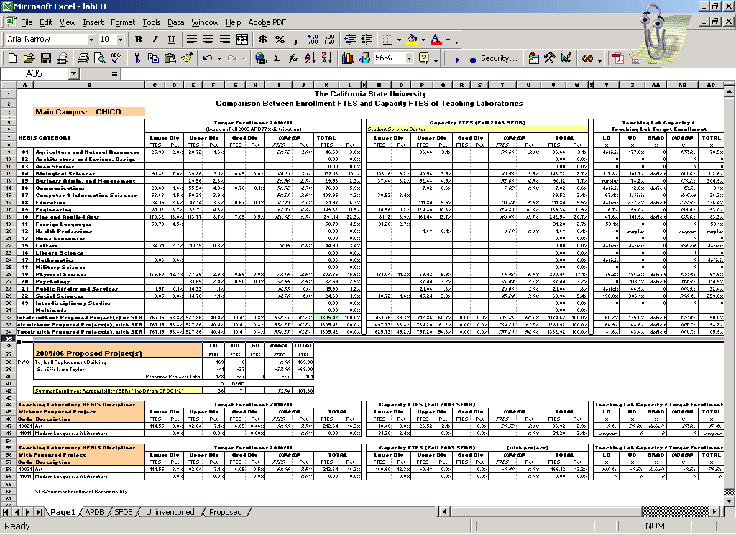
Lab Lab Book
Capacity / Target Year
Enrollment
Target Year Enrollment
Capacity
HEGIS
Category
Proposed project
Specific HEGIS Codes planned in the proposed project

Slide 39
Utilization Report
Report to the Legislative Analyst’s Office (LAO) biannually
Utilization of CSU campuses instructional physical capacity funded through the Capital Outlay Program
Instructional space:
Classrooms: space types 0001 & 0004
Teaching Labs: space type 0010
Compare utilization of classrooms and teaching laboratories for the fall term to the legislatively approved standards

Slide 40
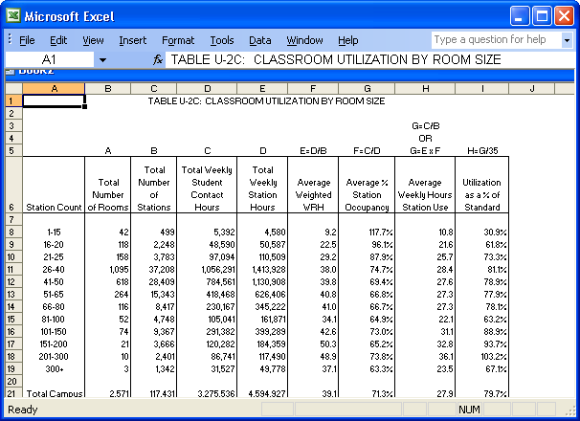
Utilization Report
SFDB
APDB
Utilization as a % of Standard

Slide 41
Utilization Report Methodology
Weekly Student Contact Hours (WSCH):
WSCH = AWRH * enrollment
AWRH (Average Weighted Room Hours)=Total Class meeting minutes per week / 50 minutes
WSCH is the number of hours each room is scheduled and the number of students enrolled in the class in a week scheduled to be face-to-face with a faculty member in class from the APDB.
Determined by room space type instead of course instruction type:
Example 1: A lecture course taught in a laboratory space adds to the average use of laboratory stations.
Example 2: Courses that are taught by individual supervision do not regularly meet in a classroom or a class laboratory and, thus do not contribute to the hours of use of a room.

Slide 42
Utilization Report Methodology
Utilization Standard:
Lecture: 35 Weekly Station Hours
Scheduled Hours from 8 A.M. – 10 P.M. (M-F): 70
Percent to be scheduled (room): 75%
Total Scheduled Hours per Week: 52.5
Percent Station Occupancy: 66%
Amount of time a station is occupied: 35
Lab: 20 Weekly Station Hours

Slide 43
Utilization Report Methodology
Number of stations
Query from SFDB
Include all campuses physical capacity for classroom and teaching laboratory, whether or not course sections were scheduled in those rooms.
Report utilization from 7 a.m. to 10 p.m. Monday through Saturday
Focus on main campus, permanent buildings only

Slide 44
Fall term Utilization Reports
Detail reports by each facility
Detail reports by each space in each facility

Slide 45
SFDB Update Process

Slide 46
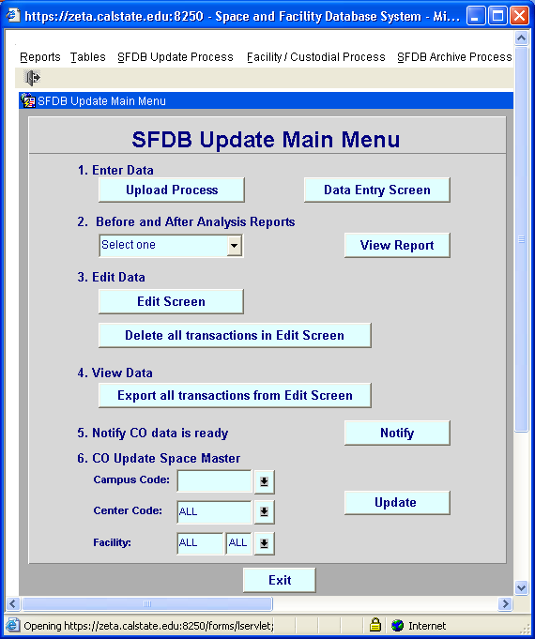
SFDB Update Main Menu
Notes:
So now that it’s May and you are ready to mSo there are 6 steps in the update process but really only 5 for campus. The last step is for me to update the space master table once we agree on all the updates.
There are two ways to make updates, the upload process or the data entry screen. I would suggest sticking with the Upload process unless you have a very small of space changes. I want to focus on the upload process. You load your file, put in your

Slide 47
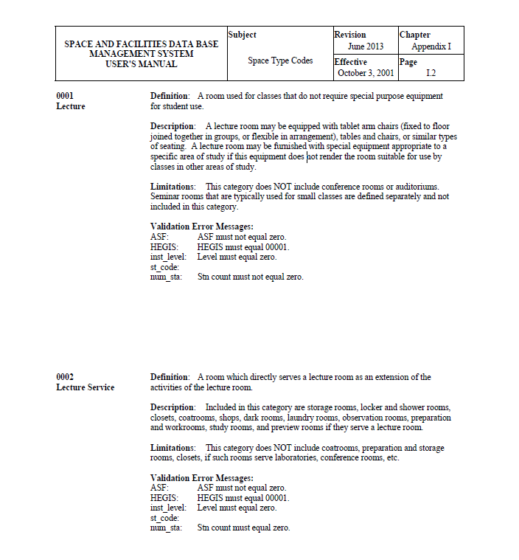
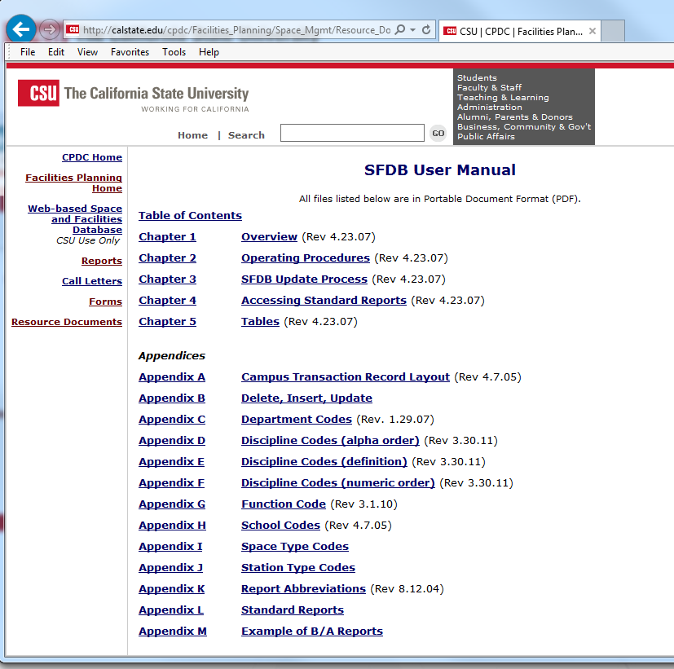

Slide 48
Space Update Process
Or
Campus Upload Process
Data Entry Screen
Validation
N
Y
Campus
Edit Screen
B/A Analysis Report
N
Y
Campus inform CO Data is ready to review
CO Analyze B/A Report
N
CO
Y
CO Update Space-master

Slide 49
Analysis of SFDB update
Process and view the Before and After Analysis Report
Analyze total campus permanent capacity
Increase of capacity:
Project related: capacity should match the program, refer to CPDC 1-2
Non project related: analyze your proposed CPDC 1-2
Loss of capacity:
Project related: capacity should match the program, refer to CPDC 1-2
Non project related: not allowed in campus TOTAL unless a sound reason is provided and approved by CPDC
Notes:
Analyze your Before and After report. We mainly focus on the permanent capacity. If you see a increase or decrease in lecture or lab, is it tied to an approved project and does it match the project information on the 1-2. If you are gaining or losing FTES, take a look at the tools, does it make sense and you will have to justify why.

Slide 50
Step 5 – Notify CO

Slide 51
SFDB Update Window, May 1st
Prepare Fall 2016 SFDB Update Data
Include spaces that will be scheduled for fall 2016 classes
Use caution in deleting spaces that may be scheduled for fall 2016 courses
Inform APDB coordinator of any facility/space ID change
All other space changes

Slide 52
Update Facility
CPDC 4-2 Facility Information Worksheet form www.calstate.edu/CPDC/Facilities_Planning/Space_Mgmt/Forms
All state and non-state facilities in the master plan must be reported in SFDB
NEW Category Codes
Update year round
Notes:
Sent out the facility file and we are asking the campus to review and apply recode categories if necessary. Example, Recreation centers.

Slide 53
Update Space
Prepare CPDC 4-3 form http://www.calstate.edu/CPDC/Facilities_Planning/Space_Mgmt/Forms
Log on the SFDB database
Update during the reporting window

Slide 54
SFDB Reports

Slide 55
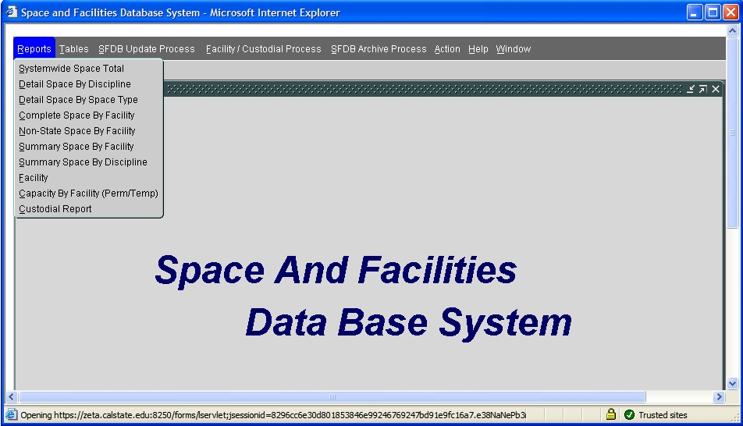
Where To Get Reports?
http://www.calstate.edu/CPDC/Facilities_Planning/Space_Mgmt/index.shtml
Notes:
You can go to SFDB and query can reports once your changes have been accepted by the CO.

Slide 56
Type of Reports
Category |  | Name of Reports
Space | Room by Room | Detail Space Report By Discipline Detail Space Report By Space Type Complete Space Report By Facility Nonstate Space Report By Facility
 | Summary | Complete Space Report By Facility (Summary) Summary Space Type Report by Facility Summary Space Type Report by Discipline
Facility |  | Facility Report Capacity Report by Facility
Custodial |  | Custodial Report

Slide 57
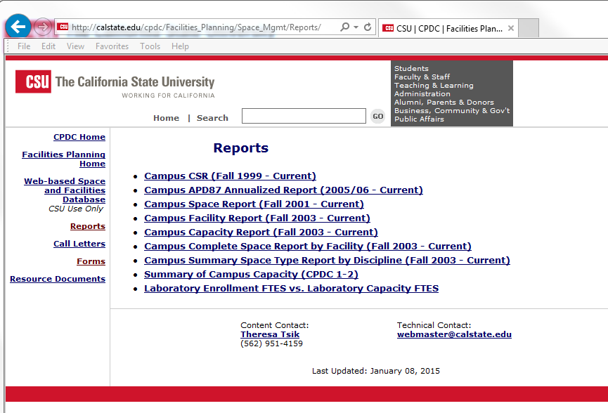
Notes:
Some of the reports can also be found on the Space Mgmt website. You can find current and historical space and facility files.

Slide 58
Private Use Reporting

Slide 59
Private Use Reporting Process
Compliance with Internal Revenue Service and State Treasurer’s Office regulations regarding Private Use in tax-exempt bond funded CSU facilities.
Reporting initially required prior to receipt of funding for project
Annually thereafter if there are any changes to the facility’s Private Use status.
SFDB should be annually updated using function codes designations for sublease and externally-funded research.
Notes:
Condense slide

Slide 60
Private Use Checklist
Questions to help determine potential private use:
1) Has the project been sold or transferred?
2) Long-term lease (> 50 days of use)
3) Management contract or franchise agreement
Qualified Management Contract
4) Sale of electricity/water
5) Sponsored Research and “safe-harbors”
6) Special legal entitlement or arrangement
Signature of VP for Administration & Finance/CFO

Slide 61
CPDC 4-2: Facility Information Sheet
To be completed for each facility that includes subleased areas
Key Requested Information:
Project Funding Type/Source and Amount
Square Footage of Subleased Area
Derived Cost of Applicable Subleased Area
Sub-lessee Information

Slide 62
CPDC 4-4: Exclusions for Research Projects
To be completed for each facility that includes areas designated for externally-funded research
Key Requested Information:
Project/Facility Funding information
Identify whether the externally-funded research taking place falls into the three “safe-harbor” categories listed
If the research does not fall within the “safe-harbor” provision, provide detail of research purpose and sponsor(s)

Slide 63
2017/18 Custodial Reporting

Slide 64
State Maintained Spaces
Spaces with instructional functions or administrative functions are eligible for custodial maintenance funding.
Custodial Categories
SQF4 – total square footage (ASF or GSF) of a state-supported facility that is eligible for funding
SQF5 – gross square footage of a farm building sitting on farm acreage, that has a roof and is use for processing farm product and/or providing shelter for animals.
http://www.calstate.edu/cpdc/Facilities_Planning/Space_Mgmt/Resource_Documents/
Notes:
Spaces that are eligible for Custodial funding are spaces with instructional functions or administrative functions. This would include any state funded facilities. The only nonstate facility that gets funding are student health centers. There are two custodial categories, SQF4 and SQF5.

Slide 65
What to Report?
NEW state maintained spaces (2017/18 Fiscal Year):
Impact on campus’ operating budget
SQF4 and SQF5 adjustment:
No monetary impact to campus’ operating budget
Improved and unimproved acreage

Slide 66
Cost of New State Maintained Spaces
Regular maintenance for new spaces:
$10.78 / square foot (2016-17)
Cost of utilities
Building maintenance
Custodial
Landscape
Administrative support

Slide 67
How to Report?
Fill out CPDC 4-1 – Custodial Worksheet
Fill out CPDC 4-2 – Facility Sheet
Fill out CPDC 4-3 – Space Worksheet (required if campus requests new space)
All forms are available on the website:
http://www.calstate.edu/cpdc/Facilities_Planning/Space_Mgmt/Forms/

Slide 68
Discussion: Scenarios

Slide 69
Scenarios
It's May 1st, and you have space updates. What form do you need to submit? And how?
Fill out CPDC 4-3 – Space Worksheet
Submit changes through SFDB
Upload Process
Data Entry Screen
You have just been informed by the APDB coordinator that they are getting a catastrophic error in their fall term reporting. How do you resolve this issue?
Log in to SFDB and see if the room exists in the space table.
Space file

Slide 70
Scenarios
The new College of Business will open Spring of 2017 and that you just got news Starbucks counter will be added to the front lobby? What forms do you use to report these changes?
Fill out CPDC 4-1 – Custodial Worksheet
Fill out CPDC 4-2 – Facility Sheet
Fill out CPDC 4-3 – Space Worksheet (required if campus requests new space funding)
Private Use Checklist
The College of Science is requesting to change two upper division Biology labs to two lower division labs? What tools would you use to analyze this request?
CPDC 1-2 (Summary of Capacity)
Lab Book (Lab Enrollment vs. Lab Capacity)
Utilization Report

Slide 71
Case Study: Space Changes

Slide 72
October 16-19
Hyatt Regency Indian Wells
http://calstate.edu/cpdc/fpm_conference/2016/

