Slide 1
An example of identifying and meeting water policy needs
Notes:
Add subtitle: “An example of identifying and meeting water policy needs”

Slide 2
Outline
Showcase State Water Board Guidance
  Background
  Key Questions
  Project approach
  Content
Engaging in water projects
  Identify needs
  Addressing emerging issues
  Resources

Slide 3
Background
California Senate Bill 541, Allen. Water: School Facility Water Capture Practices
Regulation: Stormwater permits did not apply to most school districts, so actions are voluntary
Policy: Varies by school district
Tools: Variety of previous work
Projects: Draught Response Outreach Program for Schools (DROPS)
Notes:
Bill History
Committee Summaries
Letters of Support: Increase partnerships with municipalities
Draught Response Outreach Program for Schools

Slide 4
Key Questions
Why capture runoff?
Why schools?
How to capture?
How to fund?
Are there codes to modify?

Slide 5
Project Approach
Understand needs of SWB, DSA, and CDE
Identify audience
Engage stakeholders and practitioners
Gather existing resources and practices
Identify barriers and constraints
Highlight best practices
Look for synergies among all school functions
Notes:
Healthy landscaping, healthy learning environment, etc. with stormwater capture

Slide 6
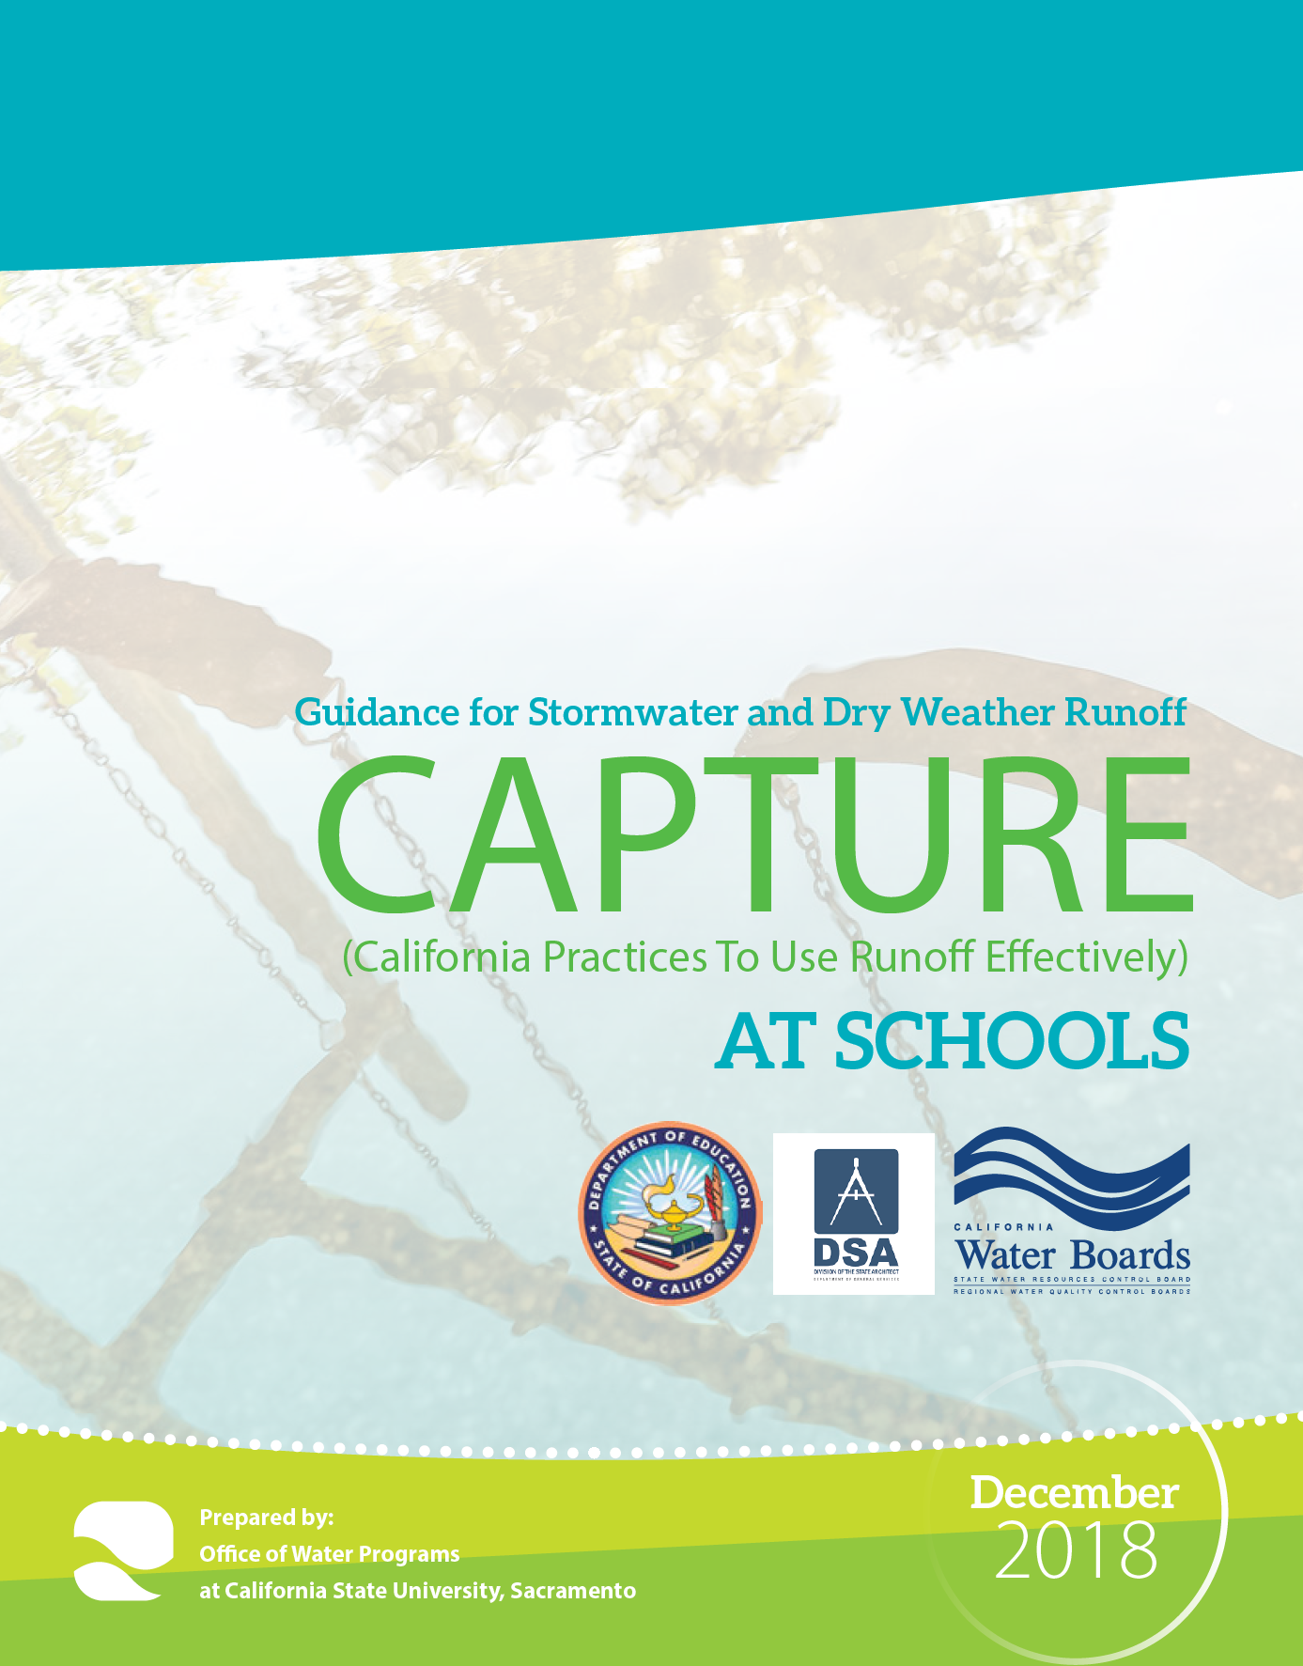
Content
https://www.waterboards.ca.gov/water_issues/programs/stormwater/storms/docs/swrcb_schools_lid_2018fnl.pdf

Slide 7

Benefits
School Benefits
  Enhanced educational opportunities
  Improved student heath and wellbeing
  Leverage funding
  Drainage improvement
Regional Benefits
  Water supply
  Water quality
  Flood control
  Environmental protection
  Community enhancement

Slide 8
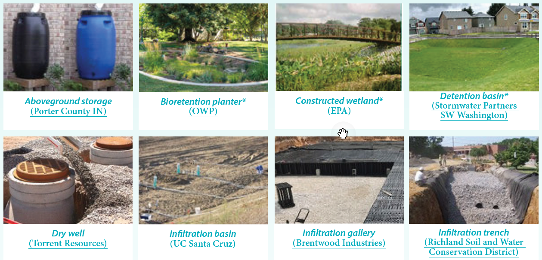
Practices
,
Notes:
Small scale
Design strategies
SCM
Additional practices: pollution prevention and source control (think beyond immediate need)
Landscape features
Site design strategies
Treatment
Capture and use
Infiltration aka Retention

Slide 9
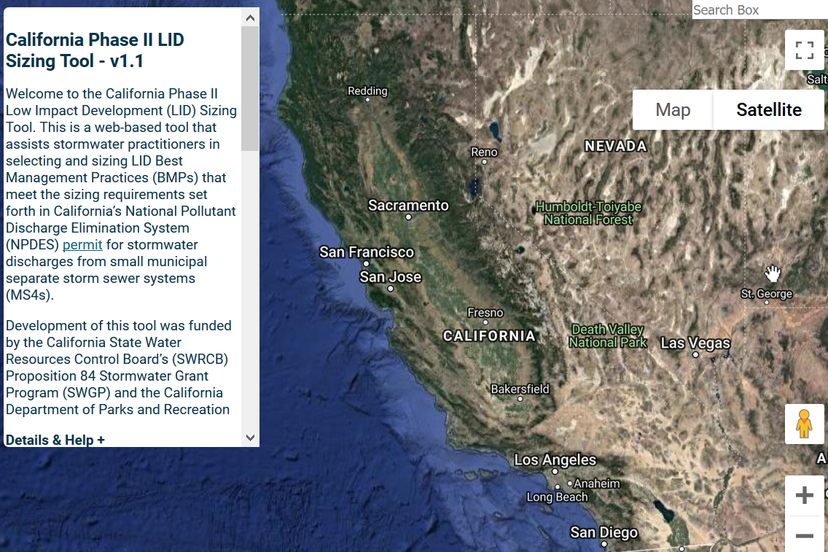
Planning and Design Tools
Steps, checklists, team development, design options
Tools: https://www.owp.csus.edu/LIDTool/Start.aspx
Notes:
Major focus: heavy use of existing resources

Slide 10
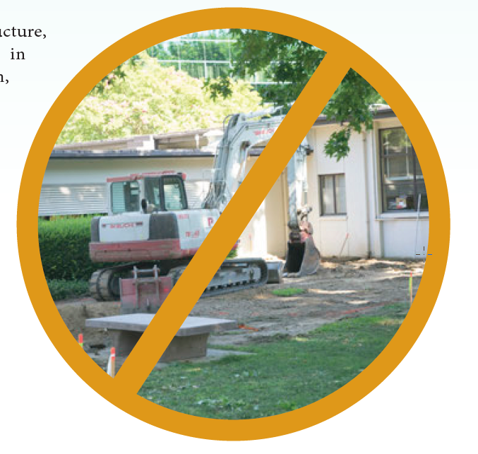
Construction Tips
Permitting
Scheduling
Nuances for SCM construction
Checklists
Notes:
Replace with report image p 50

Slide 11
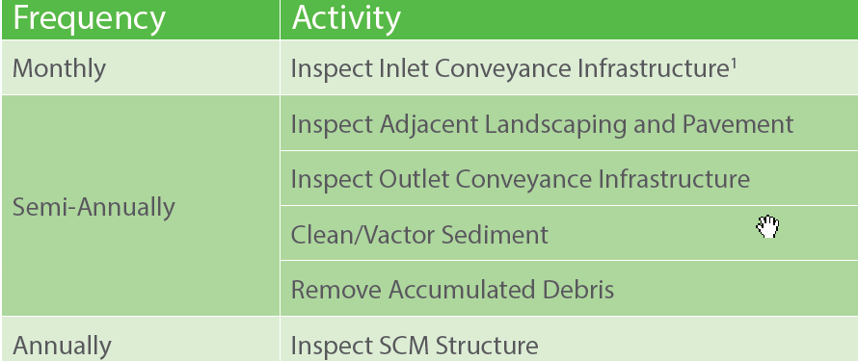
Maintenance Highlights
Requirements
Outreach to staff
O&M template
Notes:
Make it useful… template, checklists, etc.

Slide 12

Costing and Funding Tools
Capital and annual cost tradeoffs
Cost-benefit
Cost resources
Funding resources

Slide 13
Collaboration Tools
Joint use facilities
Joint programs
Joint benefits
Funding tools
Barriers
Example agreements

Slide 14
Code Constraints
Project review process and authorities
Fire safety
Pedestrian access
Hard court play areas

Slide 15
Engaging in Water Projects
Identifying needs
Addressing emerging issues
Resources

Slide 16
Identifying Need
Law
Regulations
Tools
Projects
Emerging issues
Notes:
Could also say “where to engage”
Law: be a resource. cost estimates when in draft; support proponents of law; all for one, one for all (i.e., OWP support for law that may benefit So Cal schools)
Regulations: pro/con. Barriers and Incentives. Some compel, others add requirements (e.g., fire safety).
Policy: some cities set their own goals
Tools: address difficult analysis or processes in law, regulation, or policy
Projects: planning, siting, design, inspections, operations, monitoring [don’t make a research project out of it—use the opportunity to get to know the client and identify research needs]

Slide 17
Addressing Emerging Issues : The Case of Stormwater Capture
What if capture changes downstream habitats?
What is the value of captured stormwater?
What are the better uses of captured stormwater?
What are the best water management strategies for fit-for-purpose treatment?
What science is needed for better regulation or policy (fewer barriers, more incentives)?
https://www.waterboards.ca.gov/water_issues/programs/stormwater/storms/docs/storms_capture_use.pdf (capture and use project)
Notes:
Reduce list… “and more…”

Slide 18
Resources
Legislature: https://leginfo.legislature.ca.gov/faces/billSearchClient.xhtml
California Stormwater Quality Association (CASQA); subcommittees open to all: www.casqa.org
State Water Board listserv: https://www.waterboards.ca.gov/resources/email_subscriptions/swrcb_subscribe.html
State Water Board STORMS Projects: https://www.waterboards.ca.gov/water_issues/programs/stormwater/storms/

Slide 19
www.owp.csus.edu www.efc.csus.edu
Contacts:
maureen.kerner@owp.csus.edu
erik.porse@owp.csus.edu
brian.currier@owp.csus.edu

