Slide 1
Tackling Technical and Policy Aspects of SGMA in Butte County
Christina Buck, PhD
Assistant Director
Butte County Water & Resource Conservation
WRPI Conference: April 25, 2019

Slide 2
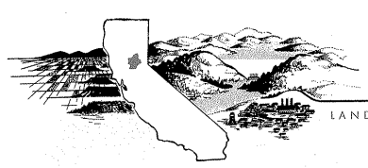
Who We Are…
Local Government:
Butte County Water and Resource Conservation
Mission: “To manage and conserve water and other resources for the citizens of Butte County”
Foundation of knowledge and science
Link land use & water resources planning
Policies to monitor and manage groundwater resources
Adapt to changing conditions

Slide 3
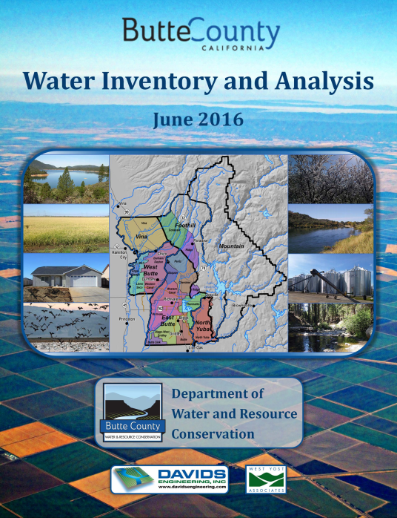
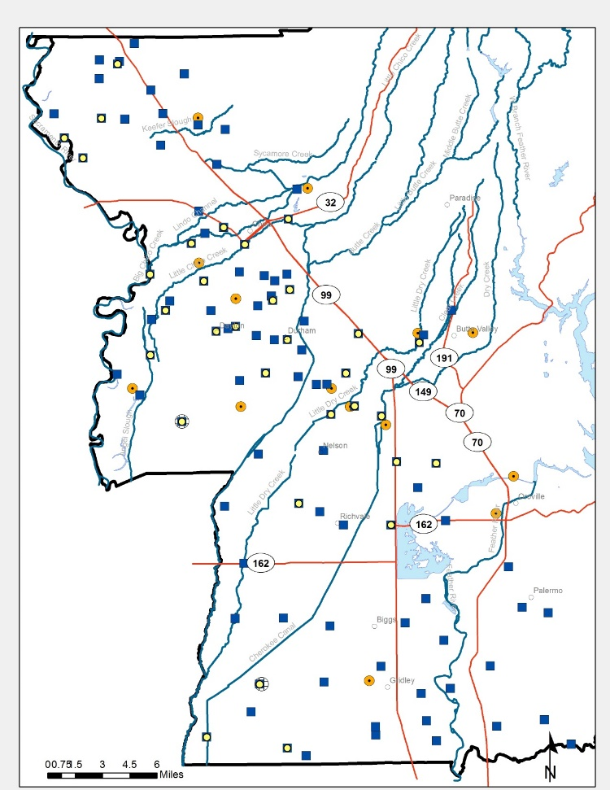
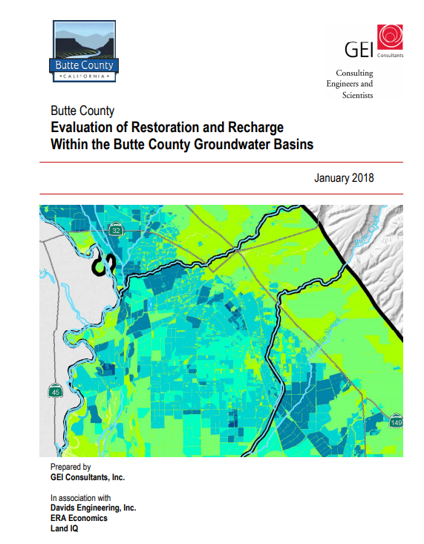
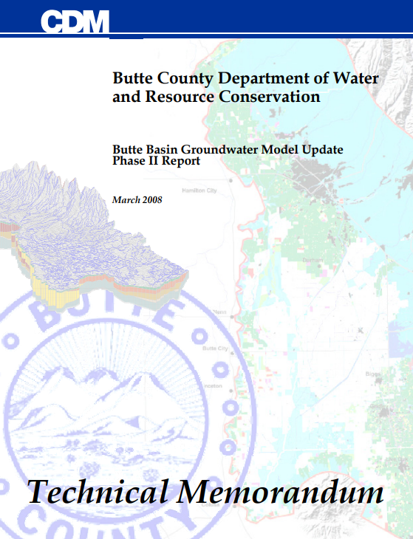
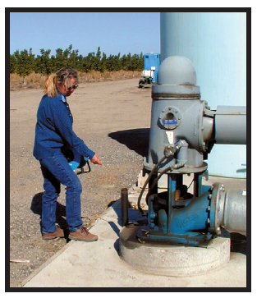
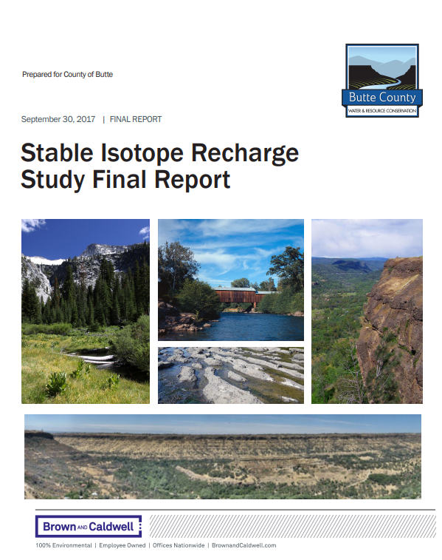
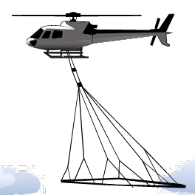
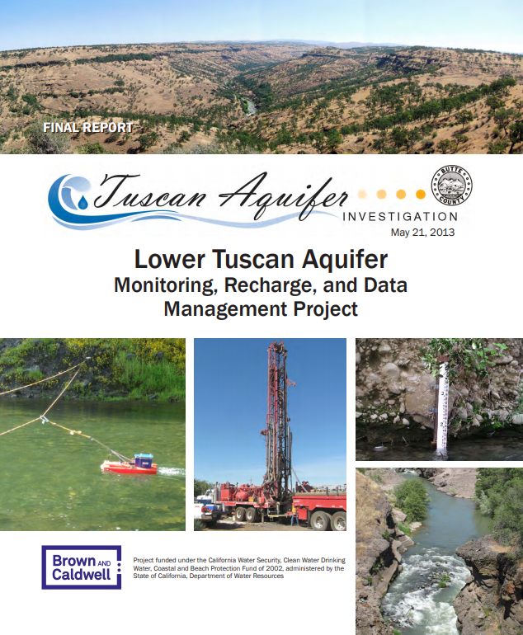
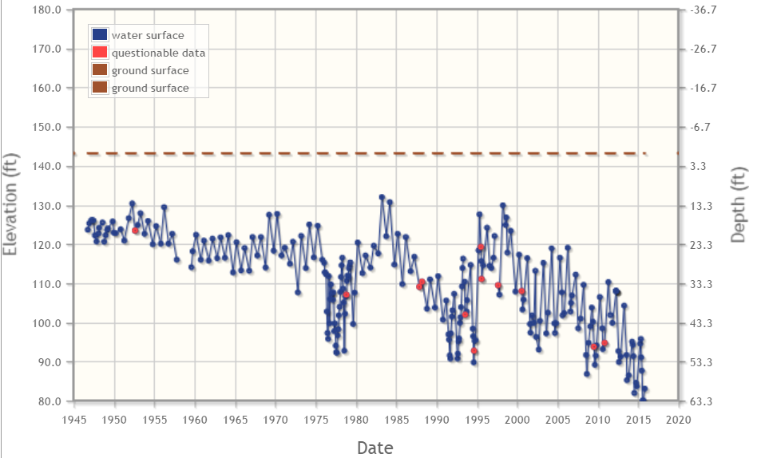
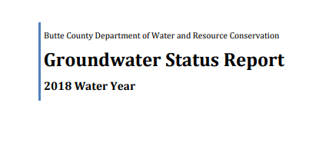
Monitoring & Special Studies
Monitoring

Slide 4
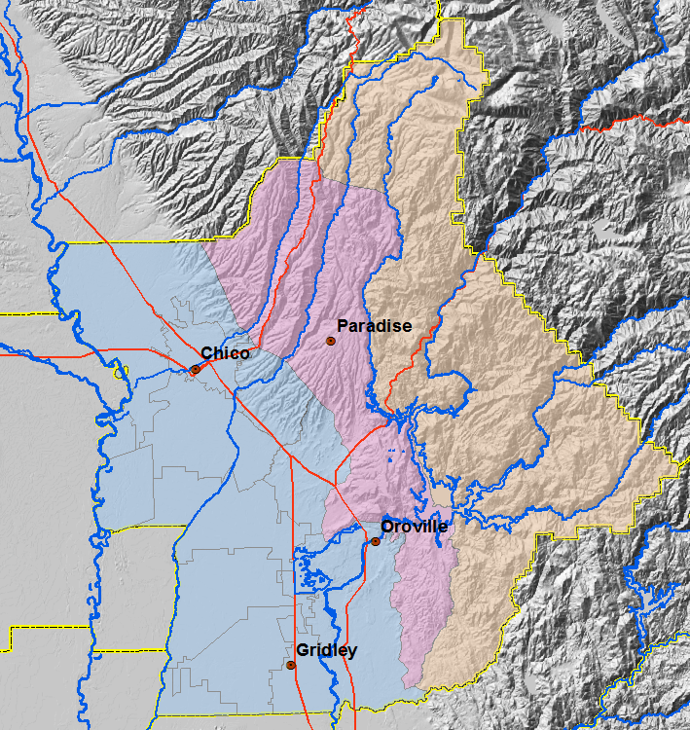
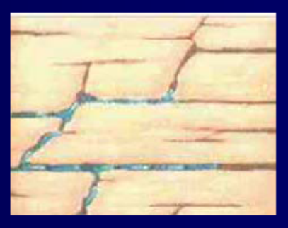
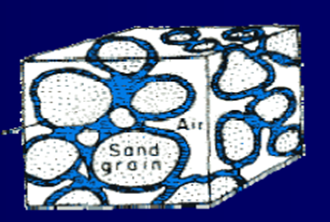
Butte County
Setting
Fractured Rock
Alluvial

Slide 5
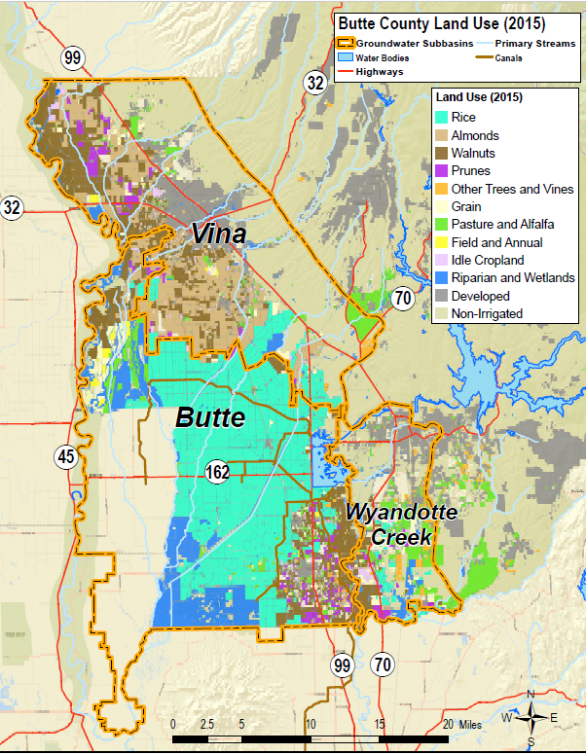
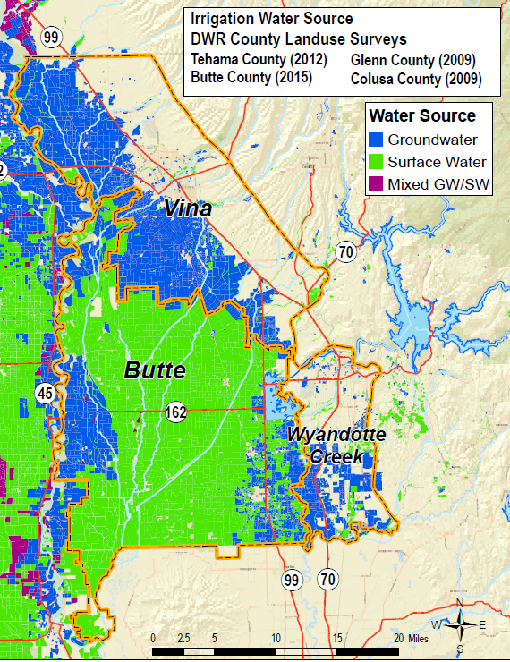
Land Use and Water Source
Notes:
Precipitation (914 TAF)
Applied Surface Water (715 TAF)
Groundwater Pumping (411 TAF)
= 2.04 MAF

Slide 6
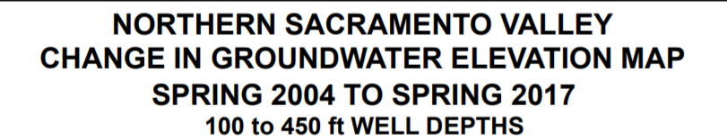
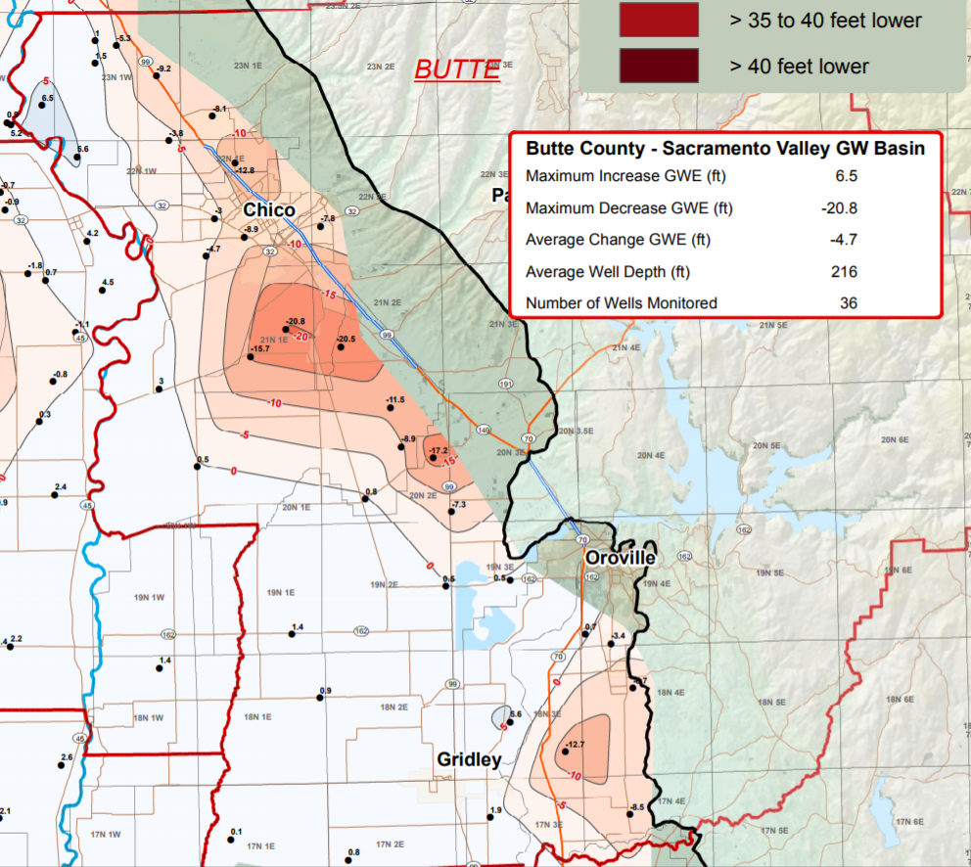
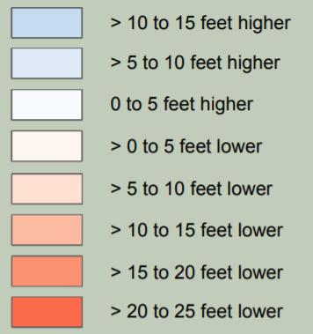
Change in Spring
Levels: 2004→ 2017
Groundwater
Conditions

Slide 7
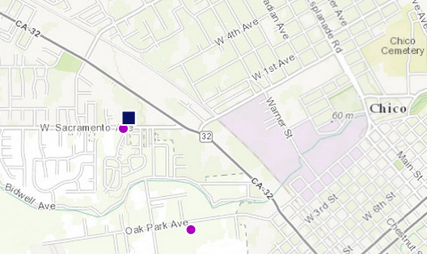
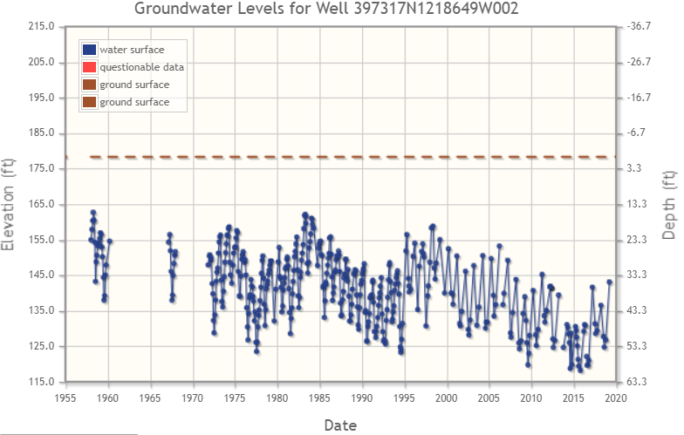
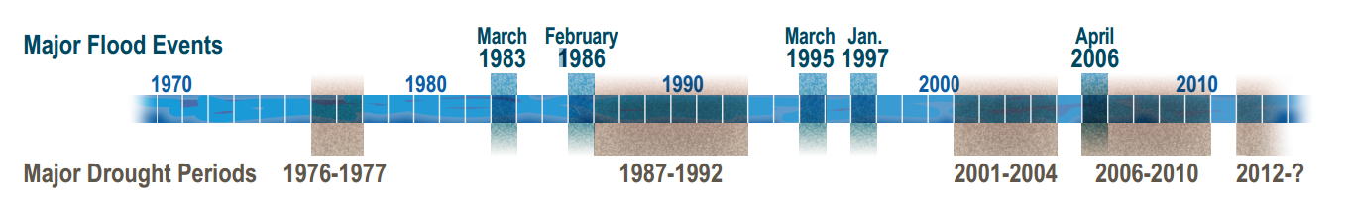
Groundwater Level Trends
7
Chico Urban Area
Intermediate depth: screened 200-279 ft.
Record begins in 1958
2013→2014~ -8 feet
2016→2017~ +12 feet
Notes:
22N01E28J003M
http://wdl.water.ca.gov/waterdatalibrary/groundwater/hydrographs/brr_hydro.cfm?CFGRIDKEY=19346

Slide 8
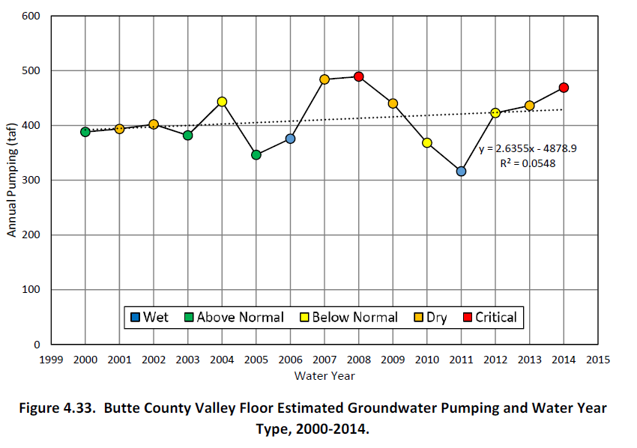
Estimated Groundwater Pumping

Slide 9




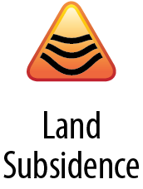
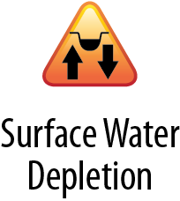
Then along came SGMA...
SGMA= Sustainable Groundwater Management Act
CA Legislation passed in 2014.
Overarching Concepts:
Local Management → “Groundwater Sustainability Agencies”
Groundwater Sustainability Plans
  Water Budget
  Thresholds and defined “Undesirable Results”
  Sustainability in 20 years
State Technical Support and Regulatory Standards
State Oversight/Intervention
Notes:
2014 SGMA legislation
2017 Establish Groundwater Sustainability Agencies
2022 Submit Groundwater Sustainability Plan(s)
2022-2042 Implementation
Annual Repots and 5-Year Plan Updates
Projects and actions to achieve “sustainability”

Slide 10
Butte County
Subbasins & GSAs
Vina
  Vina GSA
  Rock Creek Reclamation District
Wyandotte Creek
  Wyandotte Creek GSA
Butte
  ELEVEN GSAs (Water Districts, Reclamation Districts, Cities, and Counties)

Slide 11
Basin Setting Project- Technical Foundation
Groundwater Sustainability Plan (GSP)
1. Administrative Information
2. Basin Setting
  Hydrogeologic Conceptual Model
  Groundwater Conditions
  Water Budget
  Management Areas
3. Sustainable Management Criteria
  Sustainability Goal
  Undesirable Results
  Minimum Thresholds
  Measurable Objectives
4. Monitoring Networks
  Monitoring Network
  Representative Monitoring
  Assessment & Improvement
  Reporting Monitoring Data
5. Projects and Management Actions
ONE project for
All THREE Subbasins

Slide 12
Butte Basin Groundwater Model
Chosen to support Basin Setting GSP development
Integrated GW-SW Model:
  IWFM-2015 code
1970-2018, daily
1,265 square miles
7,200+ Individual elements 15-670 acres (Avg. 112 acres)
Boundaries:
  Deer Creek,
  Sacramento River,
  North side of Sutter Buttes/Yuba River
  Eastern foothills

Slide 13
Interconnected Subbasins
Sacramento Groundwater Basin
Early coordination on a regional level
Integrated Regional Water Management (IRWM) group
County staff relationships
Notes:
SGMA leaves assessment of interbasin interaction to DWR during GSP review
As a region→ better to start with common understanding of basin flows and consistent assumptions
Northern Sacramento Valley Integrated Regional Water Management Plan (NSV IRWMP)
Board
Technical advisory committee

Slide 14
Closing Thoughts
Opportunities
Creative options for utilizing “new” surface water supplies locally
Existing regional relationships
Unifying desire to protect water resources for local agricultural economy, communities, and environment
Challenges
Still setting up governance structures in all three subbasins
Characterizing stream depletion with limited data
Modeling challenge: Relatively small GWL change and shallow groundwater conditions makes needed margin of error small
Others...

Slide 15
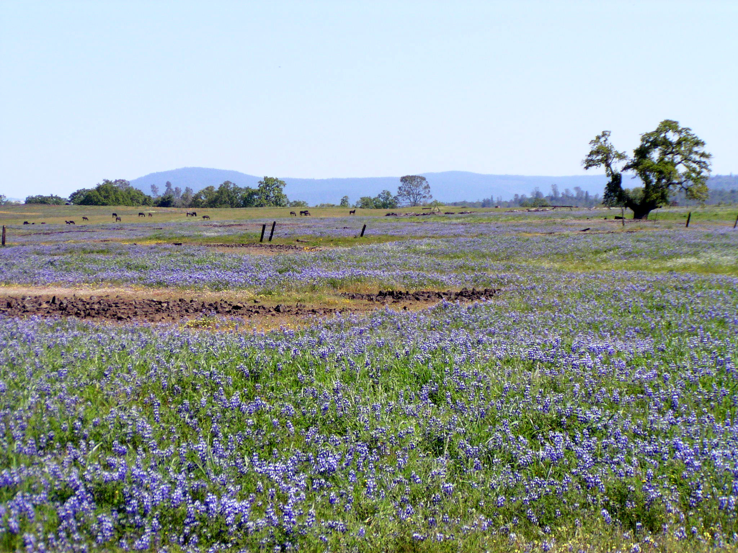
Thank you!
Contact:
Christina Buck
cbuck@buttecounty.net
Notes:
http://cdec.water.ca.gov/reportapp/javareports?name=PLOT_ESI.pdf

Slide 16
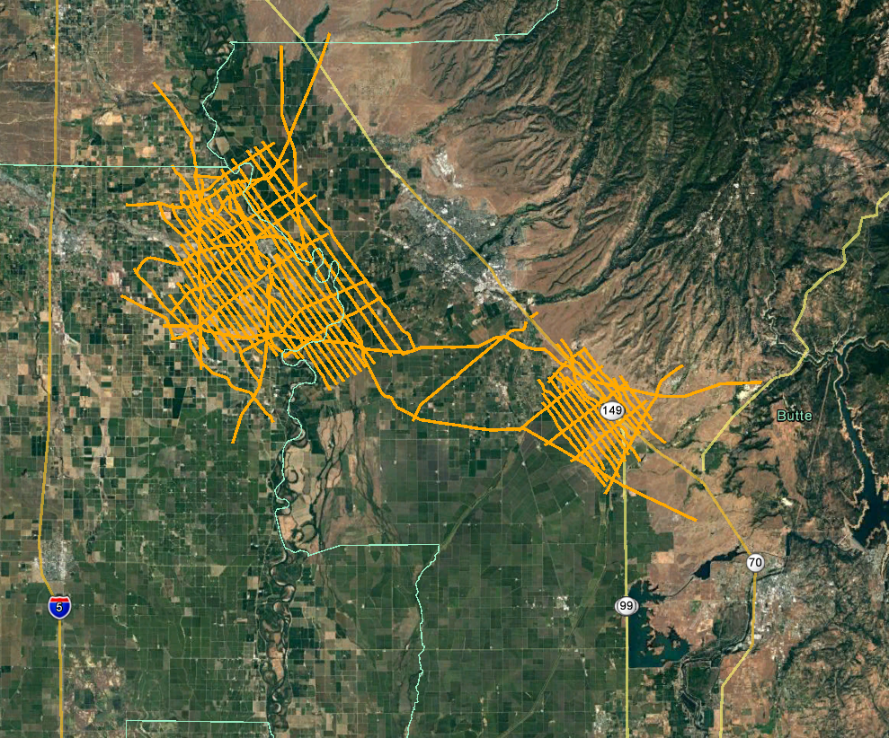
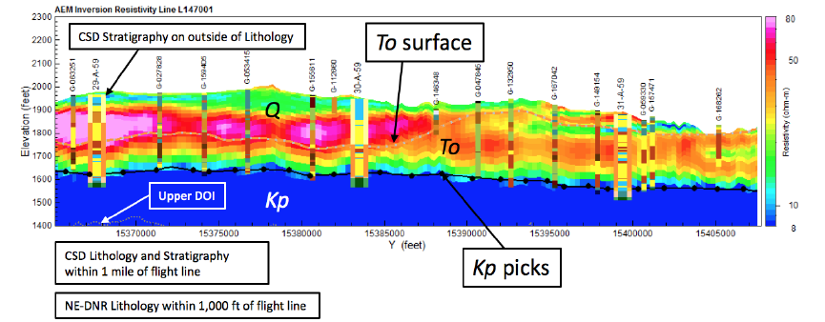
Innovative Technology and Partnerships
Airborne Electromagnetic (AEM) Survey
Figure 5-4. from work done in Nebraska

Slide 17
Back up slides…

Slide 18
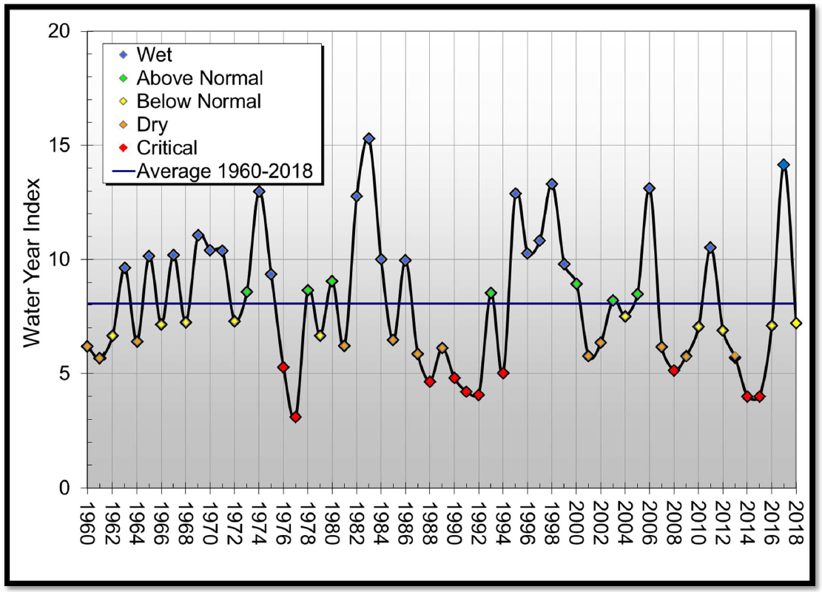
Sacramento Valley Water Year Type
WY 2018
Below Normal
Notes:
From WIA 2016 Report

Slide 19
Butte Basin Groundwater Model
Integrated GW-SW Model:
  IWFM-2015 code
1970-2018, daily
1,265 square miles
7,200+ Individual elements 15-670 acres (Avg. 112 acres)
Boundaries:
  Deer Creek,
  Sacramento River,
  North side of Sutter Buttes/Yuba River
  Eastern foothills

Slide 20
Understanding the Basin
Ongoing monitoring of groundwater levels tracks the effects of hydrologic variability and groundwater use
Research and modeling helps understand and explore the drivers (hydrology, demands, geology, basin dynamics, management alternatives, etc.)
  Inventory and Analysis Report, 2001
  Watershed Modeling (WEHY model), 2010
  Lower Tuscan Aquifer Investigation, 2010-2013
  Butte Basin Groundwater Model, 2008 update
  2016 Water Inventory and Analysis
  Stable Isotope Recharge study

Slide 21
A quick word on Depletions of Interconnected Surface Water
Potential to pose operational constraints and require Projects and/or Management Actions:
  Chronic Lowering of Groundwater Levels (#1)
  Depletions of Interconnected Surface Water (#6)
Also closely tied to dynamics of groundwater level changes and declines

Slide 22
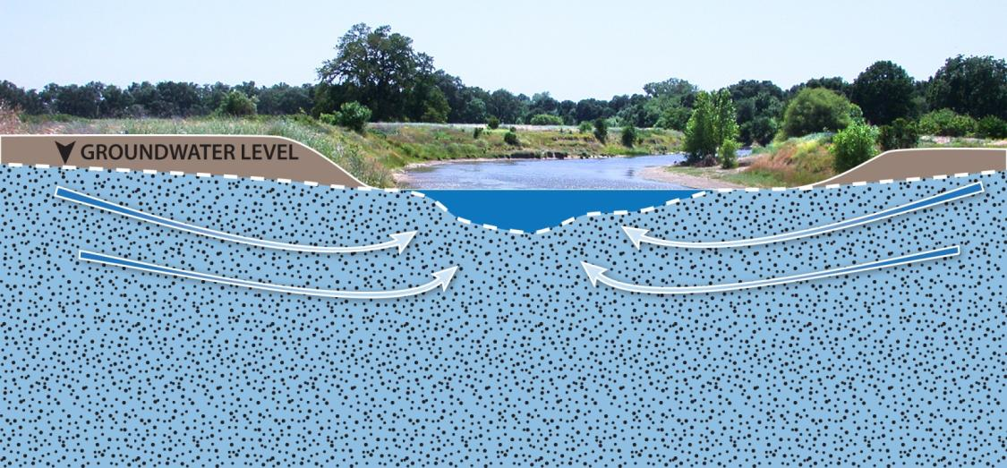
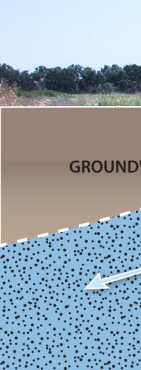
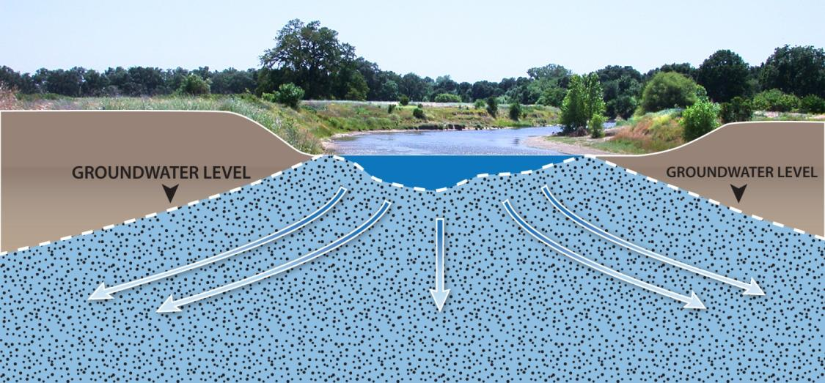

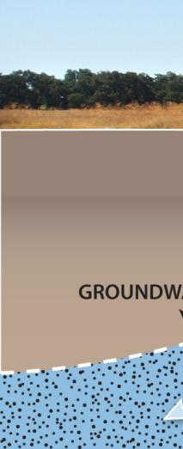
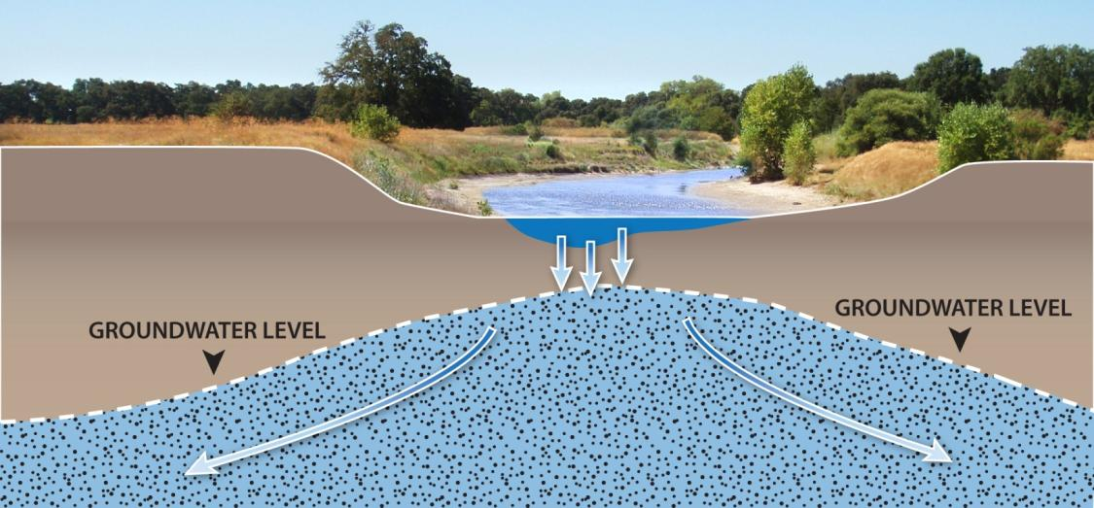
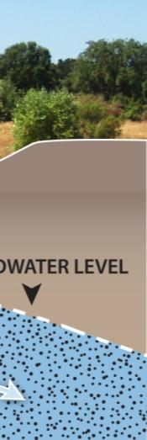





Depletions of Interconnected Surface Water
Interaction depends on relative groundwater levels and properties of streambed and aquifer
The uppermost groundwater sustains Groundwater Dependent Ecosystems, and river and stream flows
Source: The Nature Conservancy

Slide 23
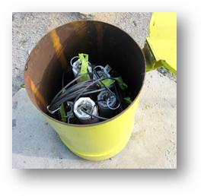
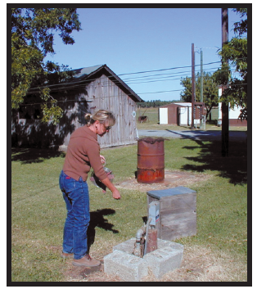
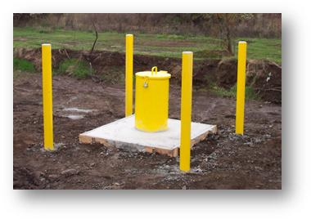
Wells are a window...
Groundwater Level Monitoring & Change Maps

Slide 24
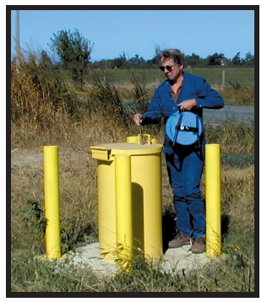
Domestic
well
Multi-completion well
Irrigation
well

Slide 25
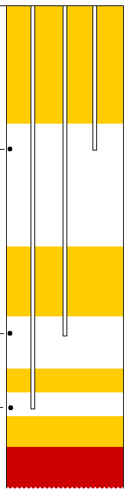
Multi-completion well
Shallow
Intermediate
Deep
Cement grout

Slide 26
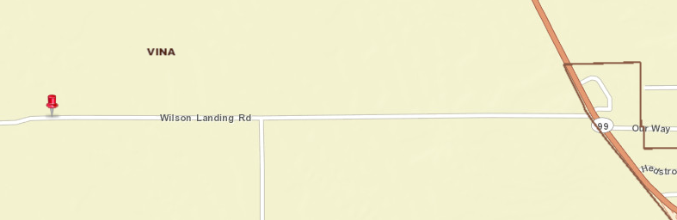
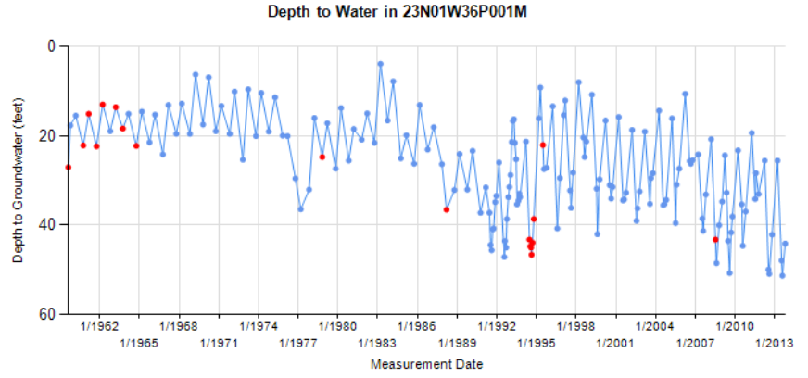
Groundwater Level Trends
Vina: Domestic
Shallow (<200 ft. total depth) Basin Deposits aquifer system.
Record begins in 1959

Slide 27
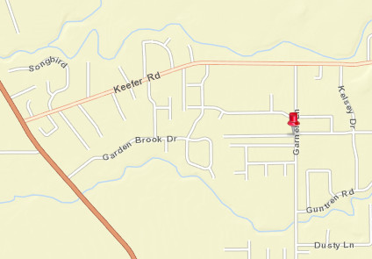
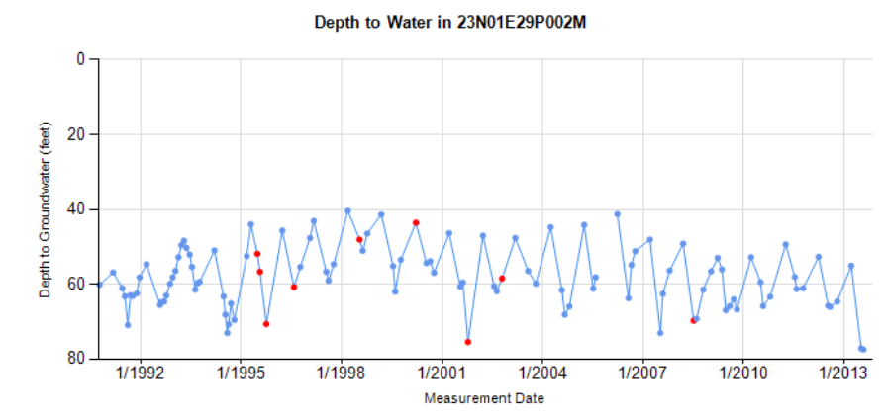
Groundwater Level Trends
Vina: Domestic, Shallow/Intermediate depth Upper Tuscan Formation
Record begins in 1990

Slide 28
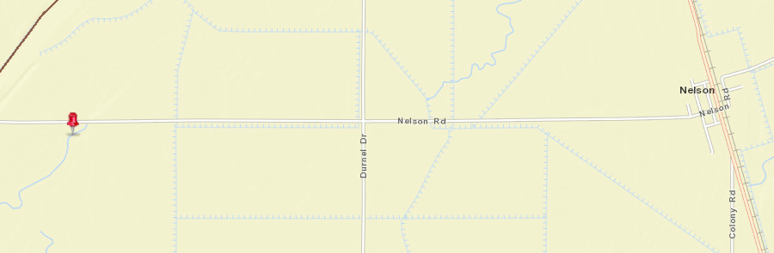
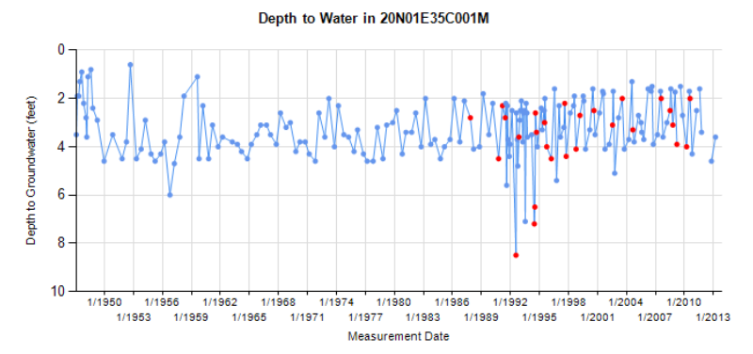
Groundwater Level Trends
Western Canal: Domestic Shallow well depth
Alluvial aquifer system
Record begins in 1947

