Slide 1

Agriculture in Baden-Württemberg:
A brief overview
Symposium at CSU-WATER, Fresno, California
26th of September 2024
Christian Sponagel, Dr.
Research associate
Institute of Farm Management, University of Hohenheim, Germany

Slide 2
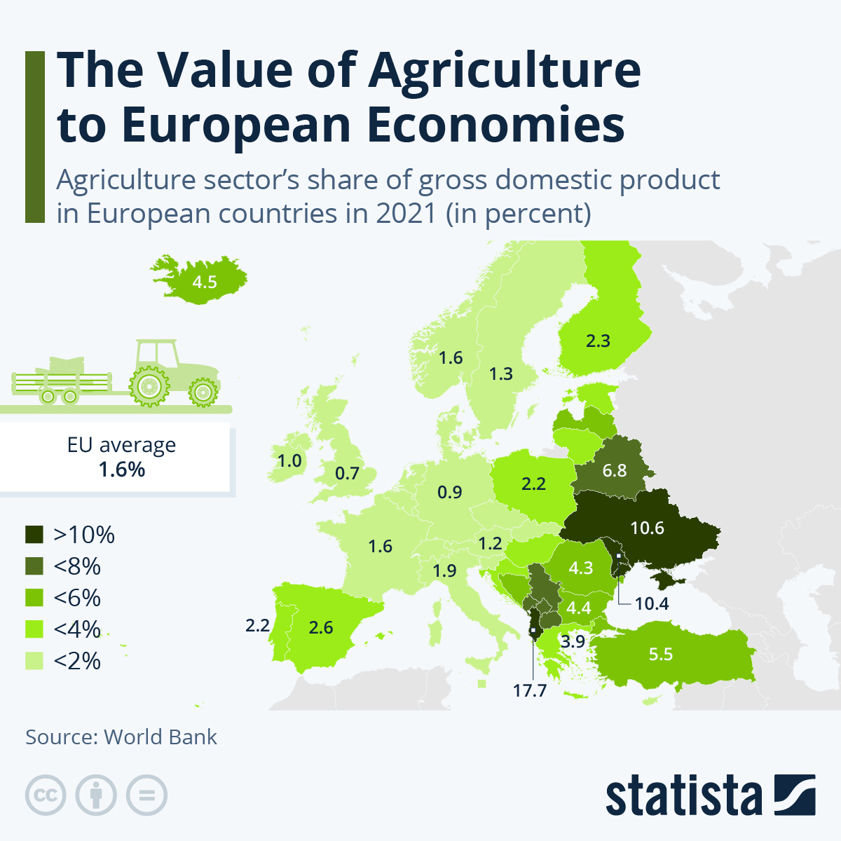
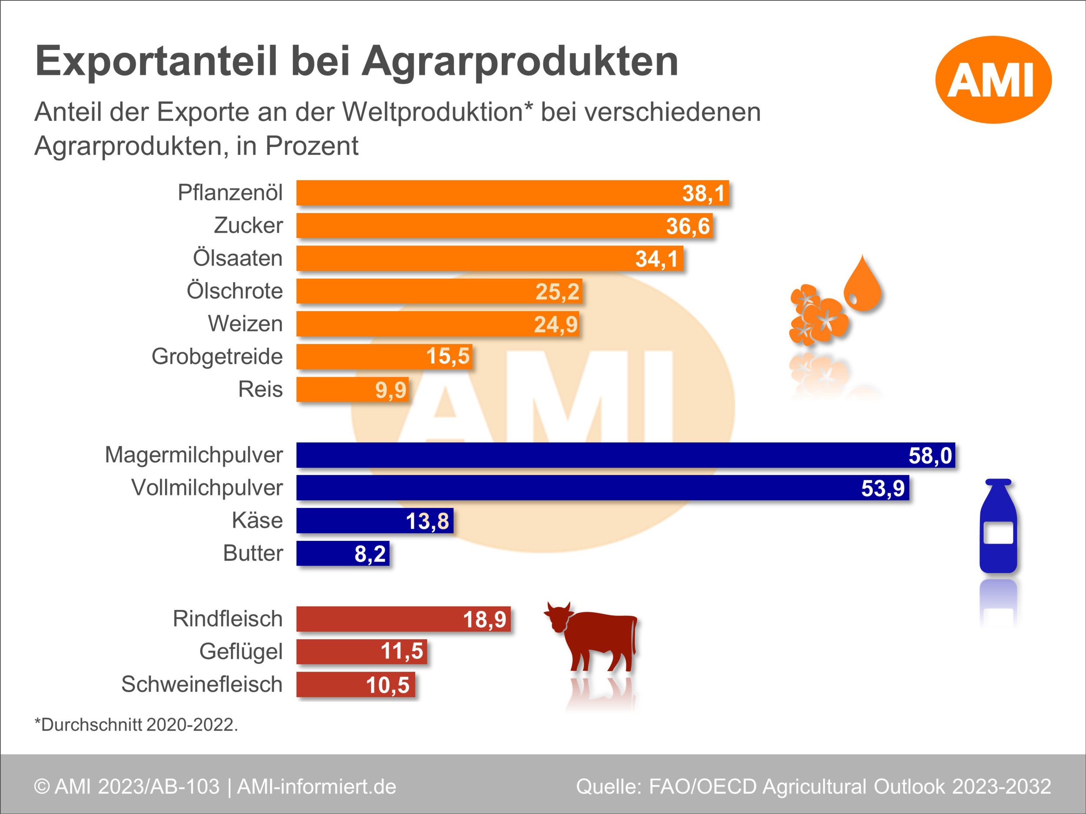
Agriculture in Germany in the EUs context
Armstrong, M. (July 26, 2023). The Value of Agriculture to European Economies [Digital image]. Retrieved September 20, 2024, from https://www.statista.com/chart/30483/agriculture-sector-as-share-of-gdp-in-european-countries/
https://www.situationsbericht.de/7/72-agraraußenhandel
Notes:
11.4 mio. inhabitants

Slide 3
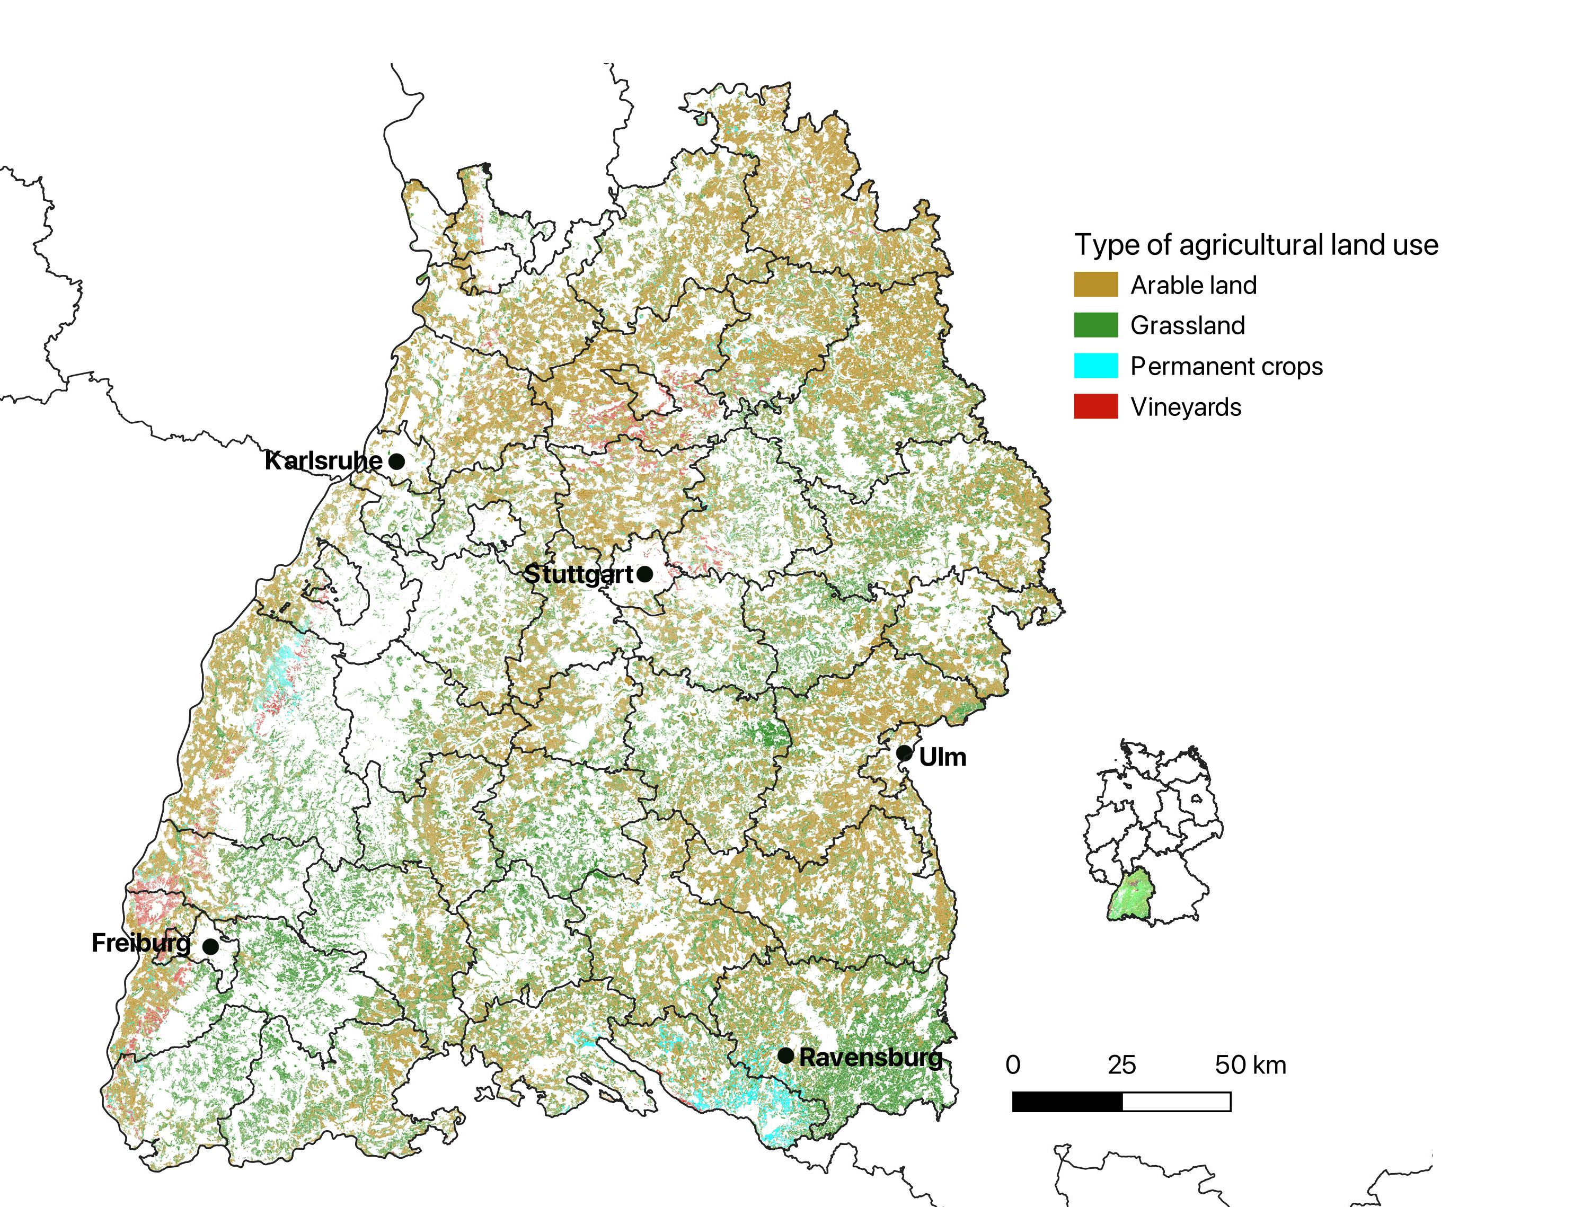
Agricultural land use in Baden-Württemberg
ca. 1.4 mio. ha of utilized agricultural area
ca. 0.8 mio. ha of arable land, i.e. 57% (in Germany it is about 70%)
ca. 0.5 mio. ha of grassland, i.e. 39%
ca. 0.05 mio. ha permanent crops, i.e. 4%
ca. 14% of utilized agricultural area under organic management
ca. 10% of arable land under organic management
Own representation after the data of the Integrated Administration and Control System 2021
Statistisches Landesamt Baden-Württemberg (2024);
Statistische Ämter des Bundes und der Länder (2024)
Notes:
11.4 mio. inhabitants

Slide 4
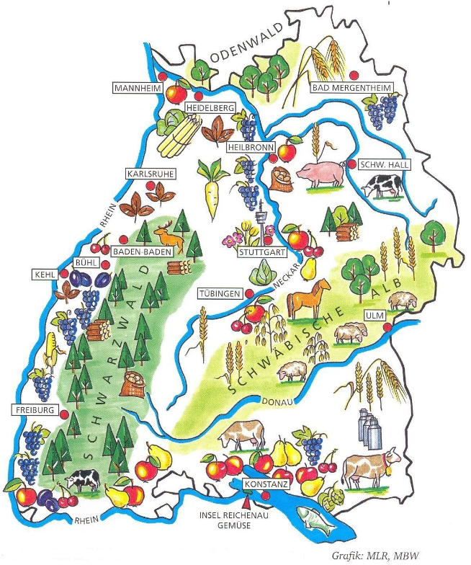
Agricultural land use in Baden-Württemberg
ca. 1.4 mio. ha of utilized agricultural area
ca. 0.8 mio. ha of arable land, i.e. 57% (in Germany it is about 70%)
ca. 0.5 mio. ha of grassland, i.e. 39%
ca. 0.05 mio. ha permanent crops, i.e. 4%
ca. 14% of utilized agricultural area under organic management
ca. 10% of arable land under organic management
Statistisches Landesamt Baden-Württemberg (2024);
Statistische Ämter des Bundes und der Länder (2024)
https://lr.landwirtschaft-bw.de/,Lde/3650826_3651462_5405915_5378885_5378888 (09/20/24)
Notes:
11.4 mio. inhabitants

Slide 5
Agricultural land use and crop yields
Field crop | Share of arable land 2021* | Average yield in dt per ha 2023**
Winter cereals | 43% | 73 (winter wheat)
Summer cereals | 9% | 49 (summer barley)
Grain legumes | 2% | No data
Maize | 24% | 97 (grain maize)
Rape seed | 5% | 41
Potato | 1% | 300
Sugar beet | 2% | 660
Clover grass | 7% | 60
Other | 7% | -
*Own representation after the data of the Integrated Administration and Control System 2021
**Statistisches Landesamt Baden-Württemberg (2024)
Notes:
11.4 mio. inhabitants

Slide 6
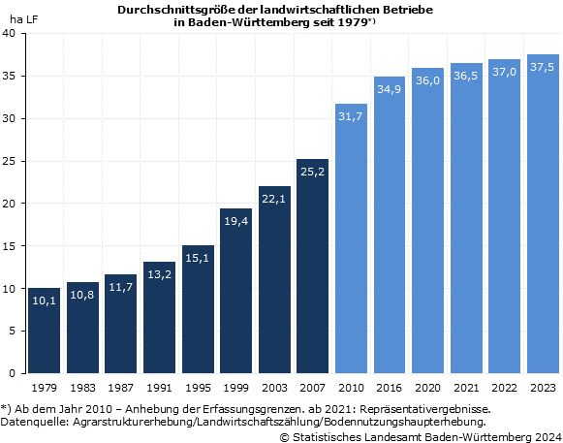
Average farm size in Baden-Württemberg
ca. 263,000 farms in Germany
About 39,000 farms in Baden-Württemberg (ca. 15%)
Farm size in BW is below national average of about 63 ha (Brandenburg in eastern Germany ca. 240 ha)
Statistisches Landesamt Baden-Württemberg (2024);
Statistische Ämter des Bundes und der Länder (2024)

Slide 7
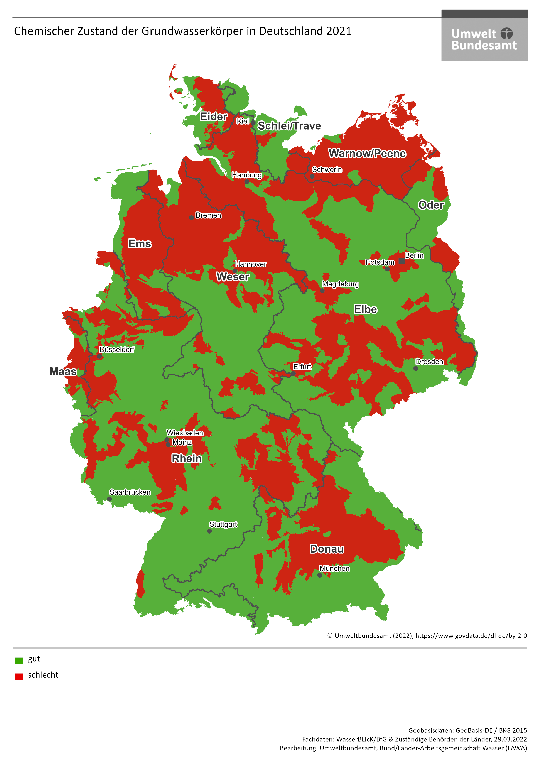
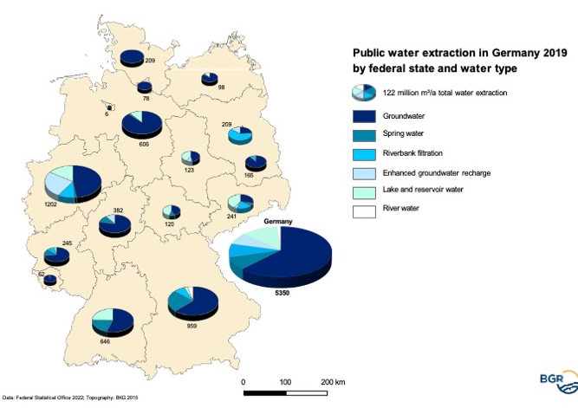
Public water supply in Germany
https://www.deutsche-rohstoffagentur.de/EN/Themen/Wasser/Produkte/Downloads/abb_oeff-wversorg_karte_pdf_en.pdf?__blob=publicationFile&v=4
https://www.umweltbundesamt.de/themen/wasser/grundwasser/zustand-des-grundwassers/chemischer-zustand-des-grundwassers
Notes:
More than 60% of drinking water from groundwater
33% of groundwater bodies are not in a good condition
11,400 protected areas for groundwater extraction

Slide 8
Legal framework conditions for
water protection
EU-Level
Germany
EU Water Framework Directive
Objective: Prevent degradation of the status of water bodies & achieve good chemical/quantitative status of groundwater
Federal Water Act
Surface Water Ordinance
Groundwater Ordinance
EU Nitrates Directive
Objective: Minimise nitrogen inputs from agricultural sources into ground and surface waters to sustainably improve water quality
Fertilizer Act
Objective: Ensuring crop nutrition & maintaining soil fertility & preventing risks to humans/animals/environment & sustainable use of nutrients and avoiding losses to the environment
Fertilizer Ordinance
Objective: Regulates good professional practice & reduction of material risks when using fertilisers
German Substance Flow Balance Ordinance
Objective: Regulation of the operational material flow balance to be prepared
8
Notes:
More than 60% of drinking water from groundwater
33% of groundwater bodies are not in a good condition
11,400 protected areas for groundwater extraction

Slide 9
Common Agricultural Policy (CAP)
First and second pillar of the CAP include measures to support groundwater quality
  Conditionality in the first pillar: GAEC (good agricultural and environmental condition), e. g. buffer zones along water bodies, prevention of erosion, minimum soil cover)
  Agri-environmental measures in the second pillar of the CAP are state-specific, for instance precision farming, strip-till management in BW
9
Notes:
100 Euro per hectare for strip tillage, e. g.

Slide 10
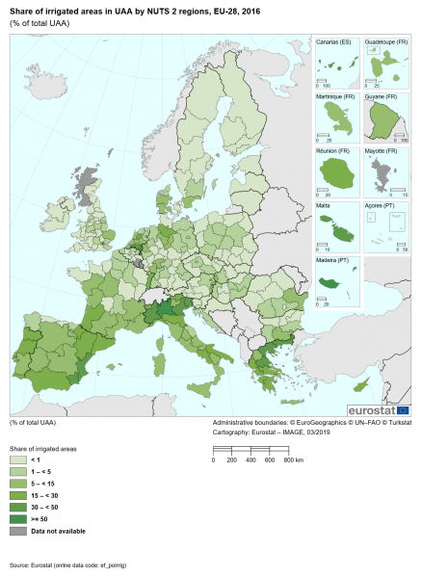
Irrigation in Europe
https://ec.europa.eu/eurostat/statistics-explained/images/4/49/Map2_Share_of_irrigated_areas_EU-28_2016.png
Notes:
ca. 10% of UAA can be used for irrigation in EU-27; 6% of UAA is irrigated; in Germany it is about 3,3% of UAA in 2022 and about 5% of UAA are ready for irrigation

