Slide 1

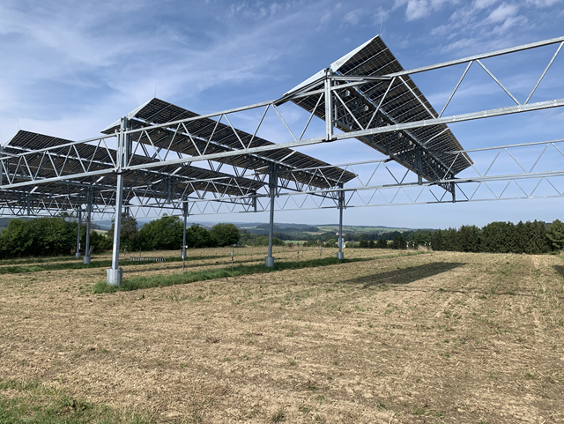
Economic Modelling
of Agrivoltaics Expansion and
Climate Mitigation Impact
Symposium at CSU-WATER, Fresno, California
26th of September 2024
Christian Sponagel, Dr.
Research associate
Institute of Farm Management, University of Hohenheim, Germany

Slide 2
Transition to carbon neutral energy supply
Climate change mitigation and independency from fossil resources as major political objectives in the European Union (European Commission 2019)
Climate neutrality in the EU by 2050 according to the objectives of the European Commission (2020)
In Germany largest share of greenhouse gas emissions from the energy sector (UM 2022)
Renewable energies have to be expanded: in particular photovoltaics as well as wind energy (Irena 2018)
Notes:
11.4 mio. inhabitants

Slide 3
Conflicts with ground-mounted photovoltaics
Land consumption is not in line with other sustainability goals (Die Bundesregierung 2021; Schindele 2021)
Land use conflicts with agriculture (Wirth 2021)
Agrivoltaics (AV) as one solution to overcome conflicts of interests (Schindele 2021)
Not really established in Germany (Wirth 2021, Schindele 2021)
But AV is politically desired in Germany (Koalitionsvertrag zwischen SPD, FDP und Grüne 2021)
Notes:
11.4 mio. inhabitants

Slide 4
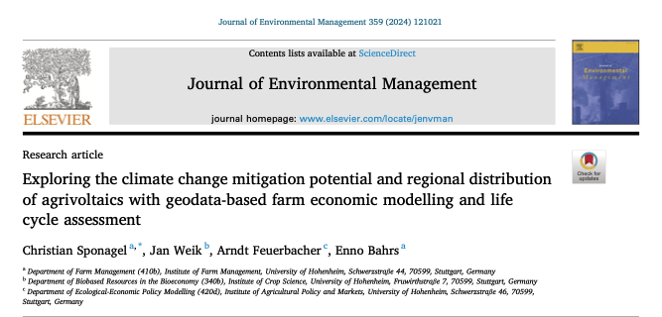
Modelling of GHG emission impacts of AV
We analysed impacts of Agrivoltaics (AV) on regional greenhouse gas (GHG) emissions at the example of the German state Baden-Württemberg using the geodata based land use model PALUD
Spatial placement was optimised from the perspective of agricultural and landscape quality assuming general rentability of electricity production by AV
Notes:
11.4 mio. inhabitants

Slide 5
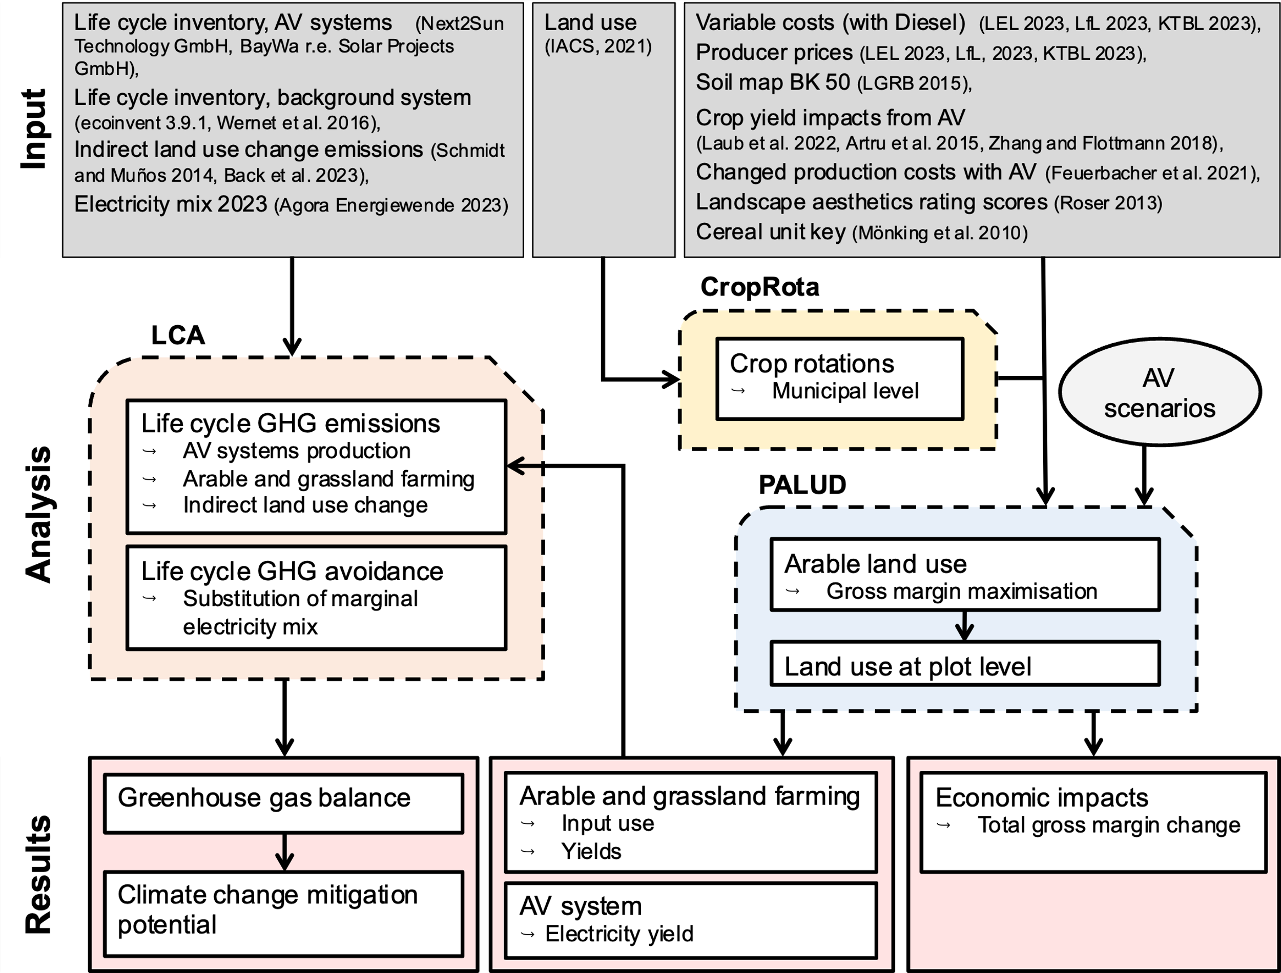
Overview of the integrated land use model
PALUD is a geodata-based economic land use model
It is based on Linear Programing
In the target equation, it maximizes the total gross margin from agricultural land use across Baden-Württemberg
Notes:
11.4 mio. inhabitants

Slide 6
Assumed crop yield impacts in AV systems
Crop | Relative crop yield in the AV system (reference = 100)
 | 2P-Tracker (25.4% shading) | Bifacial vertical (15% shading)
Clover grass¹ | 101.9 | -
Maize¹ | 65 | -
C3-Cereals¹ | 78.9 | -
Grain legumes¹ | 69.5 | -
Rape seed³ | 80 | -
Potato¹ | 78.1 | -
Sugar beets² | 70 | -
Vegetables¹ | 96.8 | -
Strawberries⁴ | 115.7 | -
Grassland¹ | - | 103.7
¹Laub et al. (2022), for strawberries the value for berries was considered.
²Artru et al. (2018)
³Zhang und Flottmann (2018)
⁴For strawberries the value for berries was taken from Laub et al. (2022), which is in line with Tang et al. (2020) who found ca. 17% higher yields for strawberries grown in a greenhouse where 25.9% of the roof was covered with PV modules.
Notes:
11.4 mio. inhabitants

Slide 7
Scenarios for AV expansion in BW
Three expansion scenarios were defined within expert workshops
AV on 1, 3 or 5% of agricultural land
In addition, landscape quality was considered as restriction
In all scenarios we considered legal and technical constraints, e. g. nature conservation areas or plot slope
Notes:
11.4 mio. inhabitants

Slide 8
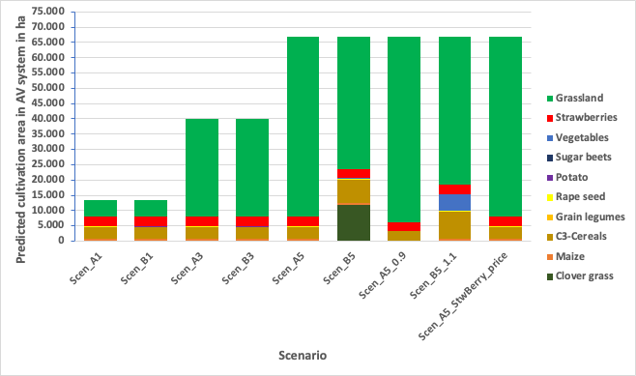
Results: Placement of AV systems
In Scenario 1 about 60% of AV systems are installed on arable land
Strawberries and cereals are the most dominant crops grown in AV systems on arable land
Further expansion takes only place on grassland
Notes:
11.4 mio. inhabitants

Slide 9
Economic and GHG emission impacts
Parameter | Unit |  |  | Changes in relation to reference scenario Scen_0 in
 |  |  | Scen_0 |  | Scen_A1 | Scen_A3 |  | Scen_A5 | Scen_A5_0.9 |  | Scen_A5_1.1 | Scen_A5_ StwBerry_price |  | Scen_B1 | Scen_B3 | Scen_B5
Marginal GM change per ha of AV | € |  | - |  | -35 | -37 |  | -39 | -76 |  | 20 | -39 |  | -38 | -59 | -150
Gross margin | Mio. € |  | 845.85 |  | 1.19% | 1.08% |  | 0.95% | -0.38% |  | 2.57% | 0.41% |  | 1.15% | 0.99% | -0.50%
Agricultural production
Food production | 1,000 GE |  | 94,415 |  | -0.13% | -0.15% |  | -0.18% | -0.26% |  | -0.01% | -0.18% |  | -0.13% | -0.18% | -0.40%
GHG emissions in agricultural sector
Nitrous oxide emissions (direct- and indirect) |  | 1,000 t CO₂ eq. | 1,015 |  | -0.14% | -0.20% | -0.27% |  | -0.44% | -0.05% |  | -0.26% |  | -0.14% | -0.25% | -0.49%
GHG emissions supply chain | 1,000 t CO₂ eq. |  | 1,319 |  | -0.13% | -0.19% |  | -0.24% | -0.35% |  | -0.16% | -0.24% |  | -0.13% | -0.23% | -0.43%
Energy supply | 1,000 t CO₂ eq. |  | 0.00 |  | -1,334 | -3,808 |  | -6,289 | -6,263 |  | -6,328 | -6,289 |  | -1,333 | -3,797 | -6,439
AV construction | 1,000 t CO₂ eq. |  | 0.00 |  | 117 | 349 |  | 580 | 580 |  | 582 | 580 |  | 117 | 349 | 583
iLUC | 1,000 t CO₂ eq. |  | 0.00 |  | 3.4 | 4.0 |  | 4.8 | 6.8 |  | 2.0 | 3.4 |  | 3.5 | 4.8 | 10.4
Total GHG emissions | 1,000 t CO₂ eq. |  | 2,334 |  | 1,117 | -1,126 |  | -3,375 | -3,352 |  | -3,413 | -3,377 |  | 1,119 | -1,115 | -3,522
 | % |  | - |  | -52% | -148% |  | -245% | -244% |  | -246% | -245% |  | -52% | -148% | -251%
Notes:
11.4 mio. inhabitants

Slide 10
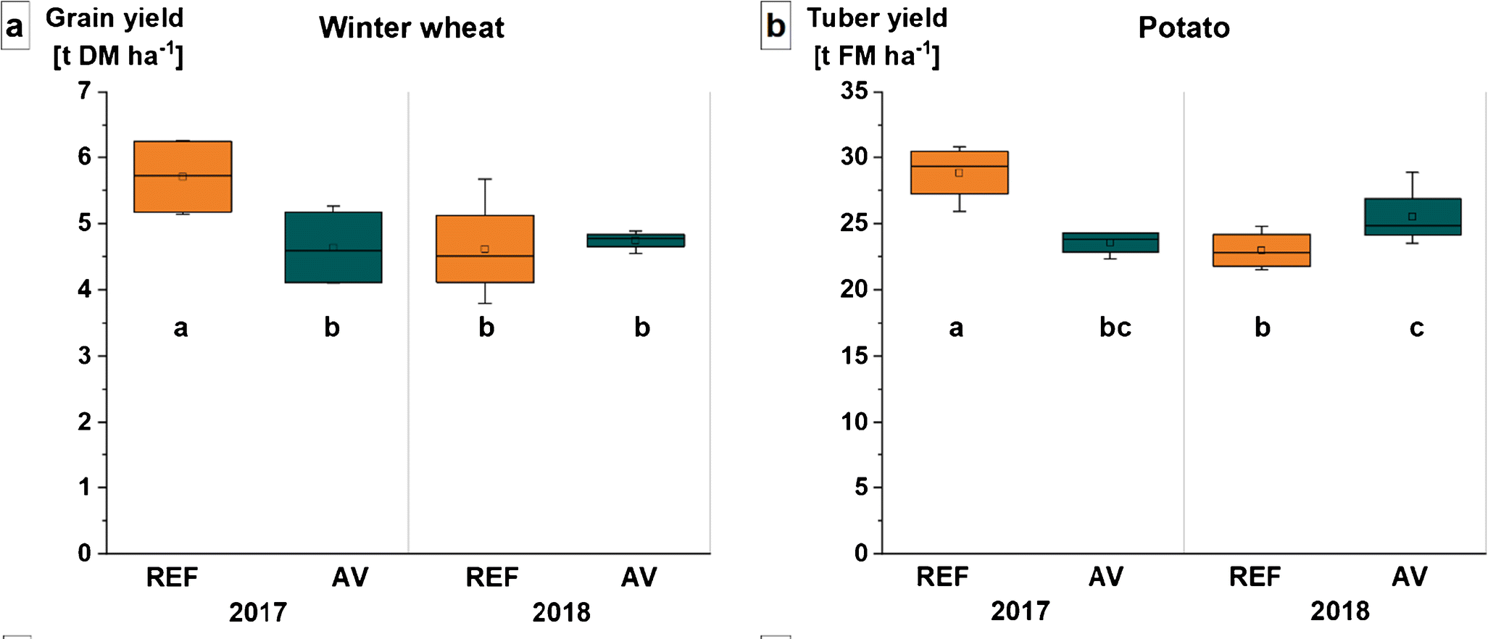
Discussion and outlook
Discussion
AV installed on 5% of Baden-Württemberg's agricultural land can reduce up to 5.5 Mt CO₂-eq
This refers to approx. ca. 9% of energy-related GHG emissions in Baden-Württemberg
AV systems were mostly implemented on grassland
From an agricultural perspective, AV can be a cost-effective GHG mitigation measure (abatement cost were most below 2 EUR per t CO2-eq.)
Research Needs
We included constant crop yield impacts due to shading in AV systems: positive impacts under drought and heat stress and contribution to resilience of cropping systems (Weselek et al. 2021)?
Transfer of the model approach to areas with different agronomic and environmental conditions?
Potential benefits with other environmental goals such as pesticide reduction?
Weselek et al. 2021
Notes:
11.4 mio. inhabitants

Slide 11
References
Artru, S., Lassois, L., Vancutsem, F., Reubens, B., Garré, S. (2018). Sugar beet development under dynamic shade environments in temperate conditi-ons. European Journal of Agronomy 97:38–47.
Die Bundesregierung (2022): Eckpunktepapier BMWK, BMUV und BMEL. URL: bit.ly/37v7sAc (22.04.2022).
European Commission (2019): COMMUNICATION FROM THE COMMISSION: The European Green Deal. URL: https://eur-lex.europa.eu/legal-content/EN/TXT/?qid=1576150542719&uri=COM%3A2019%3A640%3AFIN (20.07.2022).
European Commission (2020): 2050 Long-term strategy. URL: https://ec.Europa.Eu/clima/eu-action/climate-strategies-targets/2050-long-term-strategy_en (20.07.2022).
Irena (2018). Renewable energy prospects for the European Union. International Renewable Energy Agency (IRENA), European Commission (EC), URL: https://www.irena.org/-/media/Files/IRENA/Agency/Publication/2018/Feb/IRENA_REmap-EU_2018_summary.pdf?la=en&hash=818E3BDBFC16B90E1D0317C5AA5B07C8ED27F9EF. (20.07.2022).
Koalitionsvertrag zwischen SPD, FDP und Grüne (2021): Mehr Fortschritt wagen. Bündnis für Freiheit, Gerechtigkeit und Nachhaltigkeit. Koalitionsvertrag 2021 – 2025 zwischen der Sozialdemokratischen Partei Deutschlands (SPD), BÜNDNIS 90 / DIE GRÜNEN und den Freien Demokraten (FDP). URL: https://www.spd.de/fileadmin/Dokumente/Koalitionsvertrag/Koalitionsvertrag_2021-2025.pdf (27.01.2022).
Laub, M., Pataczek, L., Feuerbacher, A., Zikeli, S., Högy, P., 2022. Contrasting yield responses at varying levels of shade suggest different suitability of crops for dual land-use systems: a meta-analysis. Agron. Sustain. Dev. 42, 51. https://doi.org/10.1007/s13593-022-00783-7
Schindele, S., Trommsdorff, M.; Schlaak, A., Oberg-fell, T., Bopp, G., Reise, C. et al. (2020): Implemen-tation of agrophotovoltaics: Techno-economic analysis of the priceperformance ratio and its policy implications. Applied Energy 265:114737
Schindele, S. (2021): Feldfrüchte und Strom von Agrarflächen: Was ist Agri-Photovoltaik und was kann sie leisten? In: GAIA - Ecological Perspectives for Science and Society 30 (2), pp. 87–95. DOI: 10.14512/gaia.30.2.6.
Notes:
11.4 mio. inhabitants

Slide 12
References
UM (2022): Erneuerbare Energien in Baden-Württemberg 2021 – Erste Abschätzung, April 2022. Ministerium für Umwelt, Klima und Energiewirtschaft Baden-Württemberg (Hrsg.). URL: https://www.baden-wuerttemberg.de/fileadmin/redaktion/m-um/intern/Dateien/Dokumente/2_Presse_und_Service/Publikationen/Energie/Erneuerbare-Energien-2021-erste-Abschaetzung-barrierefrei.pdf (19.07.2022).
Weselek, A., Bauerle, A., Hartung, J., Zikeli, S., Lewandowski, I., & Högy, P. (2021). Agrivoltaic system impacts on microclimate and yield of different crops within an organic crop rotation in a temperate climate. Agronomy for Sustainable Development, 41(5), 59.
Wirth, H. (2021): Aktuelle Fakten zur Photovoltaik in Deutschland. Fraunhofer ISE. URL: https://www.ise.fraunhofer.de/content/dam/ise/de/documents/publications/studies/aktuelle-fakten-zur-photovoltaik-in-deutschland.pdf (27.01.2022).
Zhang, H., Flottmann, S., 2018. Source-sink manipulations indicate seed yield in canola is limited by source availability. Eur. J. Agron. 96, 70–76. https://doi.org/10.1016/j.eja.2018.03.005
Notes:
11.4 mio. inhabitants

