Slide 1

Agro-economic modeling of agricultural irrigation demand and groundwater extraction in the context of drought stress
Symposium at CSU-WATER, Fresno, California
26th of September 2024
Julian Börner
Research associate & doctoral candidate
Institute of Farm Management, University of Hohenheim, Germany

Slide 2




Project StressRes
Joint research project
  University of Hohenheim, University of Freiburg
Funded by the Federal Ministry of Education and Research (BMBF)
Part of funding measure “LURCH - Sustainable Groundwater Management”
Objectives:
  Assessment of stressors on groundwater resources
  Assessment of climate resilience of groundwater resources

Slide 3
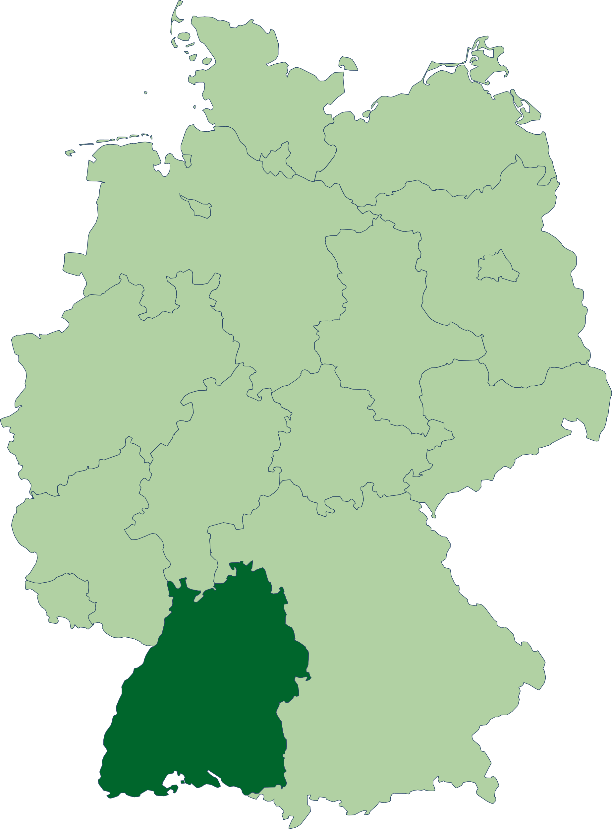
Present situation Southwest Germany
No water stress in average in Germany¹
  Water exploitation index below critical level of 20 %
  Regional and seasonal differences (hotspots)
Agricultural water abstraction
  2.2 % of groundwater abstraction from agricultural sector (Germany, 2019)¹
  Irrigation (BW, 2019): 6.8 % of farms; 2.4 % of farm land¹
  Groundwater abstraction by agricultural sector not a problem to date
Nitrate MCL of 50 mg/l is significantly exceeded → at every 6th measuring point²
  German Drinking Water Ordinance (TrinkwV)
  Groundwater Ordinance (GrwV)
  Nitrate displacement into groundwater is a problem
MCL = Maximum Contaminant Level ; 50 mg/l NO₃ = 11.3 mg/l NO₃-N
¹German Federal Statistical Office; ²German Federal Environment Agency

Slide 4
Climate projections Southwest Germany
Increase in agricultural drought during the main vegetation period¹
  Reduced groundwater recharge²
  Rising irrigation demand → increased groundwater extraction³
  Increase in nitrate concentration → due to lack of dilution effect⁴
  Rising costs for drinking water treatment⁵
Increasing heavy rainfall events in the winter months⁶
  Increased nitrate leaching from agriculture into groundwater⁷
Conflict potential between agricultural businesses and water suppliers over groundwater quality and quantity⁸
Increasingly important: cooperation between stakeholders in groundwater protection
¹Warrach-Sagi et al. 2018, LUBW 2021; ²Hellwig 2019; ³Schimmelpfennig et al. 2018, ⁴Mosley 2015; ⁵Oelmann et al. 2017; ⁶Warrach-Sagi et al. 2018, LUBW 2021; ⁷Engel & Müller 2020; ⁸Meder et al. 2020

Slide 5
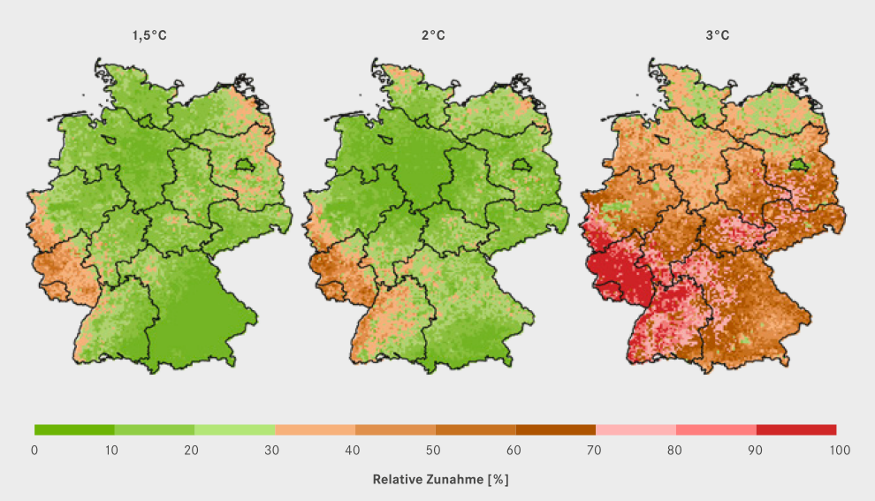
Relative increase in drought periods compared to reference period 1971-2000
Relative increase [%]
Helmholtz - Centre for Environmental Research (UFZ), 2018

Slide 6
Research objectives
Identification of hotspots with severe water stress and high nitrate input
  Based on current crop rotations on plot level and management practices
Identification of irrigation demand and groundwater abstraction
  Based on current crop rotations on plot level and management practices
Identification of effective and economical agr. measures to protect groundwater
In times with more frequent periods of drought
Method:
Agro-economic modeling using an integrated modeling system

Slide 7
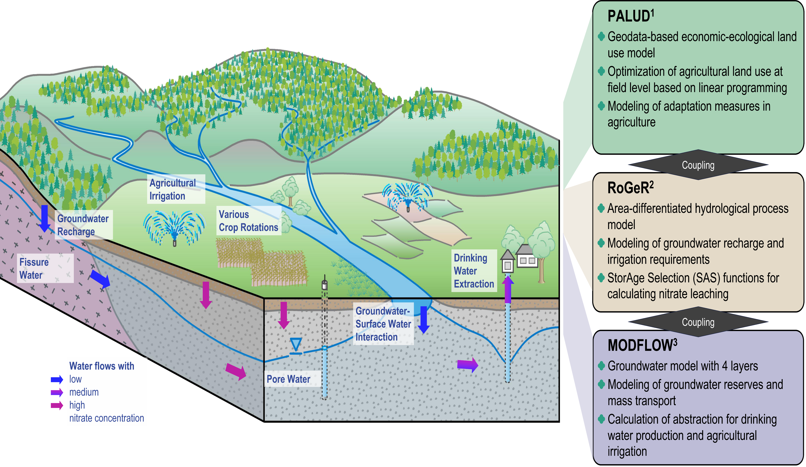
Integrated Modeling Systems
¹Sponagel et al. 2022; ²Steinbrich et al. 2021; ³McDonald & Harbaugh, 1983

Slide 8
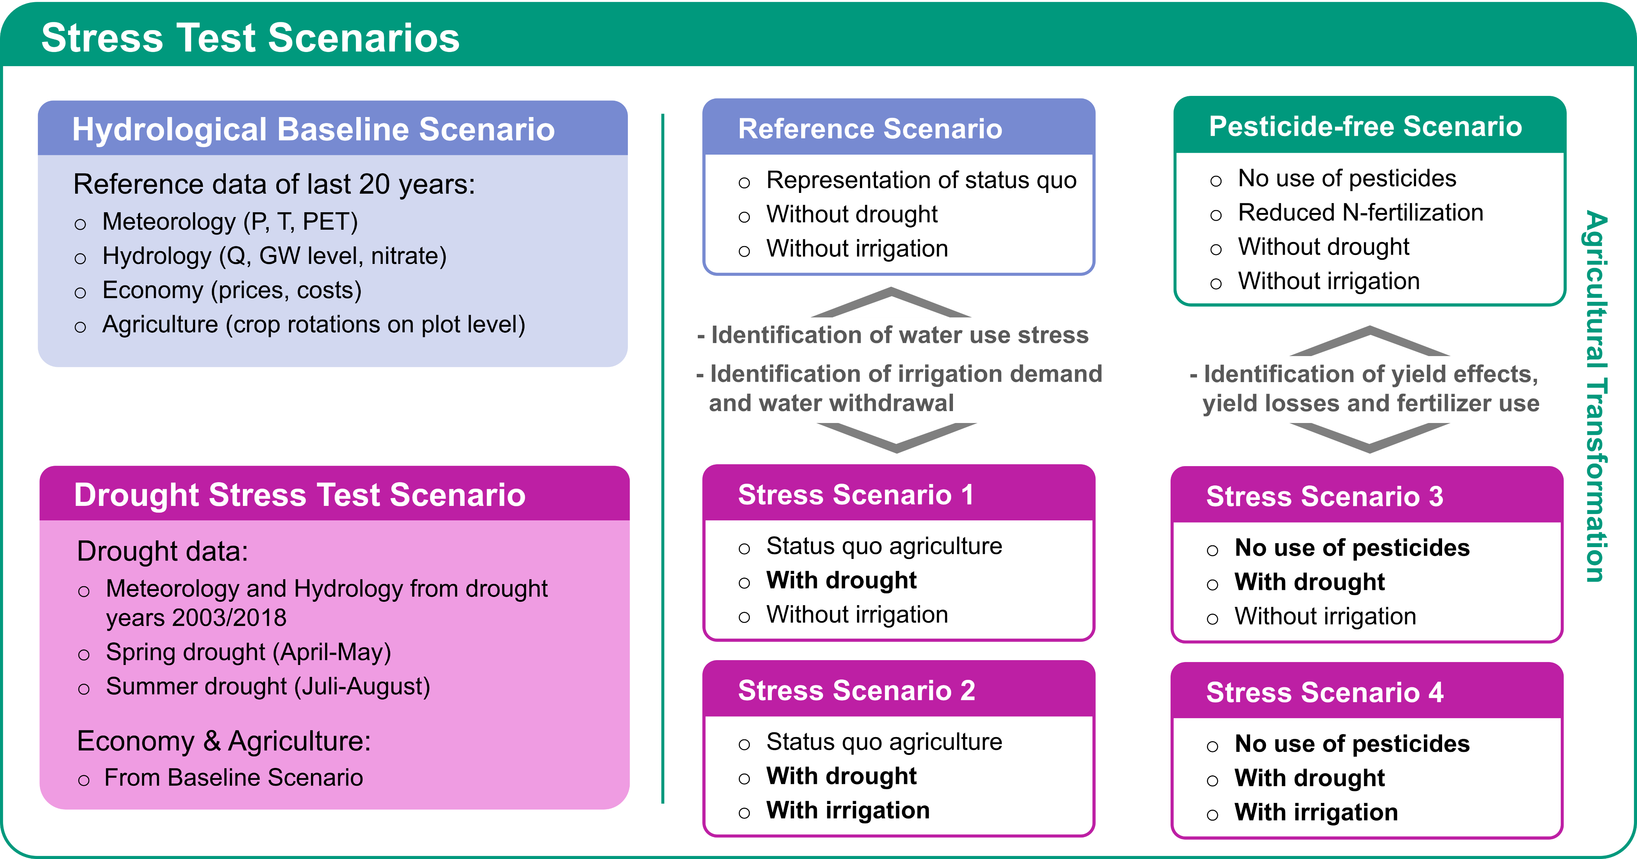
Modeling of Stress Test Scenarios

Slide 9
Analysis of Acceptance
Research objective:
  Identify the willingness of agr. businesses to implement measures to protect groundwater
  Identification of the level of compensation required by farms for implementation
  → Willingness to Accecpt (WTA)
Method: Discrete Choice Experiment (DCE)
Preliminary results (n=40)
  Highest acceptance: reduction of N-fertilization of 10 % and cultivation of cover crops
  Lowest acceptance: no use of herbicides on partial areas
  Compensation demanded: reduced water price of 0.22 $ per m³ for reducing N-fertilization by 10 %; reduced water price of 0.72 $ per m³ for not using herbicides on partial areas
  Example:
    Average annual demand for water withdrawal for irrigation: 1,230 m³/ha
    Required compensation amount of 270 $ per ha and year for N-reduction of 10 %

Slide 10
Thank you
for your
attention!

