Slide 1
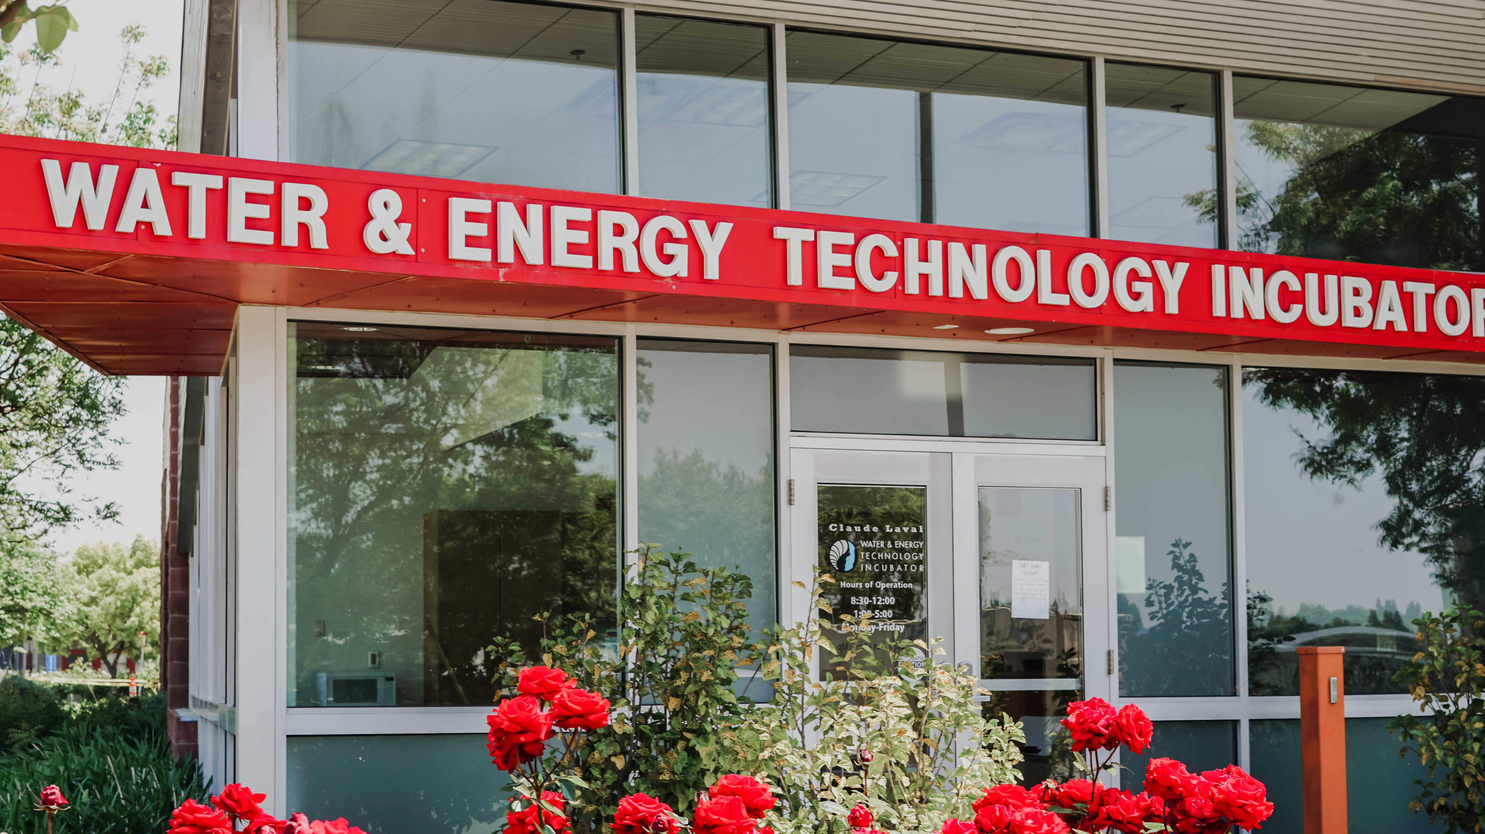


Slide 2
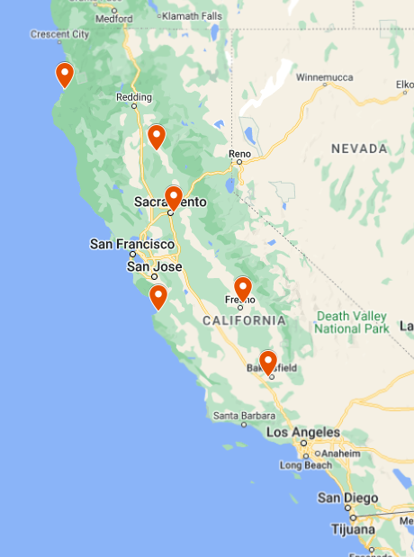
Our Headquarters
The Water, Energy and Technology (WET) Center is located in California’s heartland – the most productive agricultural region in the world!
6 million acres producing more than 250 crops
25% of the nation’s food is grown in the Central Valley (and 1% of the nation’s agricultural land)
The Central Valley represents more than $8.5 billion annually in agricultural production
Also has the highest concentration of high-value crops in the nation.
Located on the campus of CSU Fresno – a unique intersection between academia and the private sector.

Slide 3
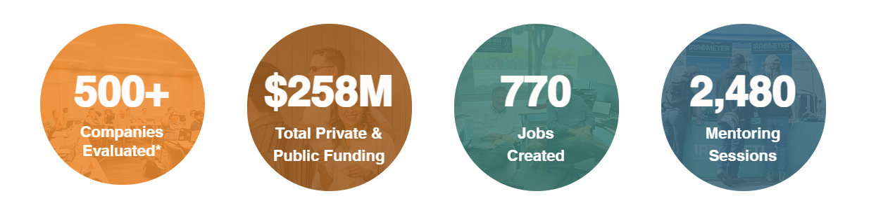
Let’s Talk Numbers!
Our Programs & Services –
Onsite incubator – Office space for 11 companies within the WET Center.
Technology Innovation Evaluation (TIE) Program
Valley Ventures Accelerator – Currently running in our 8th cohort.

Slide 4
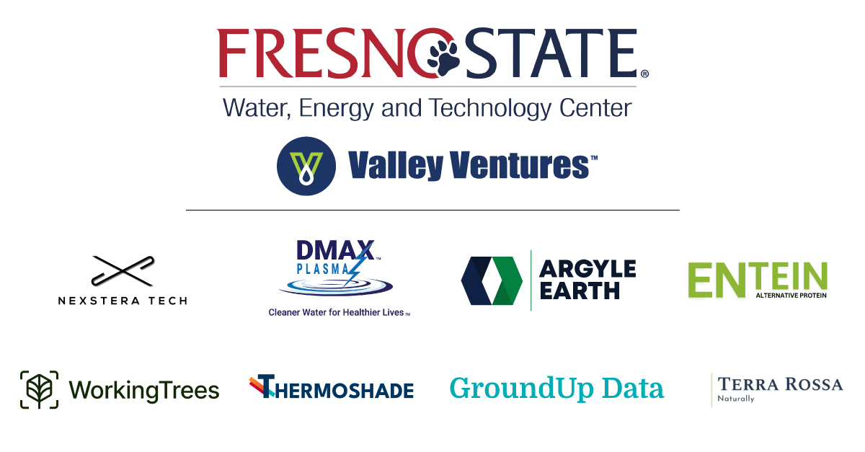

Slide 5
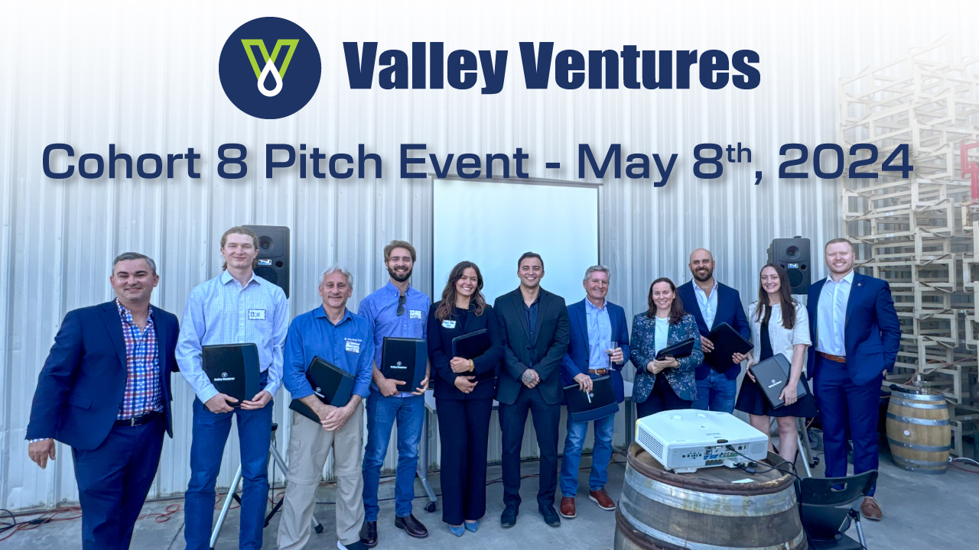

Slide 6
Let’s Talk Numbers!
Our Programs & Services –
Onsite incubator – Office space for 11 companies within the WET Center.
Technology Innovation Evaluation (TIE) Program
Valley Ventures Accelerator – Currently running in our 8th cohort.

Slide 7

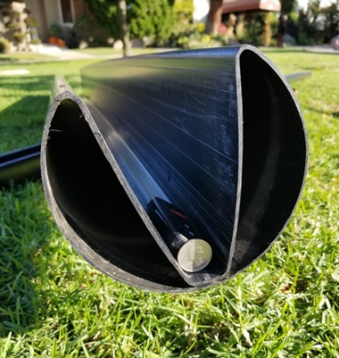
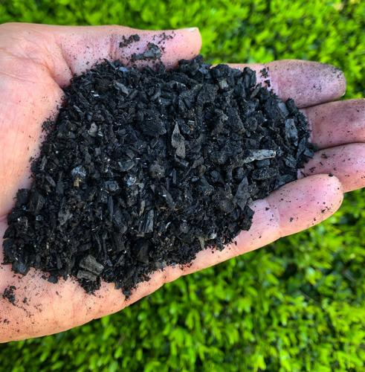
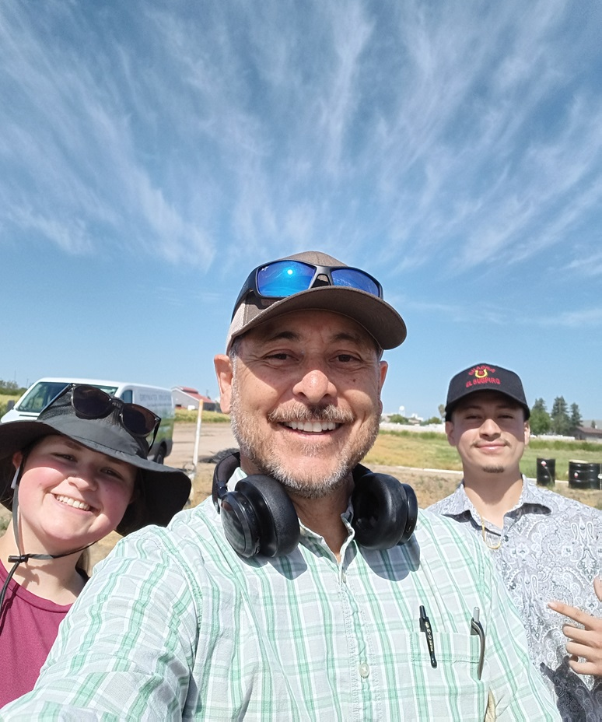
Resident Spotlight - Umida Ag
Aquifer Pipe
Almond Shell BioChar
Joseph Gallegos – President Umida Ag
Ireland McCall – Fresno State Sr. Project (groundwater recharge)
Alexis Valadez – Fresno State Graduate Student (BioChar)

Slide 8
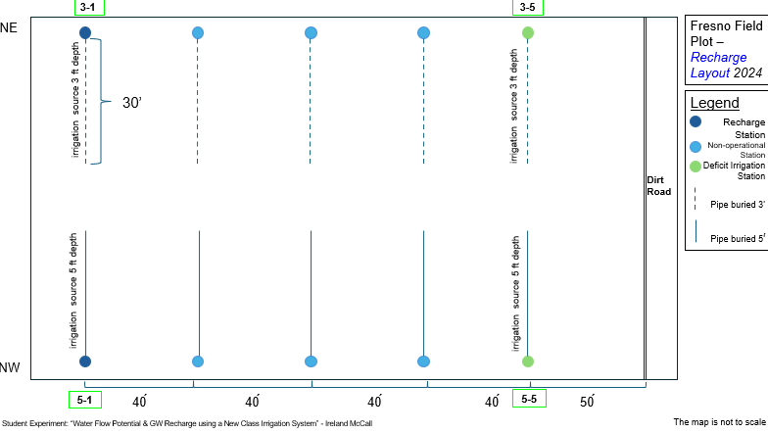
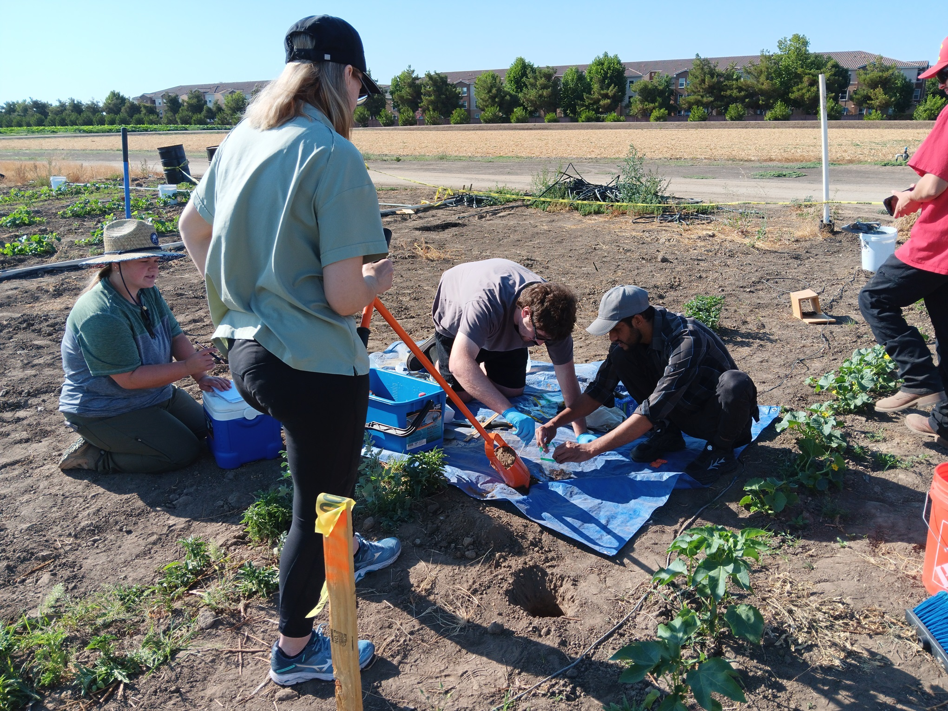
Resident Spotlight - Umida Ag

Slide 9
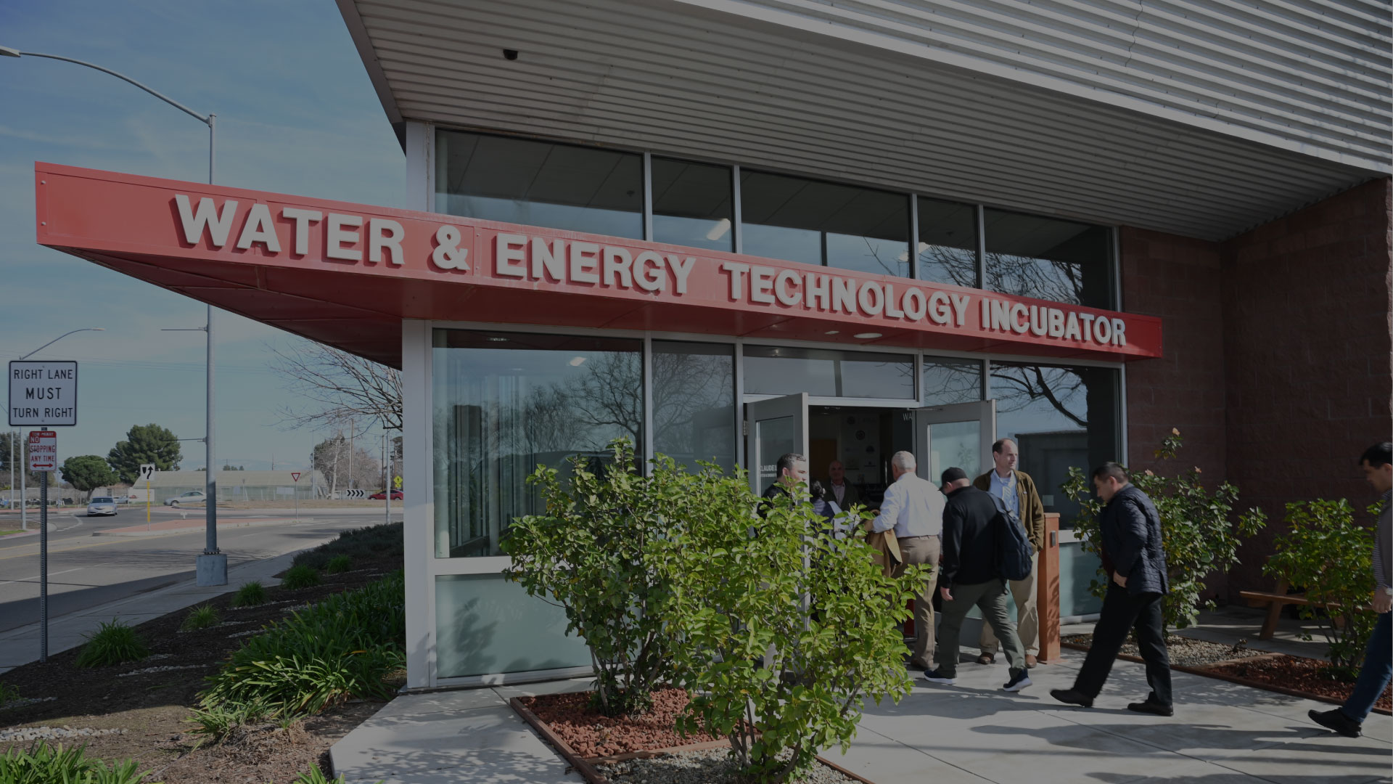
Addressing some of our region’s most pressing challenges
Helping innovators and underserved communities find solutions.
Aiding industry partners and the CSU system bridge the skill gap divide.

