Slide 1
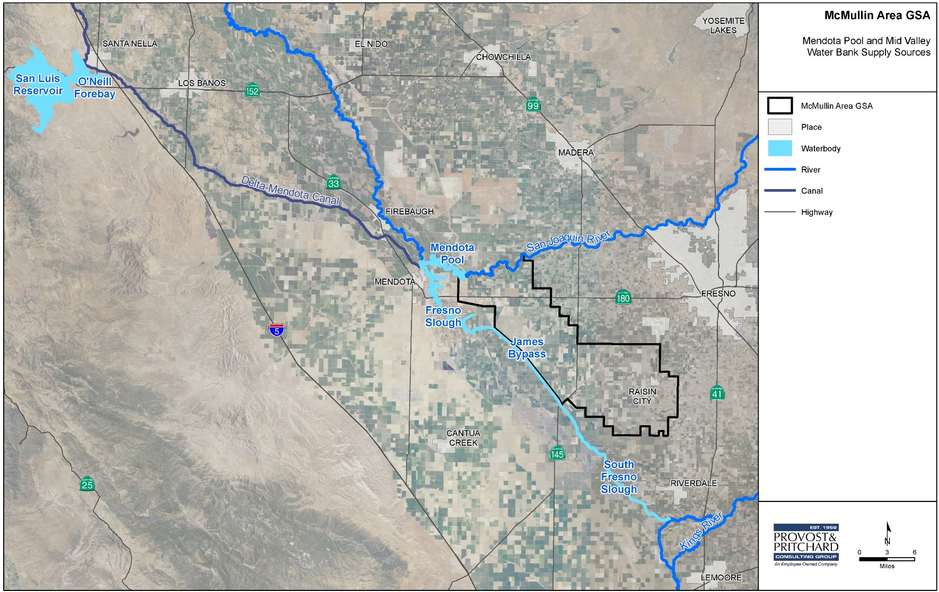
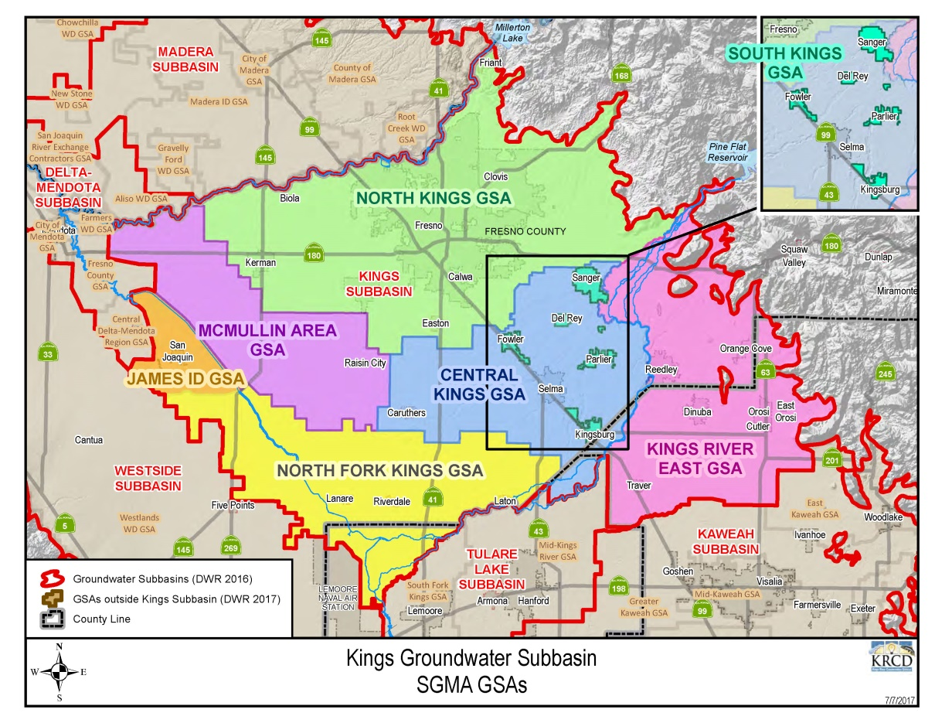
Mcmullin area groundwater sustainability agency
Located in Fresno County, encompassing 120,635 acres
Groundwater-dependent, No surface water
91,100 acre-feet of annual groundwater overdraft

Slide 2
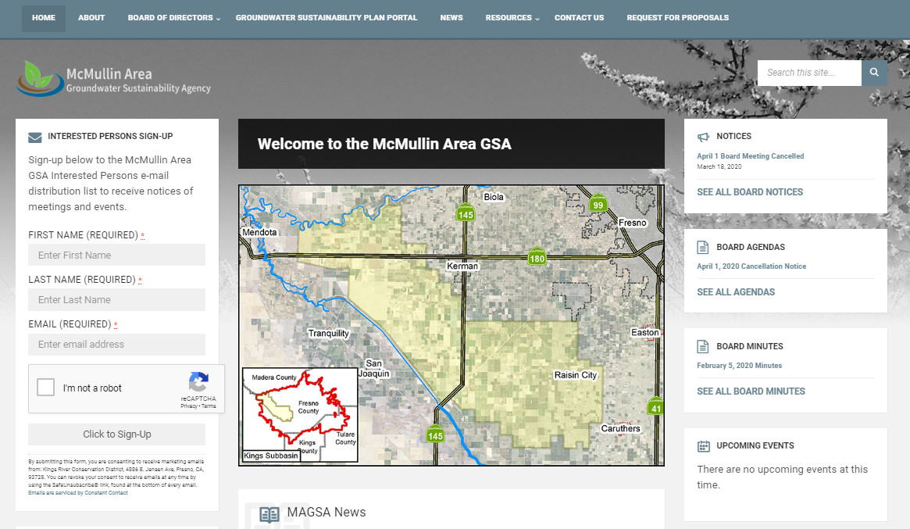
Stay informed
follow us on X
@McMullinAreaGSA
Join our email list
Sign up at www.McMullinArea.org
Cristel Tufenkjian, MAGSA Deputy General Manager
ctufenkjian@mcmullinarea.org

