Slide 2
Jordan College Academic Departments
Agricultural Business: Faculty have formed the core group who are participating in the USDA Southwest Regional Food Business Center.
Animal Science and Agricultural Education: Meats processing lab expansion is progressing.
Food Science and Nutrition: Faculty have established a new nutritional sciences lab and secured equipment for Human Nutrition Assessment Lab.
Industrial Technology: Plans are underway for a model manufacturing lab
Plant Science: Planning a soil health minor and greenhouses are being renovated.
Viticulture and Enology:
Research winery renovations to start on June 15, 2024

Slide 3
Jordan College Initiatives and Centers
Center for the Optimization of Poultry (COOP): Is a USDA-funded Center of Excellence in poultry education.
Center for Irrigation Technology (CIT)/Water, Energy, and Technology Center (WET) Center: Received $5M to help build the Central Valley’s energy innovation ecosystem.
Ag One: Raised $10M in funding making Jordan College the top fundraising unit at Fresno State.
Global Agriculture and Food Security Initiative (GAFSI): Received €348,000 from NATO to study the risk of pollution in the Black Sea as a result of natural or man-made disasters.
Institute for Food and Agriculture (IFA): Manages over $26M in grant funding and leads the Pacific Coast Coalition
Viticulture and Enology Research Center (VERC): Has 18 affiliated researchers.

Slide 4
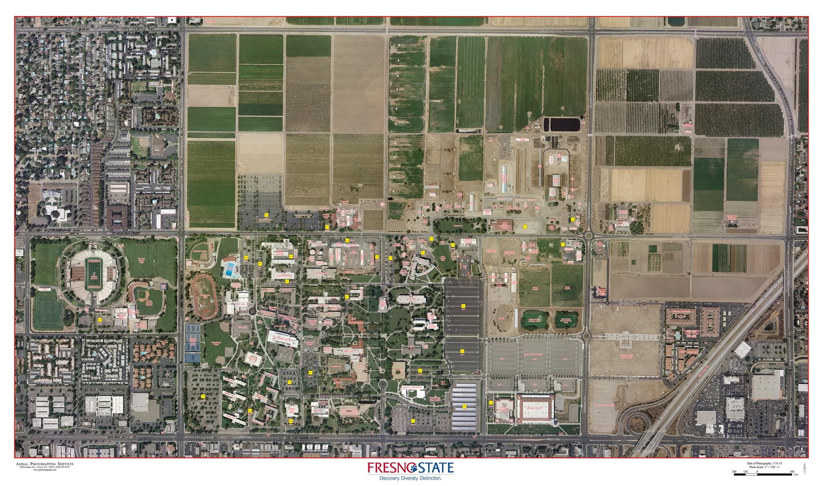
DAIRY
Raisin & Wine
SENSORY
CREAMERY
MARKET
1,000 acre laboratory
18 enterprise units

Slide 5
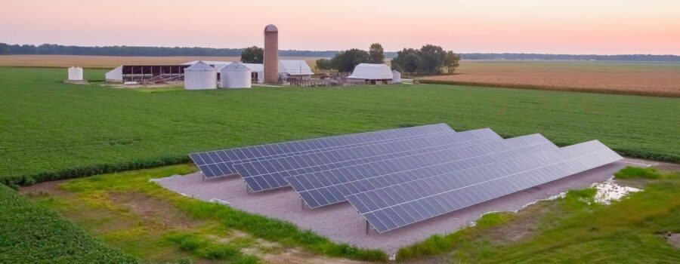
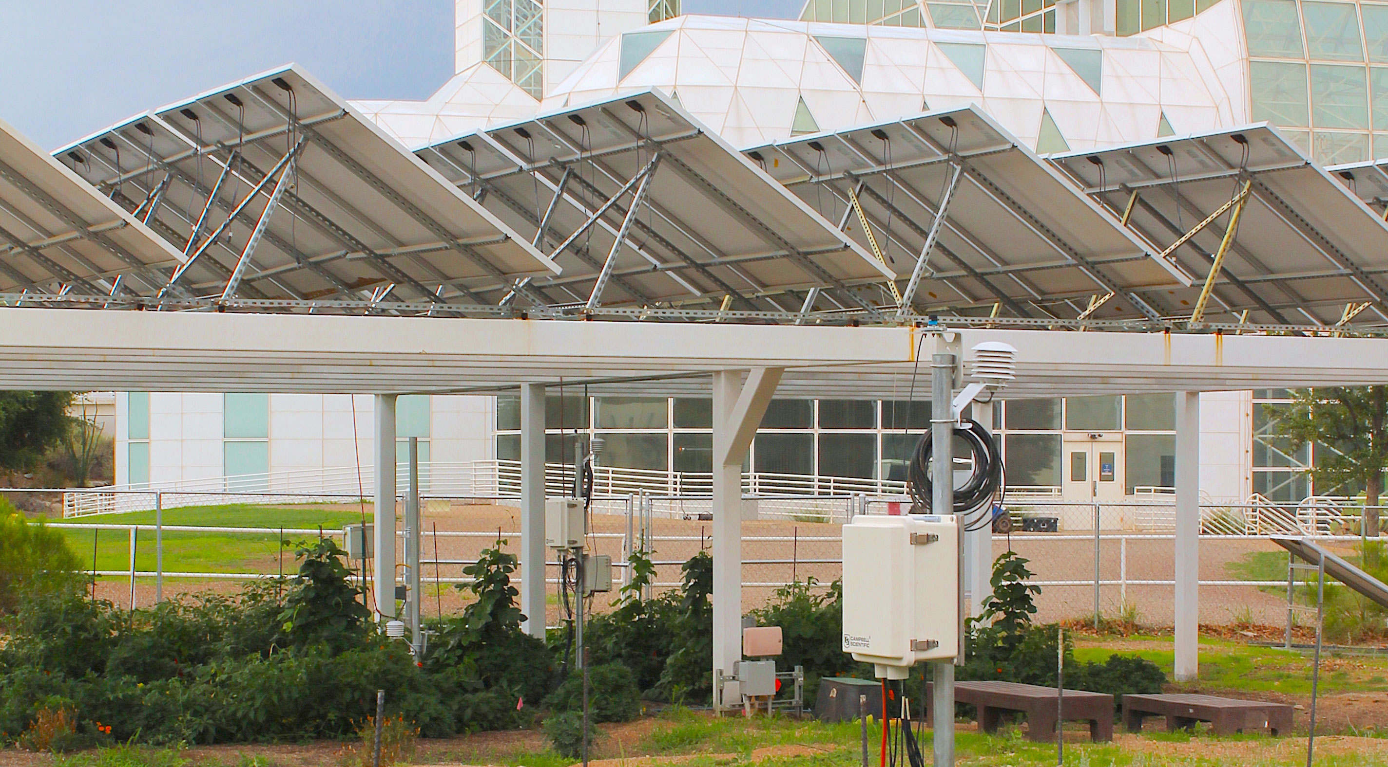
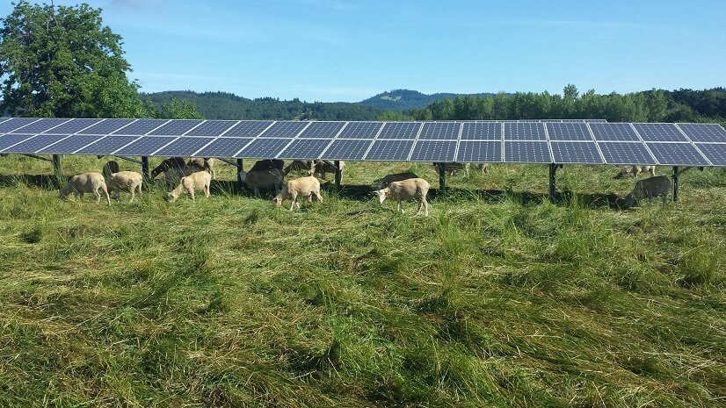
Agrivoltaics Initiative
Source: Univ. of Arizona

Slide 6
